Slide 1
Funding Your Future: A Guide to Scholarships and Bursaries

Slide 2

What is a Scholarship?
Scholarships are non-repayable monetary awards granted to students to help finance their education
Typically based on academic excellence, but also often considering other achievements such as athletic skill, leadership, community involvement, or specialized talents.
These awards can be provided by governments, educational institutions, businesses, or charitable organizations

Slide 3
What is a Bursary?
Bursaries are based on financial need, which may have to be demonstrated in your application.
They are non-repayable

Slide 4
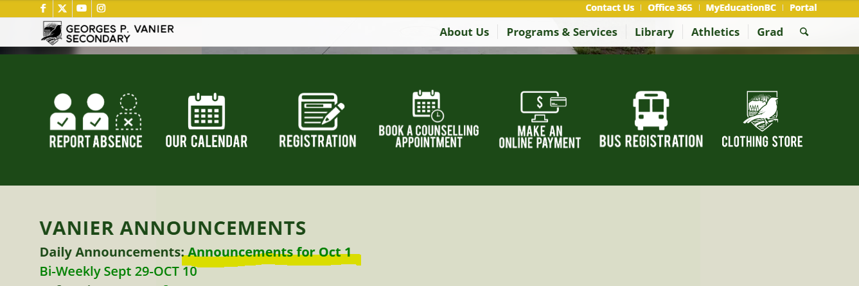
Where to Look For Scholarships and Bursaries?
G P Vanier Daily Announcements

Slide 5
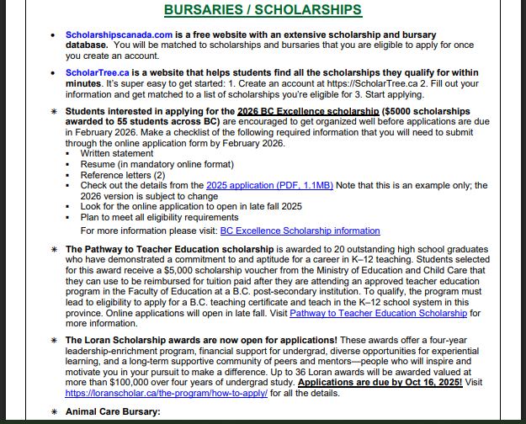

Slide 6
Where to Look for Scholarships and Bursaries?
Post-Secondary Institutions you are applying to. Most schools have a Financial Aid and Awards section on their website.
North Island College Financial Aid and Awards
University of Victoria Scholarships, Awards, and Aid
University of British Columbia Awards: Scholarships and Bursaries

Slide 7
Most post-secondary schools offer a combination of:
Merit-Based scholarships (awarded for academic, athletic, or artistic excellence)
Need-Based bursaries (allocated based on financial need)
Entrance Scholarships
Additionally, many institutions provide scholarships and bursaries for specific demographics, such as Indigenous students or those facing adversity

Slide 8
Entrance Scholarships
Nearly all universities in British Columbia offer some form of entrance scholarships, though the types, amounts, and application processes vary significantly between institutions and programs.
Some scholarships are automatic based on high school grades, while others require additional applications, resumes, and reference letters.
It's essential to check each university's specific scholarship offerings and eligibility criteria, as these opportunities are designed to attract students and may be contingent on accepting an offer of admission

Slide 9
Tips
Start your research and apply early
Post-secondary applications open October 1st
Compile your achievements
Be aware of application/scholarship/bursary deadlines. Add them to your calendar.

Slide 10



Where to Look for Scholarships and Bursaries?
Online Scholarship/Bursary Finding Platforms
Scholar Tree https://scholartree.ca/
Scholarships Canada https://www.scholarshipscanada.com/
Yconic https://yconic.com/
Indigenous Bursaries Search Tool

Slide 11
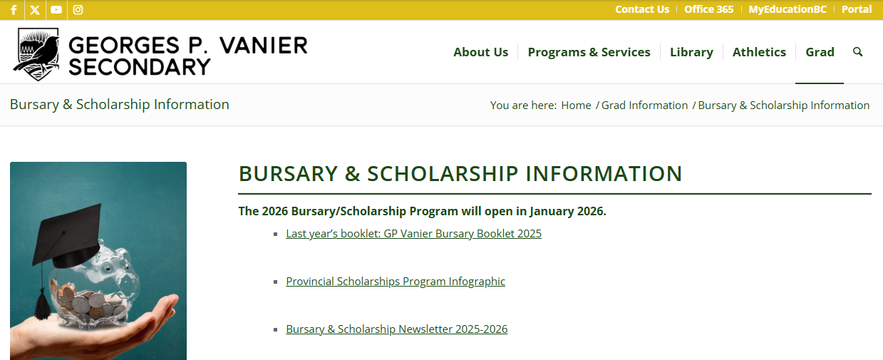
Where to Look for Scholarships and Bursaries?
G P Vanier Local Bursary and Scholarship Program- program opens to grade 12 students in January 2026

Slide 12
How to prepare for G. P. Vanier Local Bursary and Scholarship program
Obtain one letter of reference from a teacher, member of the community, and/or employer. To help your referee write a tailored letter of recommendation, complete and hand them the following Brag Sheet when asking for a reference letter.
Compile of list of extra-curricular activities, volunteering, you have participated in since grade 10.
Prepare a letter of introduction:
introduce yourself
explain your post-secondary plans
summarize your interests, activities, involvements, accomplishments etc.
comment on your financial circumstances (if appropriate).
closing comment thanking committee for considering your application.

Slide 13
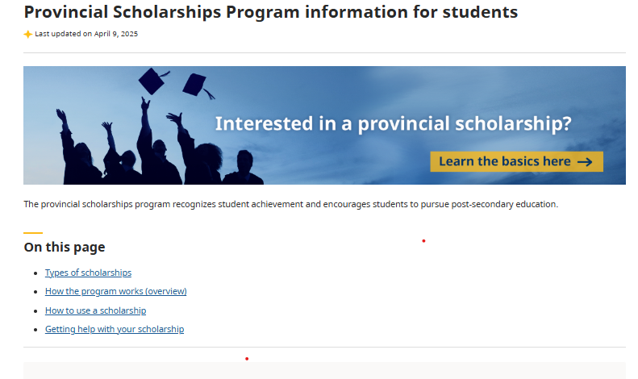
Where to Look for Scholarships and Bursaries?
Provincial Scholarships Program

Slide 14
Questions & Support
Visit the counselling office
Book a one-on-one planning session
Let’s make your post-secondary dreams happen!

Slide 15
Additional Resources
Education Planner BC financial resources
Student Aid BC
Scholarship, Bursary, and Student Loan Newsletter

