Slide 1



GP Vanier
Bursary and Scholarship Guide
2026

Slide 2
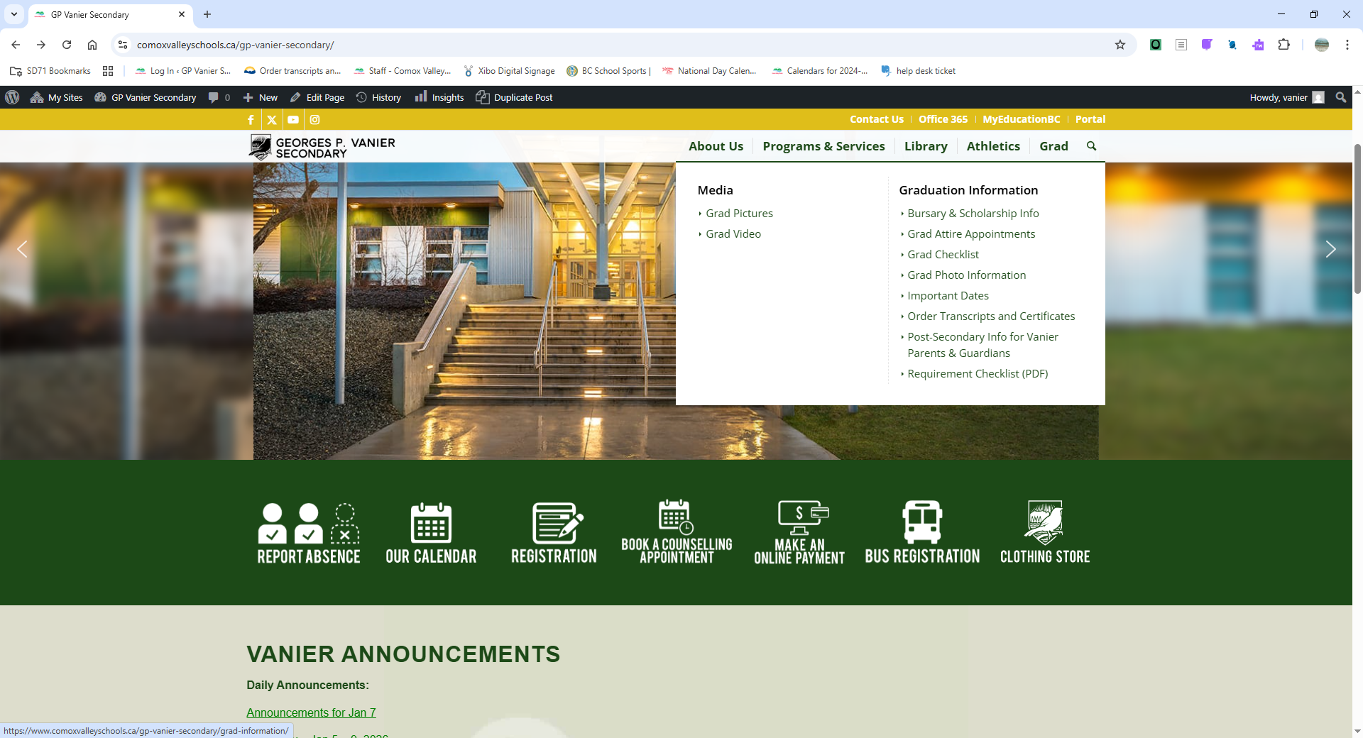
Where do I start?
Visit our website! Under the Grad tab you will find our
Bursary & Scholarship Information page
Read our Bursary Booklet

Slide 3
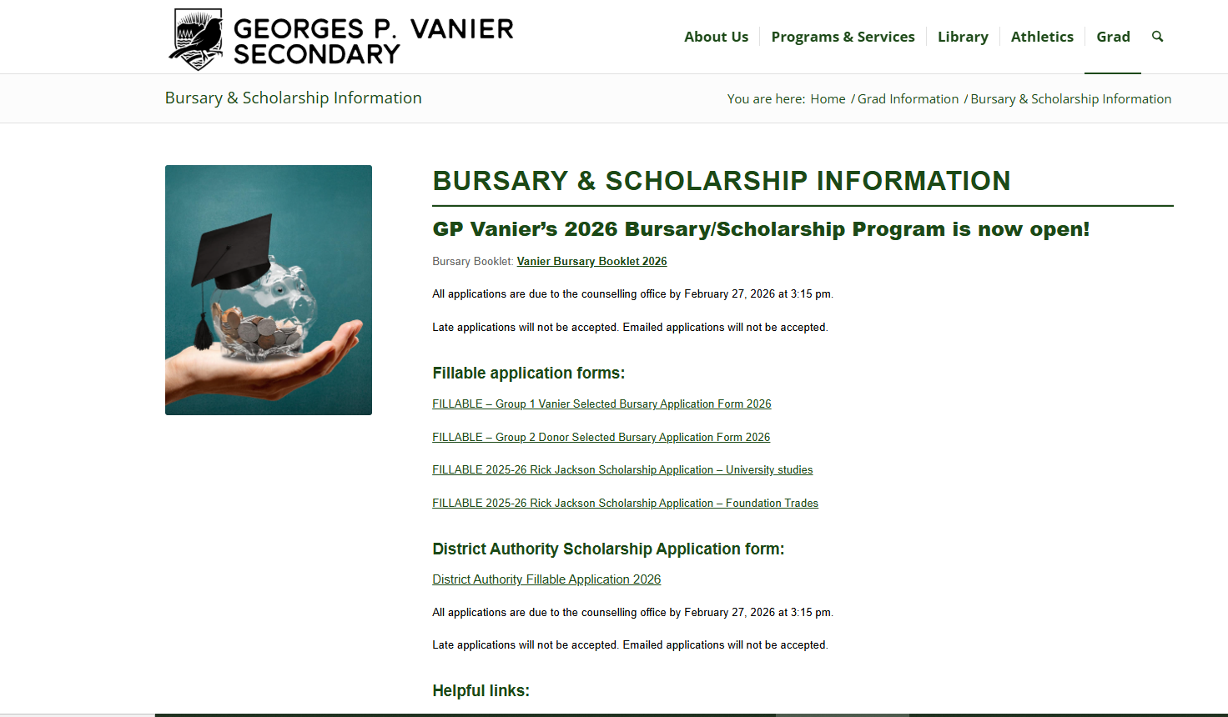
Our bursary booklet can be
found on our website

Slide 4
You will need to source a reference letter and write a letter of introduction to accompany your application(s):
Request a reference letter
Write your letter of introduction

Slide 5

REFERENCE LETTER
Your application package(s) must include a reference letter. Be sure to ask your referee early to avoid disappointment. Referees may include teachers, counsellors, coaches, employers. Relatives can not write you a reference letter.
Use the “brag sheet” found on our website (or grab a paper copy from the counselling office) to help your referee write the perfect letter for you.

Slide 6

LETTER OF INTRODUCTION
Your application package(s) must include a letter of introduction addressed to the Vanier Bursary Committee (for your Group 1 application package) or to the specific donor (for all Group 2 applications).
This letter is a great place for you to introduce yourself, speak on your accomplishments, list any adversities you have overcome and outline your future goals.
See page 6 of the bursary booklet, section ‘F. Getting Ready to Apply’, to see what your introduction letter should contain.

Slide 7
Bursary? Scholarship?
What is the Difference?
Bursaries - Criteria based on…
Financial Need
Leadership / Volunteerism
Area of study
Scholarships - Criteria based on…
Academic Standing
Leadership / Volunteerism
Financial Need

Slide 8
Types of Bursaries & Scholarships that you will find in our Bursary Booklet
Group 1 :
Vanier Committee Selected
Group 2 :
Donor Selected
Group 3 :
Online Donor Selected

Slide 9
Group 1
Vanier Bursary Committee Selected Bursaries and Scholarships
These applications stay at Vanier Secondary School and recipients are selected by the Vanier Bursary Committee.
You will need to complete only one bursary application package.
Read descriptions in booklet and mark your selections on the front page of the application form. Only select the ones that you qualify for.

Slide 10
Organize your Group 1 Bursary Application package in this order
Application Form
Reference Letter
Transcript
Letter of Introduction

Slide 11
Group 2
Donor Selected Bursaries and Scholarships
These applications are given directly to the donors to select bursary recipients.
For the donor selected bursaries you will need an application form for each bursary or scholarship you are applying for.
Please read descriptions carefully as some bursaries require a special application form. These are available in the counselling office.

Slide 12
Organize your Group 2 Bursary Application packages in this order
Special Application Form (if applicable)
Followed by the Vanier Application Form
Reference Letter
Transcript
Letter of Introduction

Slide 13
Group 3
Online Donor Selected Bursaries and Scholarships
These applications are sent by you directly to the donors. Do not hand in to the counselling office.
You will need to follow the directions given in the descriptions.
Please read descriptions carefully as they all have different application deadlines.

Slide 14

You can print your transcript
directly from MyEdBC
or ask for a
copy from
Shannon in the counselling office
after February 9th.

Slide 15
Handing in Applications
Group 1 & 2 Application deadline is February 27th, 2026 @ 3:15 pm.
Late applications will not be accepted.
Staple each application package together in the proper order. Do not place in envelopes or folders.
Hand in to the counselling office.

Slide 16

District Authority Scholarships
The District/Authority scholarship is awarded to 5,500 high school graduates in BC who have demonstrated excellence in their chosen area.
The Ministry confirms that the selected students have met basic criteria and then sends these confirmed recipients a $1,250 scholarship voucher.
Students have five years to redeem their District/Authority scholarship vouchers; an expiry date is printed on each voucher and extensions are not possible.
Students can apply using the fillable form on our website or by picking up a paper copy in the counselling office. Applications must be handed in to the counselling office by February 27th at 3:15 pm.

Slide 17

Drop in support will be
available in the counselling
office on Flex Day
Wednesday, January 14th
Stop by if you have questions

Slide 18

Helpful tips
Read the booklet
Be organized
Plan ahead
Do not leave until the last minute
Check the announcements often

