Slide 1

Course Selection Information Session February 12, 2026

Slide 2

Introductions
Principal – Karma Taiji
Vice Principals – Brad St. Pierre (A - G)
Sherrie Martens (H - O)
Erica Black (P - Z)
Counsellors – Katherine Brach (A - G)
Stephanie Morris (H - O)
Jocelyn Schultz (P - Z)
Career Programs - Dawnn Thorson (Teacher)
Whitney Murphy (Teacher)
Kelley Giorgianni
(Work Experience
Program Worker)

Slide 3
Course Selection Timelines
Course Selection Booklet
and
Course Selection Sheets are available on our website now.
Wed Feb 11 –
Friday Feb 13
Counsellors/Admin visit classes to talk about course selection
Mon Feb.23-
Friday Feb 27
Vanier Students will select their classes online
Friday Feb 27 – Online Course Selection is closed.

Slide 4
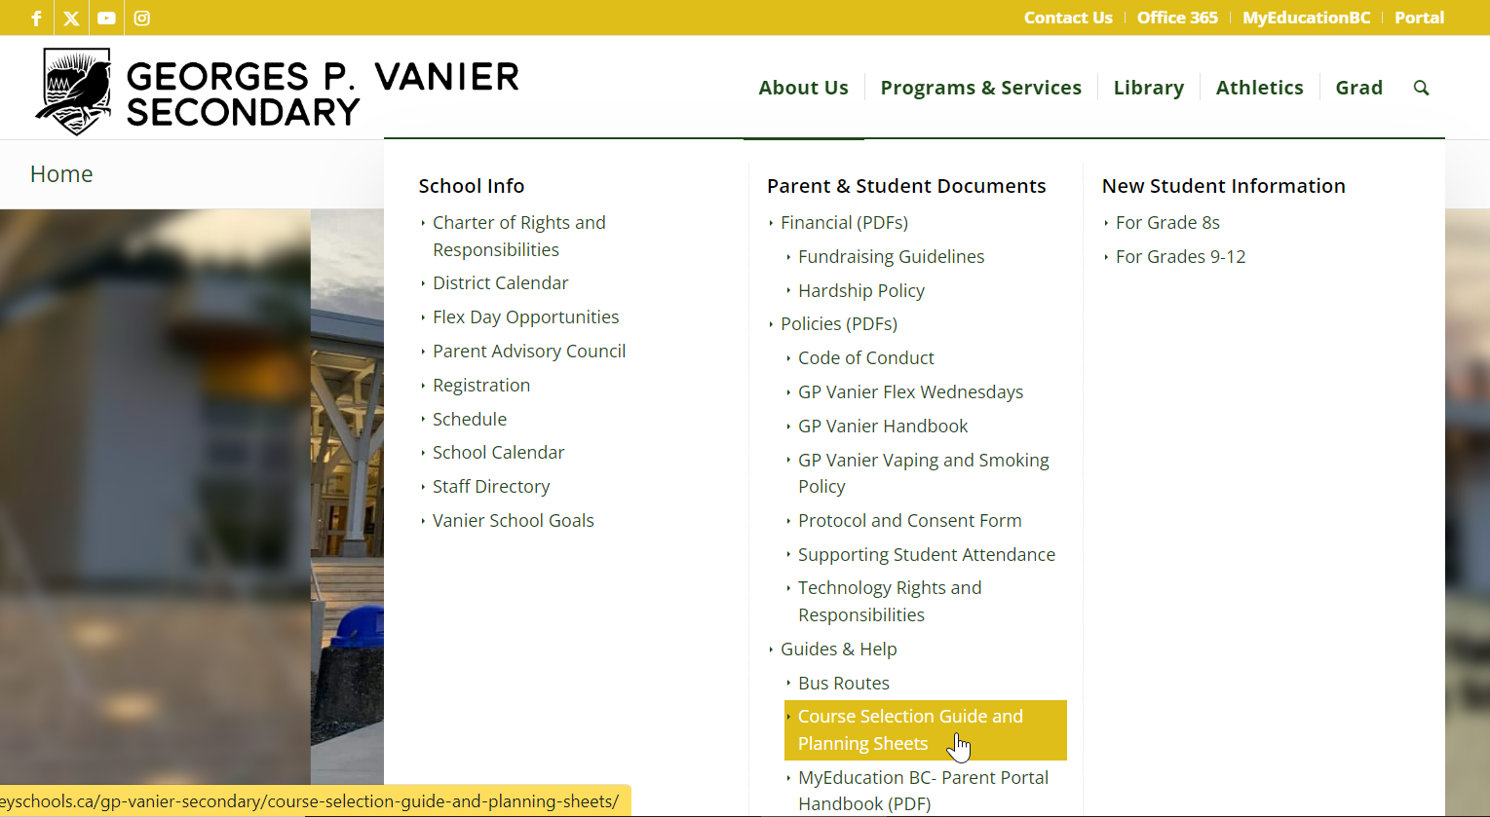
Vanier Website – gpvanier.ca about us> Parent & Student Documents > Course Selection

Slide 5


Slide 6


Slide 7
Grade 9 Program:
Core academics of English, Socials, Math and Science and PHE will be semestered classes
Exploratories such as Drama, Art, Metal, Wood, IT, Foods, Textiles, and Leadership will be term classes
Elective choices for Band &
Elective choices for Languages
Extracurricular programs & clubs
Get involved ☺

Slide 8
2025 Graduation Program
Students Grade 10 – 12 courses count for graduation
80 credits required to graduate including 52 credits from required courses, Careers 10 & 11, Career Life Connections 12 / Capstone and an Indigenous Focused Course (English First Peoples 11)
Semester courses = 4 credits
Term courses = 2 credits
Two graduation assessments are also required:
Numeracy (10) Literacy Assessment (10 & 12)

Slide 9
Grade 10 Required Courses
Science 10
Social Studies 10
Career Life Education 10
Foundations and Pre-calculus Mathematics 10 or Workplace Mathematics 10
An English Language Arts Course (Literary Studies/Composition, New Media/Spoken Language or English 10 First Peoples)
Physical Health Education 10
A Fine Arts or Applied Skills Course
(4 credits in total)

Slide 10
Grade 11 Required Courses
English Language Arts
English First Peoples Literary/Writing or
English First Peoples Literary/New Media
Social Studies 11 or 12
Explorations in Socials 11, World History, BC First Peoples, Comparative Cultures, Human Geography, Law, Social and Environmental Studies, Physical Geography, Social Justice, Genocide Studies, Political Studies
Mathematics 11
Pre-Calculus 11, Foundations 11, Workplace 11 or
Computer Science 11
Science 11
Life Sciences, Chemistry, Earth Science, Physics, Science for Citizens, Forensic Sciences, Physics and Engineering, or
Social and Environmental Studies
Career Life Education B

Slide 11
Grade 12 Required Courses
English Studies 12 –
English Studies 12, Communication Skills,
English First Peoples
12 additional Grade 12 Credits –
these can be any courses at the grade 12 level
Career Life Connection & Capstone -
4 credits (30 hours work experience and project

Slide 12










The best of both worlds.
VanierFLOW Offers Students:
Not just online school.
Access to digital courses with real in-person coaching.
Not a spare block.
A scheduled place and space
for meaningful work.
Personalization
&
VanierFLOW
Your pace, Your place.
Work independently, in small-groups, or 1:1 with teachers.
Flexibility
Personalized, Teacher-Supported Flexible Learning Option (Grades 10-12)
&
Support + Accountability
Don’t let the timetable decide your transcript!

Slide 13






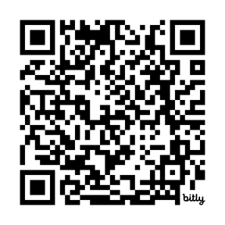



Independence ≠
Alone
Humanities + Math/Science Teacher Support
Designed for your reality.
The Busy
Athletics? Work?
Family Commitments?
Weekly
Check-ins
How it works:
VanierFLOW is designed to be accessible and flexible:
  Students enroll in 1–8 FLOW blocks (depending on their needs and timetable).
The Accelerator
Want to move faster or dive deeper?
Regular assessment
The Specialist
Need a specific course? Access it through FLOW
Ready to “Go with the FLOW?”
Your pace.
Your plan.
Your VanierFLOW.
bit.ly/VanierFLOW-Courses

Slide 14
Mathematics
Grade 10 is the first grade where students go into different streams of mathematics.
Foundations of Mathematics and Pre-Calculus 10 & Workplace Mathematic 10
Mathematics is required at grade 10 & 11 to graduate
Different colleges, universities and programs require different levels of math. Students need to choose carefully to meet their requirements.
Speak to your child’s math teacher or take
a look at the Math Pathways page in the
GP Vanier Course Selection Booklet for help

Slide 15
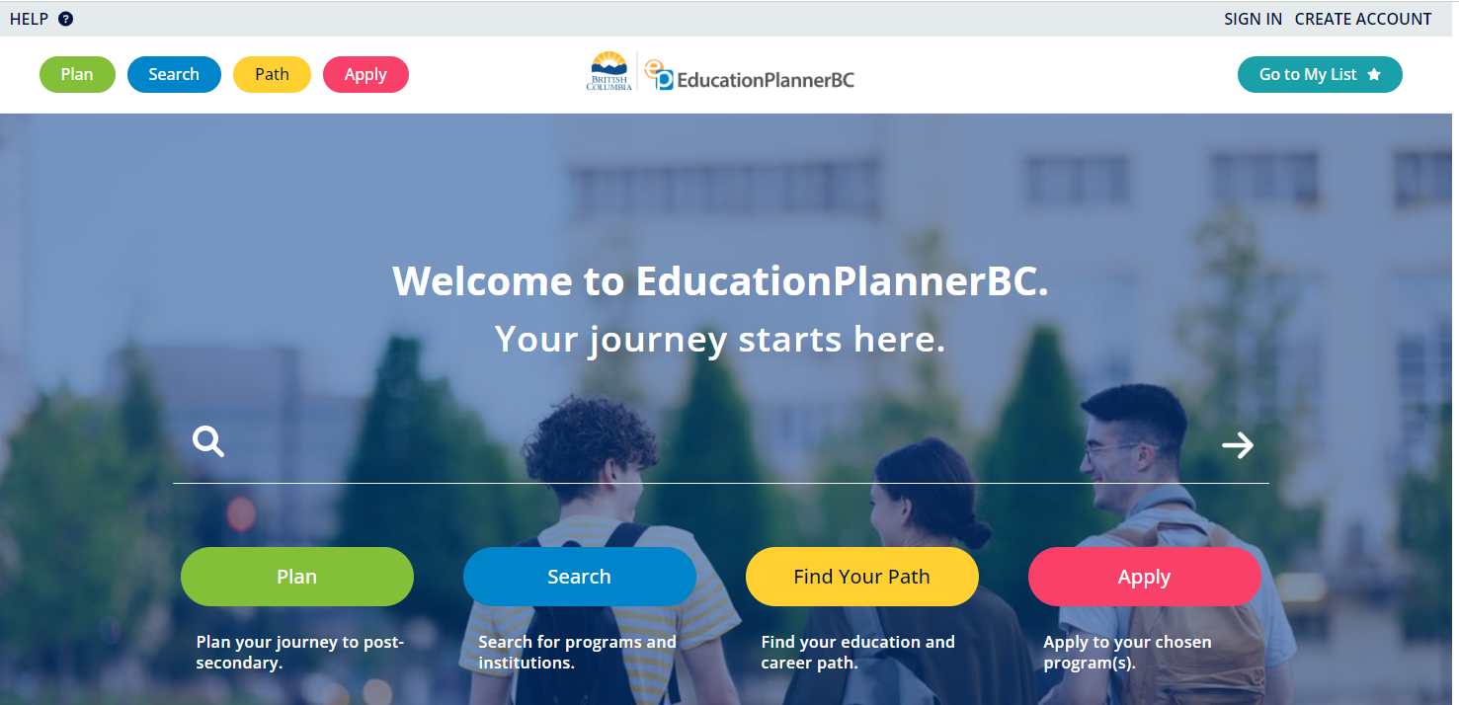
Education Planner BC
Education Planner BC
a centralized resource that helps learners plan, search and apply for admission to post-secondary institutions in British Columbia
consider post-secondary admission requirements when making course selections

Slide 16
Outside the timetable Opportunities (for Credit)
Jazz Band
Improv Drama
Musical Theatre
Vanier Vocalists
North Island College Dual Credit Courses
Sports Leadership
Dungeon & Dragons
Work Experience

Slide 17
Breakout Rooms
Grade 10 Stay in MPR
Grade 12 Room
164
Grade 11 Room
163
Grade 9 Stay in MPR

