Slide 1
Aboriginal Seasonal Activities
What activities do you do during all the different seasons?

Slide 2
A Journey into Time Immemorial
Sto:lo Virtual Tour

Slide 3
Fall

Slide 4
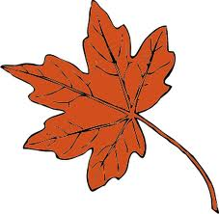
Fall Salmon Fishing with a net

Slide 5
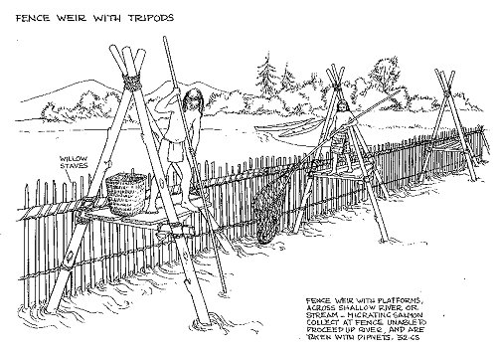

Slide 6
Cooking Salmon

Slide 7
Drying and Smoking Salmon

Slide 8
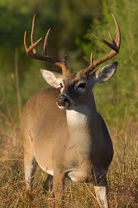
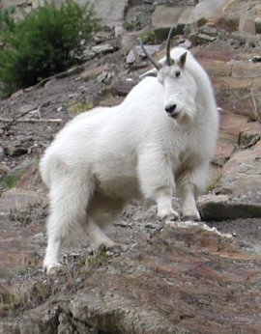
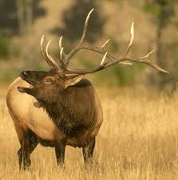
Fall Hunting
Deer, grouse and elk were hunted in the fall as well as bear and sheep.

Slide 9
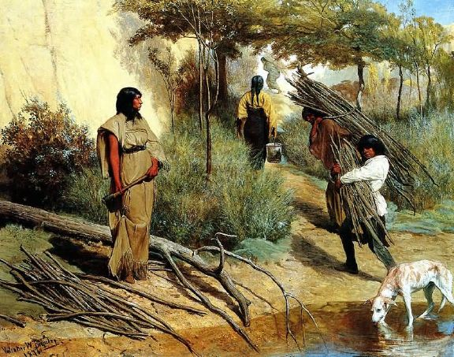
Gathering Wood
Wood pitch was gathered for torches and fires. Natural splitting of logs was accomplished by inserting round stones as wedges into the cracks in drying logs.

Slide 10
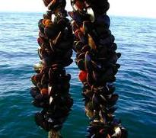
Seafood Gathering Drying and Smoking
Shellfish were collected and dried for winter use.

Slide 11
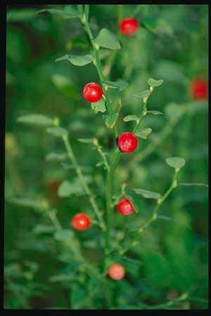
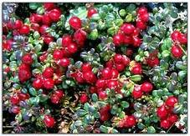
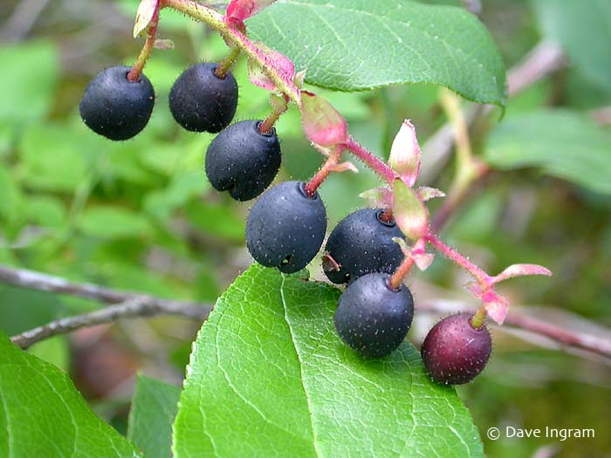
Gathering Berries
Berries were eaten fresh and many were pounded and dried on racks in the sun. The dried berry cakes were rolled up and stored for winter. Dried berry cakes were often eaten with fish oil.

Slide 12
Winter

Slide 13
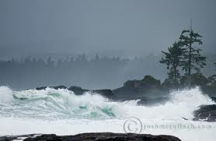
Making or Repairing Baskets

Slide 14
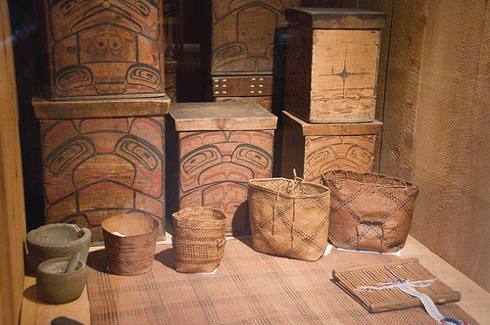
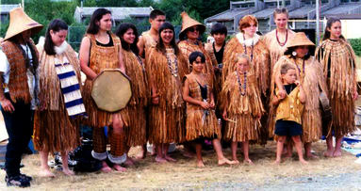
Making Cedar Goods
Winter clothing is needed and there is more time to weave mats and capes. Twine, rope, lines, cables, baskets, storage boxes, cooking utensils and baby cradles were made.

Slide 15
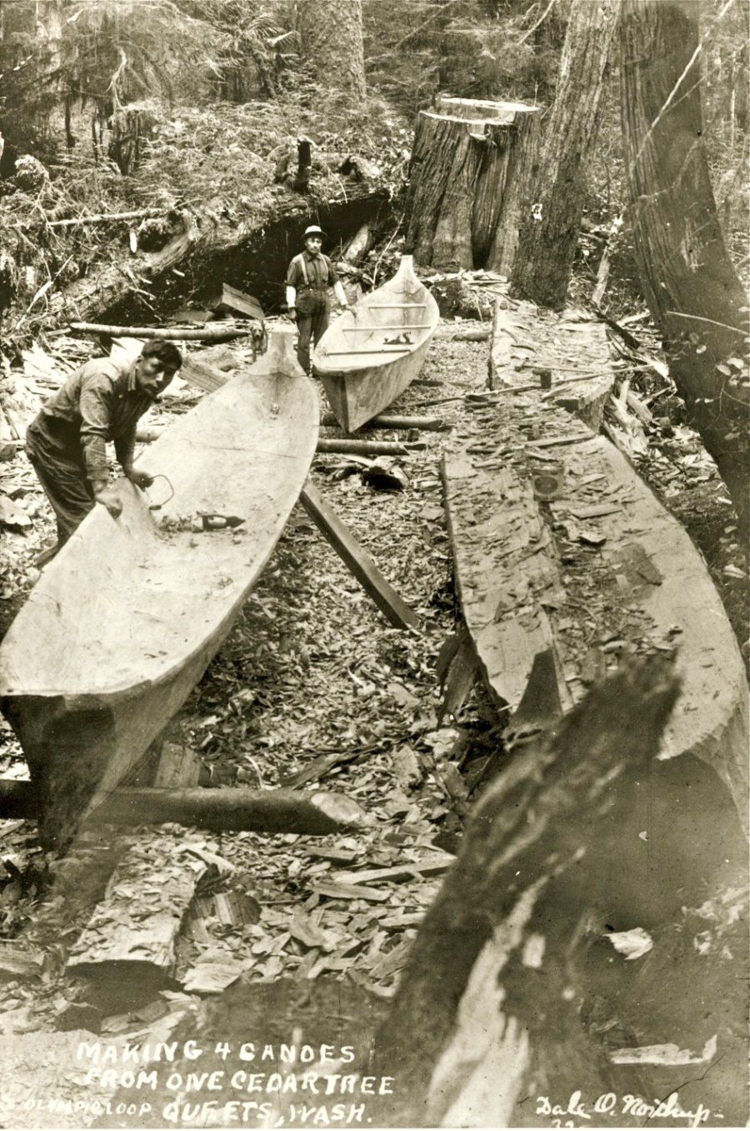
Making or Repairing Canoes
Roughed out canoes were brought into the longhouse to be finished.

Slide 16
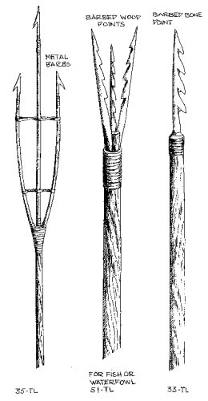
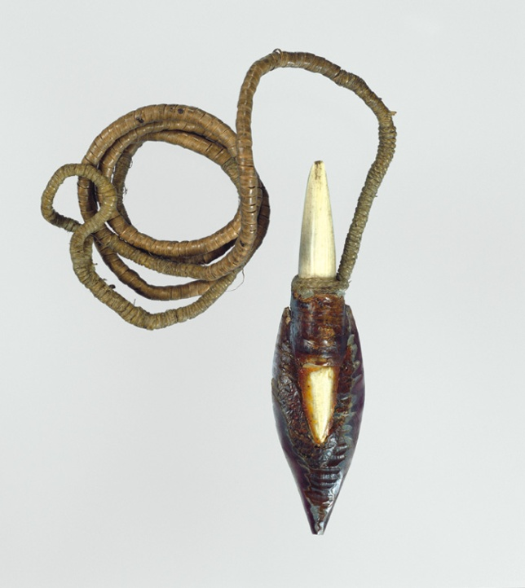
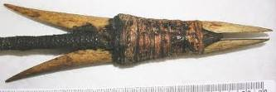
Making or Repairing Tools
Tools and fishing gear were made and repaired in winter.

Slide 17
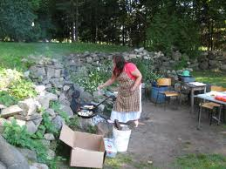
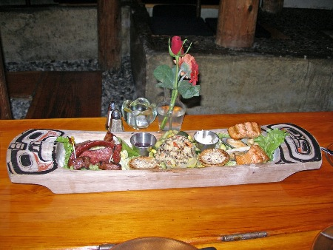
Feasting
People settled down for winter and enjoyed the stores of food they had gathered.

Slide 18
Dancing Singing Gathering Together
Winter is the most important time of year for spiritual and cultural activities. People gathered in the big house for Winter ceremonial dances, new dancers were initiated and ceremonies are witnessed.

Slide 19
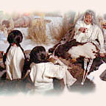
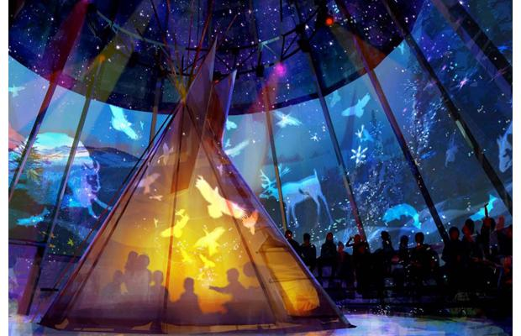
Storytelling
Elders tell legends and use stories to teach children the right way to live.

Slide 20
Spring

Slide 21
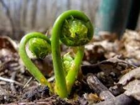
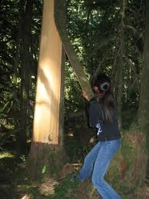
Stripping Cedar Bark
Best time to fall cedar logs for canoe building and other uses. The warmer weather causes the tree sap to run which makes it easier to strip the bark.

Slide 22
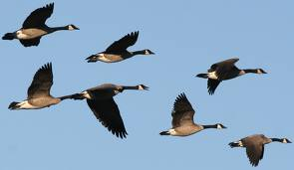
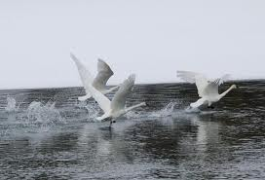
Hunting Duck Geese Swans
Duck were captured with nets while they gathered on the ocean to dive for herring roe and spawning herring. Brant Geese were hunted and dried for future use.

Slide 23
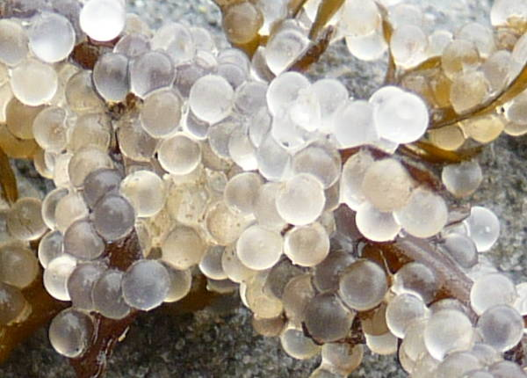
Herring Eggs
Cedar branches were placed in the water along the shore to collect herring roe.

Slide 24
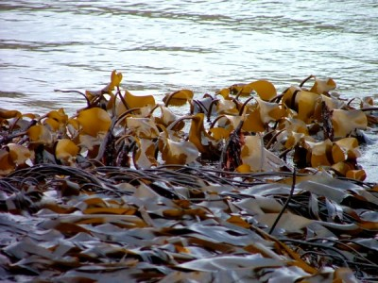
Seaweed Gathering
Kelp or seaweed was gathered at the right time and dried. It was cooked with clams and eulachon oil in a soup which was eaten with great enjoyment.

Slide 25
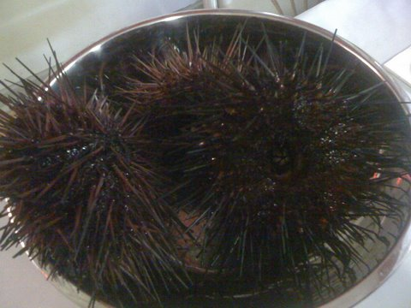
Sea Urchins
Both purple and green sea urchins were collected and eaten in the spring.

Slide 26
Summer

Slide 27
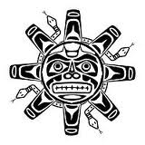
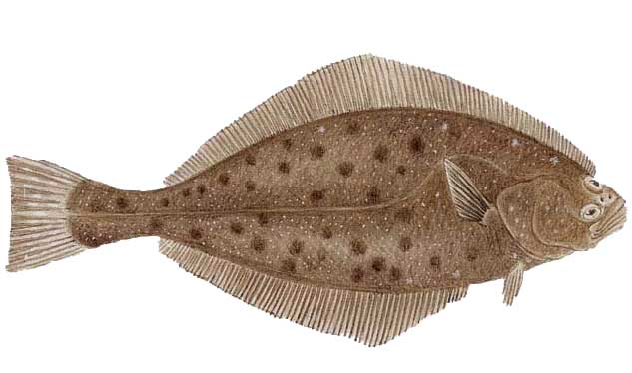
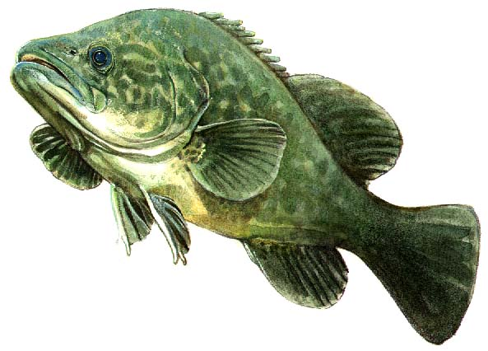
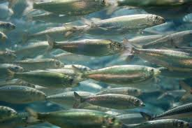
Summer Fishing
Dog Salmon, Coho, Humpback, Sockeye,Tommy Cod and Ling Cod were food staples.

Slide 28
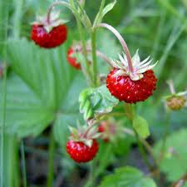
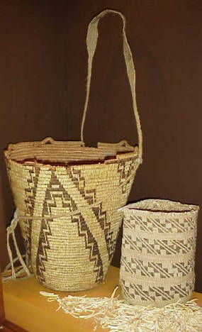
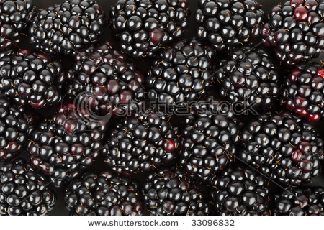
Summer Berries Gathering

Slide 29
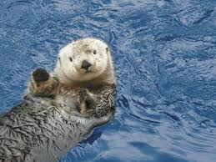
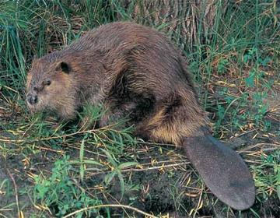
Summer Hunting
Seals and sea lions were hunted as well as beaver and otter.

Slide 30
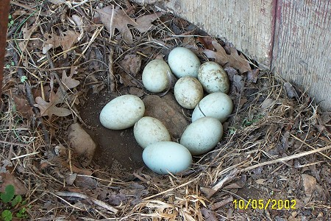
Birds Eggs
Fresh gull eggs were collected from camus plots where they were laid.

Slide 31
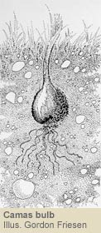
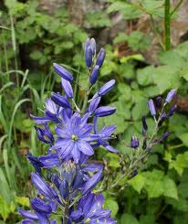
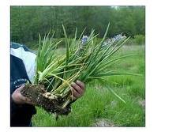
Summer Camas Bulb Harvesting
Camas bulbs were the main source of starch. Families had traditional territorial grounds (land and water) which were used at various times of the year.

