Slide 1
Animal furs
Importance of animals to aboriginal people

Slide 2
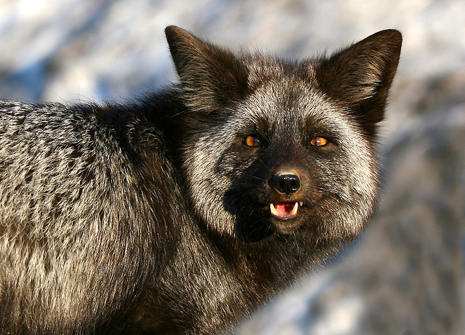
Wild silver fox

Slide 3
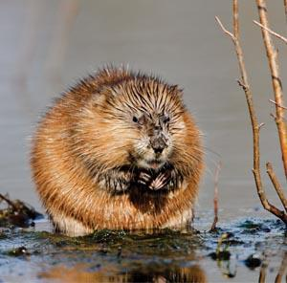
muskrat

Slide 4
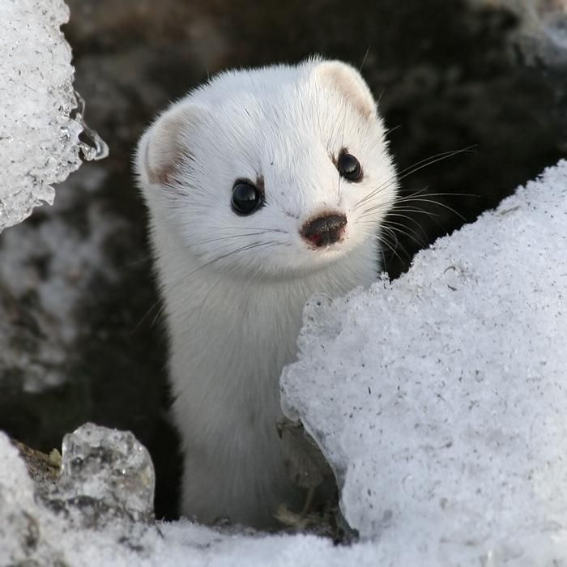
weasel

Slide 5
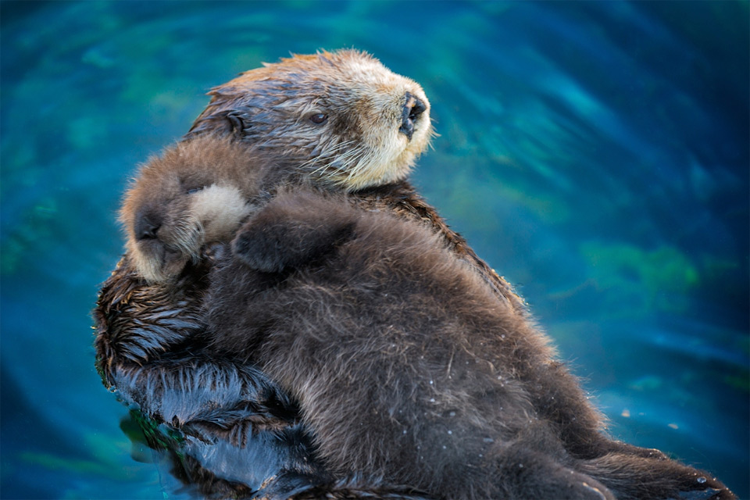
Sea otter

Slide 6
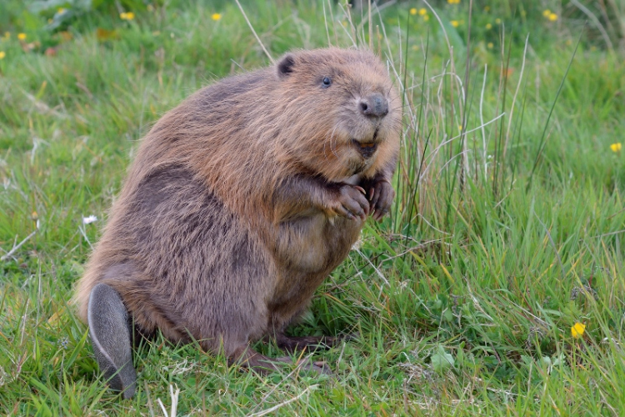
Beaver

Slide 7
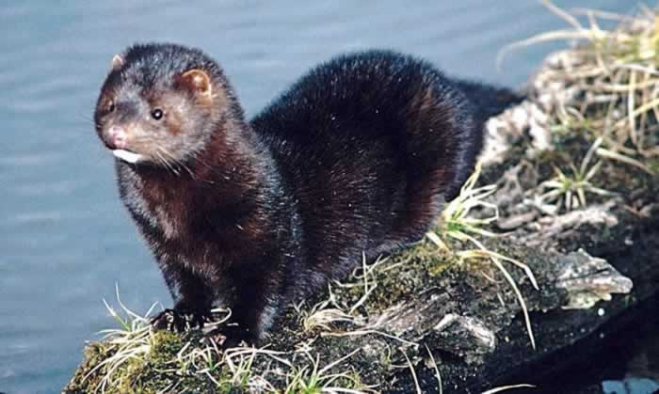
Wild mink

Slide 8
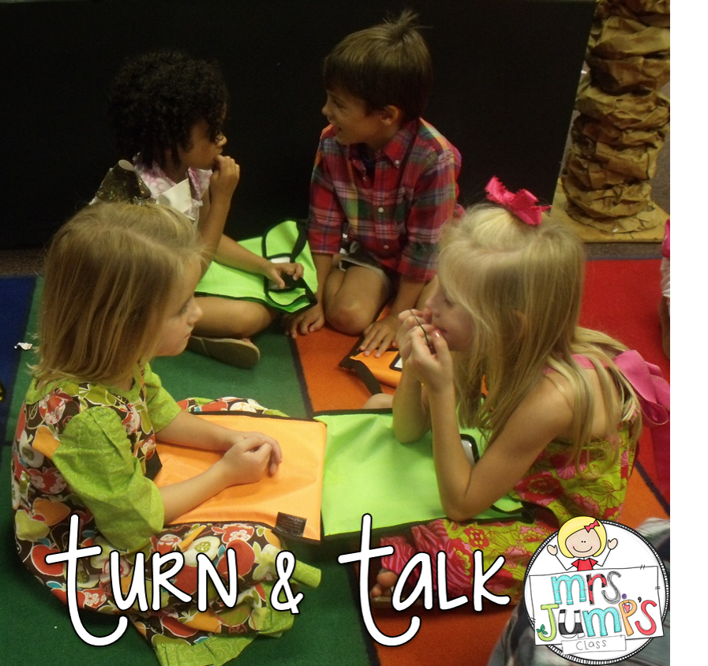
Which fur is your favourite?
Turn and Talk to a partner
Knee to knee
What is your favourite fur?
How would you use it?

