Slide 1
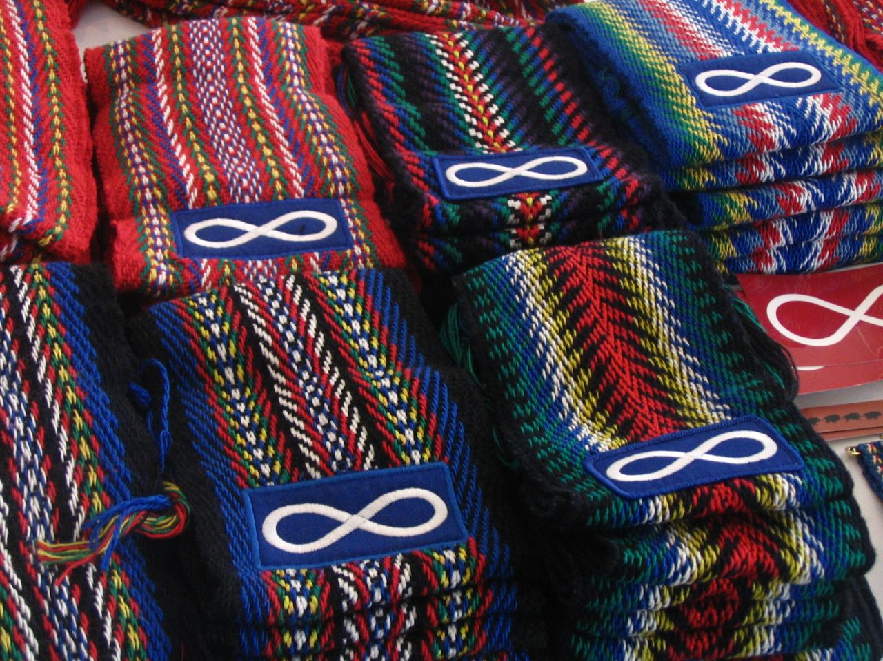
Introducing Métis People
Taking a look at Métis people in Canada
Notes:
The word Metis comes from the French word “metises” which means mixed
The fur trade played an important role in the origins of the Metis people.
European fur traders met and married Aboriginal women, mixing of two cultures that created a distinct society with its own language, traditions, beliefs, culture and governance
Traditional Metis people, as recognized by the Canadian Government, are from the Manitoba and Saskatchewan areas with traceable family ties to the Red River area in Southern Manitoba in the 1800s.

Slide 2
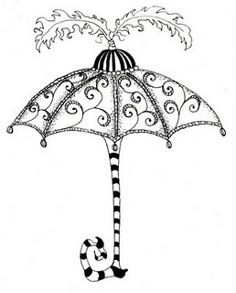
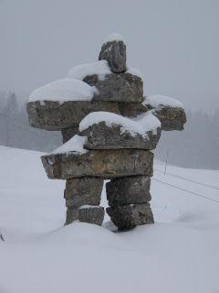
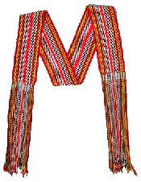
Aboriginal
Notes:
The word “Aboriginal” is like a big umbrella that refers to all First Nation, Métis and Inuit people in Canada
You may have heard other names, including “Indian”, “Native”, and “Indigenous”, but these have different meanings to different people.
To some, these words do not properly represent the huge variety of cultures found in Canada’s aboriginal community
Turn and Talk to a partner: how do you think these 3 images represent First Nations, Métis and Inuit people?
(Cedar Tree represents First Nation, the Métis Sash represent the Métis people and the Inuksuk represents Inuit)
The term aboriginal refers to the first inhabitants of Canada and anyone who has ancestral connections to these people.
The history of relationships between the Canadian state and Aboriginal peoples is complex. Terminology can represent colonial histories and power dynamics. Words can be used as a powerful method to divide peoples, misrepresent them and control their identity. For example, what we can see in Canada today with “status” and “non-status”, the legally defined categories of people under the Indian Act (http://indigenousfoundations.arts.ubc.ca/home/identity/terminology.html)

Slide 3
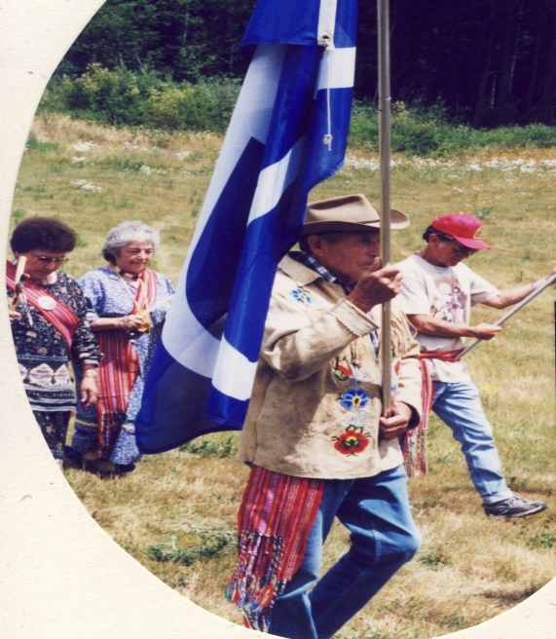
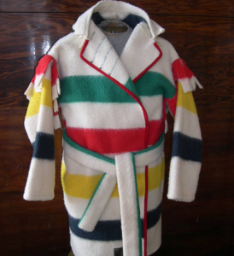
Métis symbols
Métis people are a blend of First Nations and European descent.
Notes:
Métis people are a blend of European and First Nation people
Early settlers and fur traders intermarried with Aboriginal women and over time their Métis children developed their own unique culture
From Saskatchewan, Manitoba and western Ontario regions.
Métis flag – infinity flag
Capote – is a coat made from a Hudson Bay blanket

Slide 4
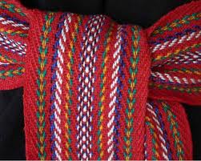
Métis Sash
Notes:
The woven sash is the most widely recognized symbol of the Metis people
The sash was used to carry personal belongings, and could also be used as a rope, a horse bridle, a tump line, a sewing kit and as a blanket or scarf for added warmth.
Personal belongings (pipe, tobacco, flint, knife) were kept close in the folds of the sash in case the boat or canoe tipped into the water.

Slide 5
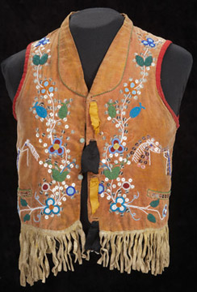
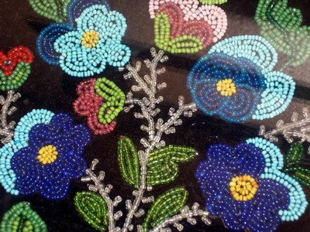
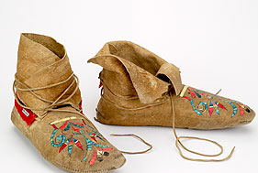
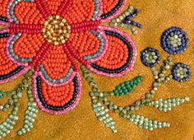
Flower bead work
Notes:
Some people refer to the Métis as the Flower Beadwork People because of their beautiful beading.
Some Métis people can tell where someone is from by the designs on their moccasins

Slide 6
Métis beading
Notes:
Metis, Frank Camp’s beaded coat made with smoked, tanned leather and beaded with seed beads
Made circa 1930’s by an unknown artist.

Slide 7
River Lots along the Red River
Notes:
River lots at the Parish of Kildonan, a typical Metis community with every family having access to the river.
When the HBC sold Rupert’s Land to the Government of Canada, who was encouraging European settlement, these type of lots became a contentious issue which lead to the Riel resistance.

Slide 8
Red River Cart Trails
Notes:
These trails were used extensively in the fur trade
Have students compare present day Manitoba to Manitoba on this map, what is the same? What is different?
Notice how extensive the network of trails is.

Slide 9
Red River, Manitoba
Notes:
This view of the Red River is looking south, the river flows to the North into Lake Winnipeg

Slide 10
Language: Michif
Michif Dictionary
Notes:
Traditional Metis people, as recognized by the Canadian Government, are from the Manitoba and Saskatchewan areas with traceable family ties to the Red River area in Southern Manitoba in the 1800s.
The Metis families in this area developed a strong and distinct culture, language and traditions.
The Metis people have their own language called Michif. It is a blend of European and Aboriginal languages including: French, English, Scottish, Saulteaux, Cree languages

Slide 11
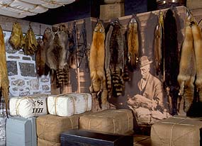
Fur Trade
Notes:
Metis people were instrumental in the fur trade when Canada was forming as a nation
They were adept hunters and knew how to survive in the wilderness
European people relied on them to provide furs at the trading posts, as wilderness guides, survival experts, interpreters, food suppliers (pemmican) etc.

Slide 12
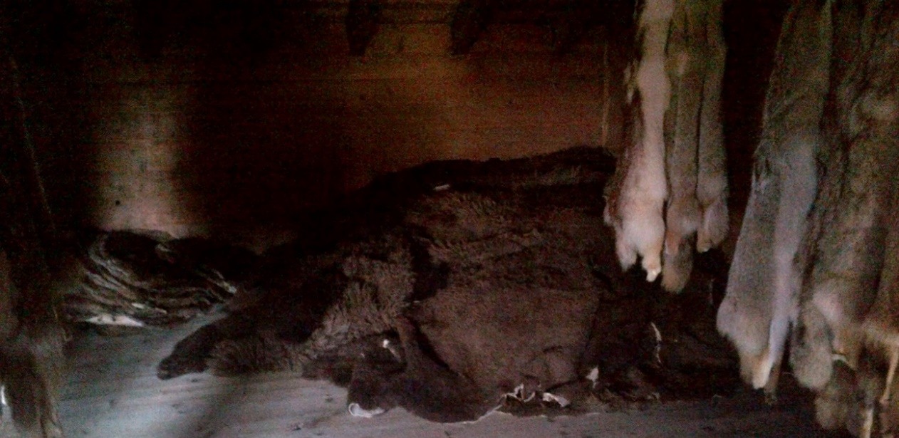
furs
Notes:
Beaver pelts and furs were traded by Metis people for trade goods at the Trading Posts

Slide 13
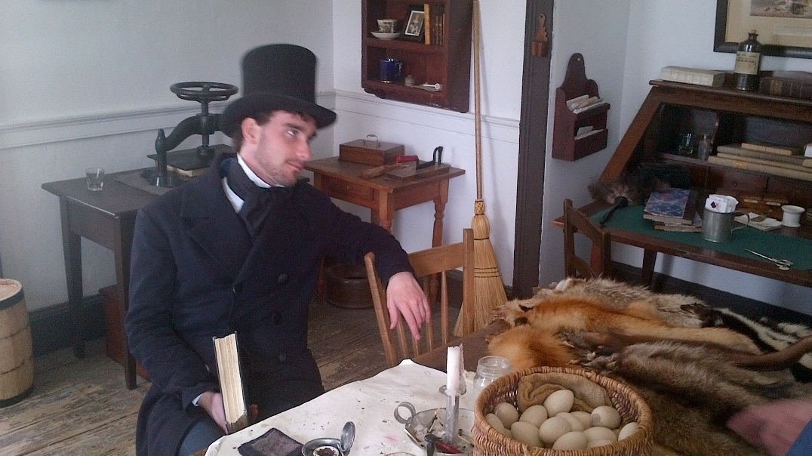
Beaver pelts to top hats
Notes:
Beaver pelts were used to manufacture felt for hats that were all the rage in Europe
The beaver hat fashions started the fur trade in North America

Slide 14
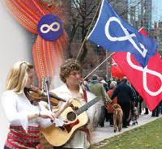
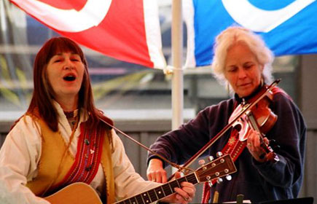
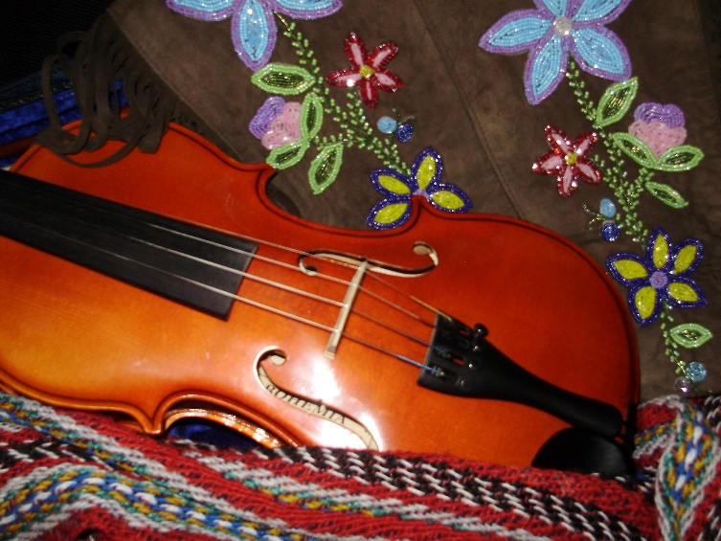
Fiddle music
Notes:
The Métis people celebrate their culture with lively music played on a fiddle and a special type of dance called jigging
The Metis fiddle symbolizes Metis nationhood and pride

Slide 15
Jigging
Notes:
Red River Jig is a unique dance developed by the Metis people
Jigging combines intricate footwork of Native dancing with the instruments and form of European music.

Slide 16
Red River Jig

Slide 17
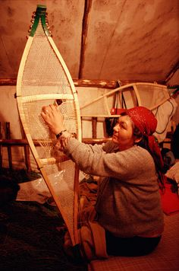
Travel by foot, canoe, snowshoe, Red River Cart, York boat
Notes:
Metis people were adept at travelling in the Canadian wilderness. They used snowshoes in winter, canoe in spring, Summer and Fall and used a Red River Cart to transport furs to trading posts

Slide 18
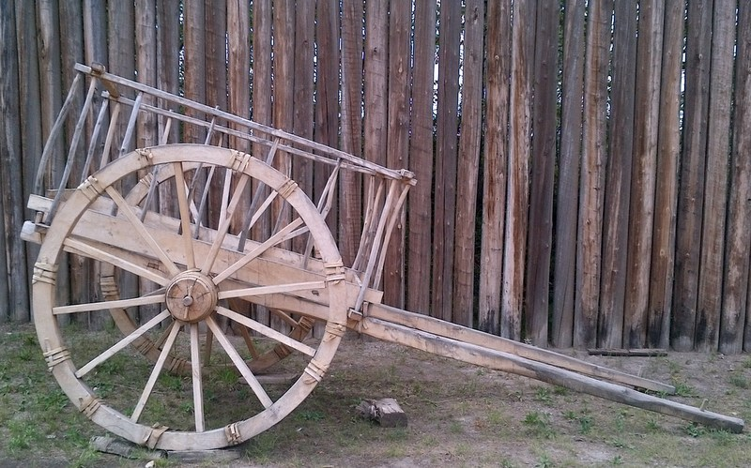
Red River Cart
Notes:
Used to transport furs and other goods to the trading posts the Red River Cart was made entirely from wood
They did not use grease on the axle so the Red River Carts had a distinctive squeaking sound as they travelled across the prairies

Slide 19
Red River Cart
Notes:
When encountering streams and rivers along their journey, the Metis people could pull the pin out of the wheel, remove the wheels, place them under the cart and float the cart across the water.

Slide 20
York Boat
Notes:
The York boat was a type of inland boat used by the Hudson's Bay Company to carry furs and trade goods along inland waterways in Rupert's Land, the watershed stretching from Hudson Bay to the eastern slopes of the Rocky Mountains. It was named after York Factory, the headquarters of the HBC

Slide 21
York boat
Notes:
The York boat was a type of inland boat used by the Hudson's Bay Company to carry furs and trade goods along inland waterways in Rupert's Land, York boats were preferred as cargo carriers to the birchbark canoes used by the North West Company, because they were larger, carried more cargo and were safer in rough water.
A York Boat could be built in 28 days.

Slide 22
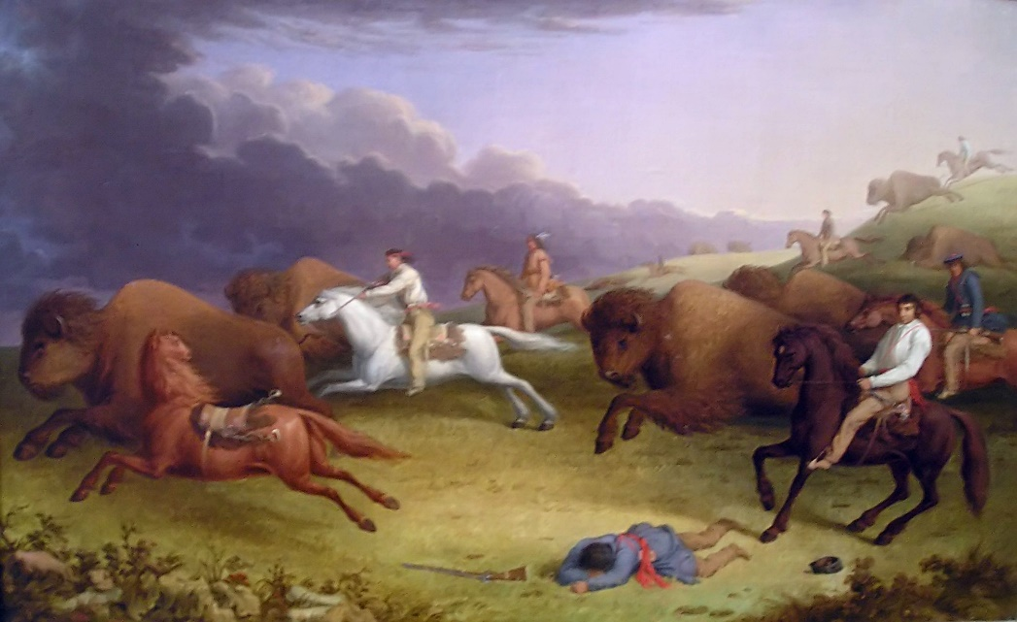
Buffalo Hunt
Notes:
Metis people did annual buffalo hunts twice a year, in spring and fall
The prairie Metis lived almost entirely off buffalo, all parts of the buffalo were used, nothing wasted
A miniature government was formed to control all aspects of the hunt
1814 Miles McDonnell (Governor of Assiniboia) issued a proclamation banning the “running” of buffalo with horses. This proclamation directly impacted Metis families who used buffalo as their main resource, for food, clothing and shelter

Slide 23
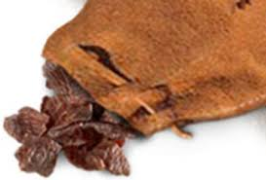
Pemmican
Notes:
Pemmican was a food staple for the Metis people
It is a great survival food made from dried buffalo meat, it is nutritious and lasts for a very, very long time. Stories tell of pemmican lasting up to 15 years.
Pemmican Proclamation: In 1814 Miles McDonnell (Governor of Assiniboia) forbid the export of any provisions (mainly pemmican) from leaving the territory of Assiniboia. He claimed it was so there would be adequate provisions for settlers expected to arrive in the summer, but this proclamation directly impacted Metis families in the region who relied on pemmican for their survival as a food source and income as a trade good.

Slide 24
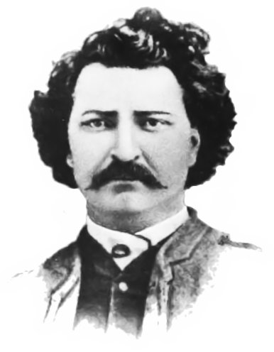
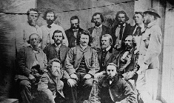
Louis Riel
Notes:
Louis Riel is a famous Metis leader and legend in Canada
Fought for the rights of Metis people in the Red River area
Riel fought the Canadian Government at Batoche 1885, where the Metis were crushed by a thousand troops with Gatling guns.
As a result of the rebellions, Riel was later hung for treason.
Louis Riel Day is celebrated in Canada on Nov. 16

Slide 25
Louis Riel Day, Nov. 16th
Notes:
Riel was once viewed as a traitor, but now he is recognized as a strong leader in Canadian history.
Louis Riel, July 4, 1885. ”My people will sleep for one hundred years, but when they awake, it will be the artists who give them their spirit back.”

