Slide 1
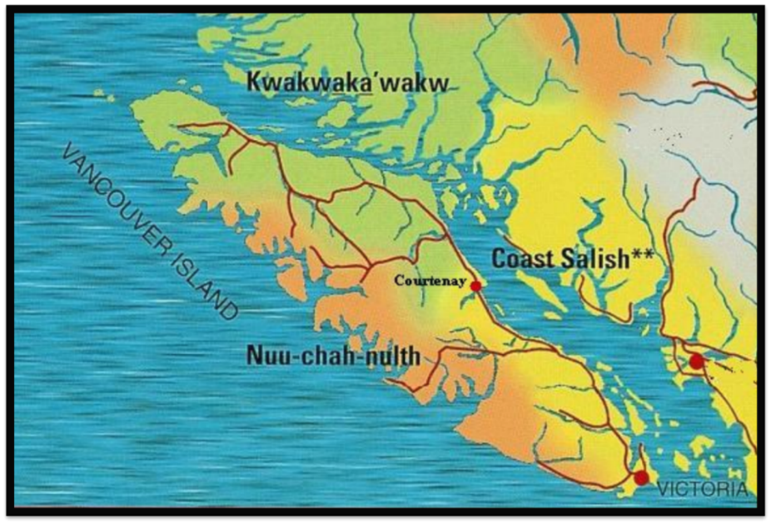
k̓uta̱la
Salmon
Kwak’wala
Sliammon
jɛnxʷ

Slide 2
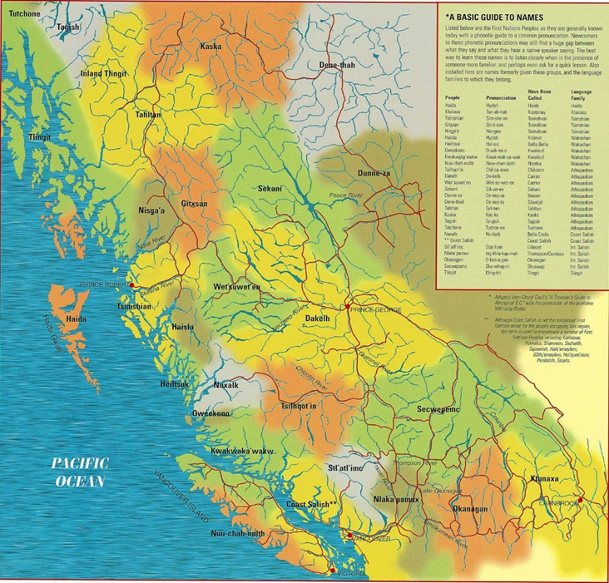
Language
*language information is as we understand it at this time. Please check in periodically to see if our understandings have changed or if you have information to help improve our understanding. (Indigenous.education@sd71.bc.ca )

Slide 3
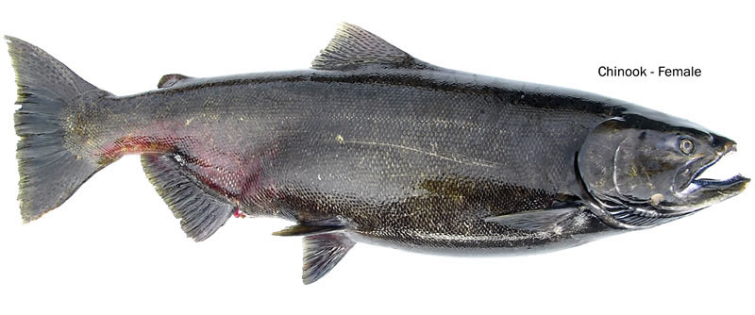
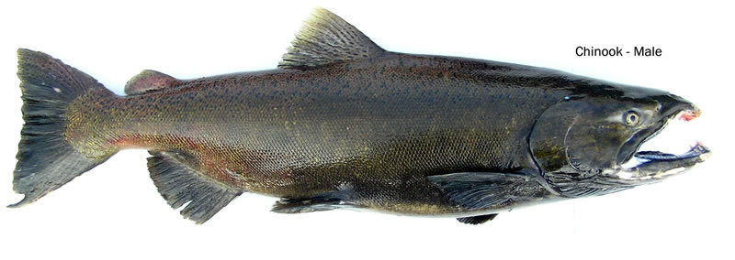
English
spring salmon
Chinook Salmon
(Spring, King, quinnat, jacks or tyee)
Kwak’wala
sat̕sa̱m
θat̓ᶿəm

Slide 4
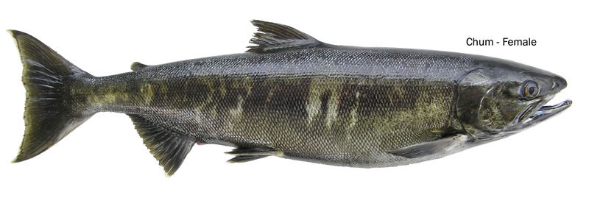
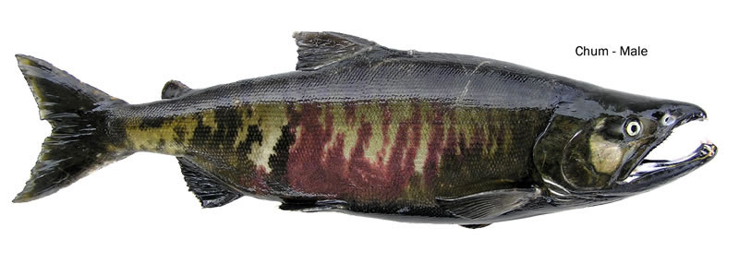
ǥwax̱'nis
Chum Salmon
(Dog)
ƛoχʷay

Slide 5
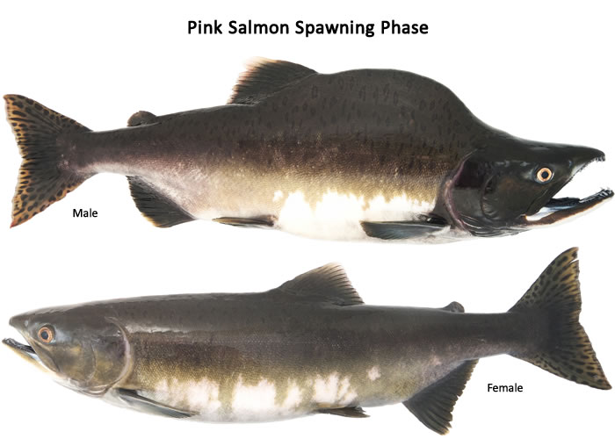
ha̱nu'n
Pink Salmon
(Humpback)
kʷətɛčɩn

Slide 6
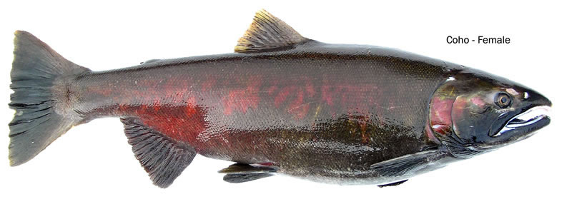
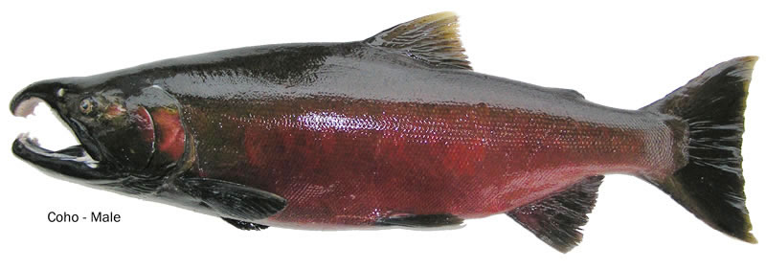
dza̱'wa̱n
Coho Salmon
(silver)
χɛyt̓ᶿɛqʷ

Slide 7
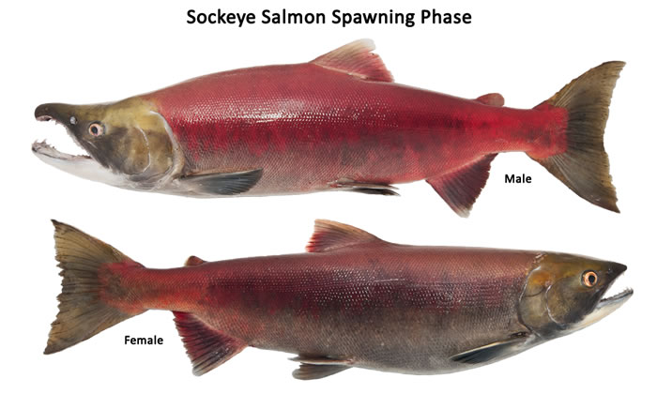
ma̱łik
Sockeye
θəqay

