Slide 1
Spring

Slide 2
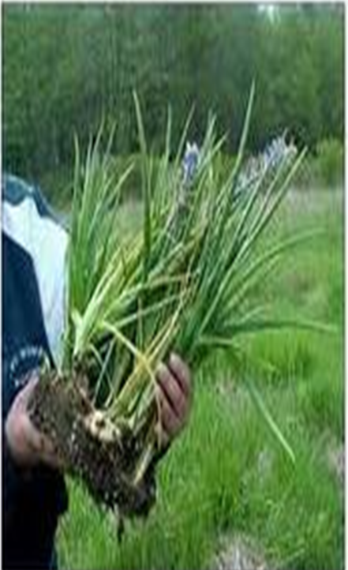
Camas Bulb
Notes:
Flower Earmarked in spring and go back in late/summer to fall for picking

Slide 3
Eulachon
Notes:
Spring in north

Slide 4
Miner’s Lettuce
Notes:
Later in season

Slide 5
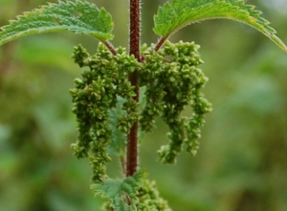
Stinging Nettle
Notes:
Very first greens

Slide 6
Wild Onion and Garlic
Notes:
Nodding onion or hooker onion (missing garlic) check in two books

Slide 7
Lodgepole Pines
Notes:
Ate really thin slice of of inner bark

Slide 8
Bird eggs

Slide 9
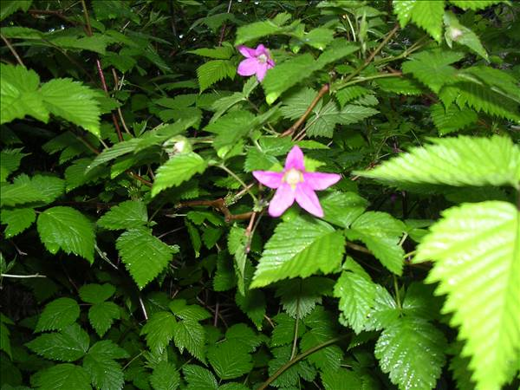
Salmonberry and Thimbleberry shoots

Slide 10
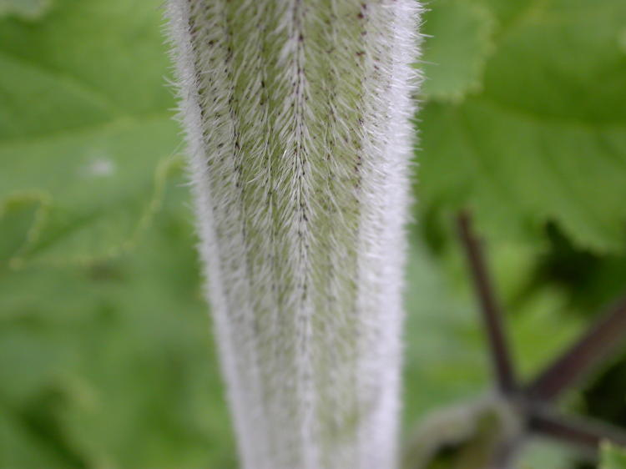
Cow Parsnips
Notes:
Some parts are edible and some are not (read more)

Slide 11
Oregon Grape Flower
Notes:
You can eat the flowers, they are tart.

Slide 12
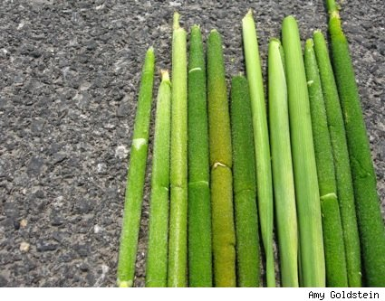
Cattails

Slide 13
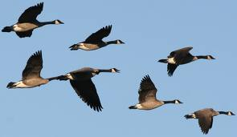
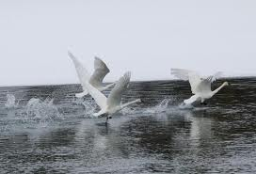
Hunting Duck Geese Swans

Slide 14
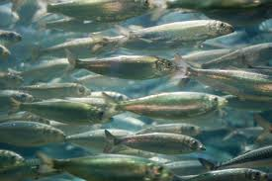
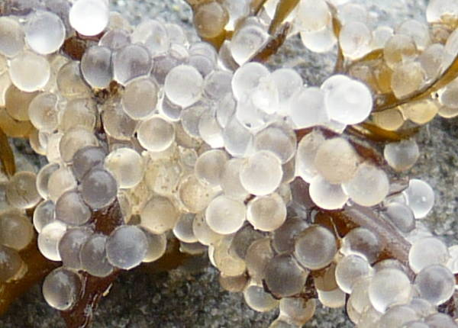
Herring Eggs

Slide 15
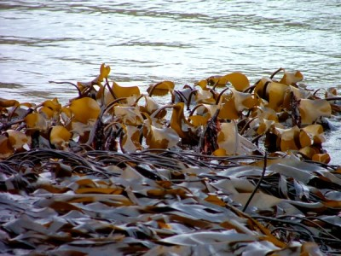
Seaweed gathering
Notes:
Quite a few different kinds

Slide 16
Sea Urchins

Slide 17
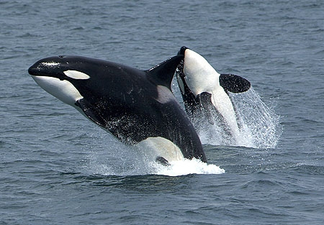
Seals, Whales

Slide 18
Clams
Notes:
(winter too) no red tide (always a source of food – that is why so many middens around)

Slide 19
Summer

Slide 20
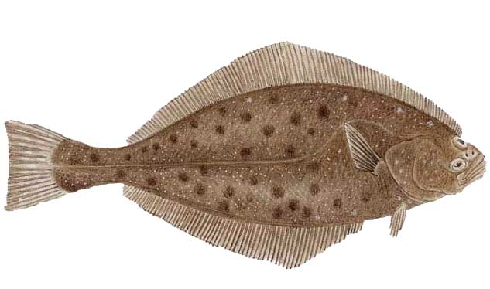
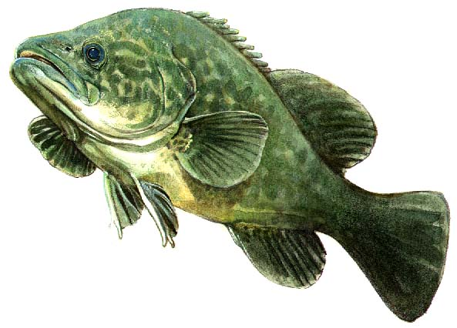
Fishing Cod and Halibut

Slide 21
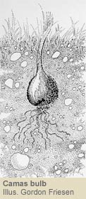
Camas bulb
Notes:
Flower Earmarked in spring and go back in late/summer to fall for picking

Slide 22
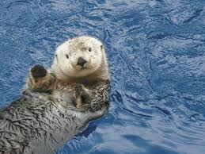
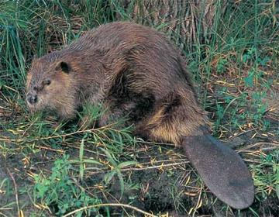
Seals, Sea Otters, Beavers

Slide 23
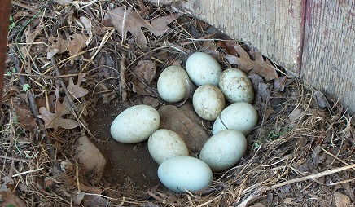
Birds Eggs

Slide 24
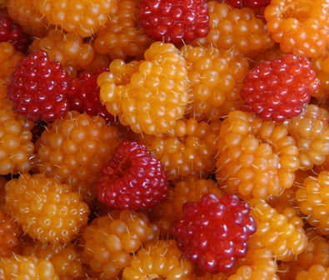
Salmonberries
Notes:
Marked the beginning of the salmon fishing season (check fact)

Slide 25
Thimbleberries

Slide 26
Blackberries

Slide 27
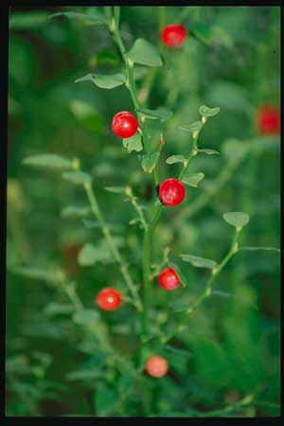
Huckleberries

Slide 28
Oregon Grape

Slide 29
Salal Berries

Slide 30
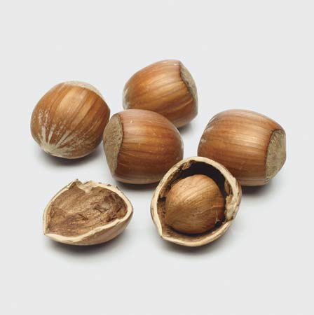
Hazelnut

Slide 31
Crabapples

Slide 32
Clams

Slide 33
Mussels

Slide 34
Bear

Slide 35
Steelhead Salmon

Slide 36
Sockeye Salmon

Slide 37
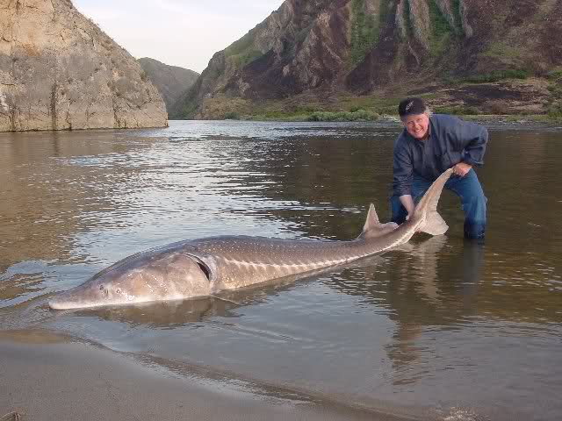
Sturgeon Eggs

Slide 38
Chinook

Slide 39
Kinnikinnik

Slide 40
Fall

Slide 41
Crabapples

Slide 42
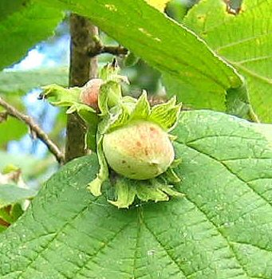
Hazelnuts

Slide 43
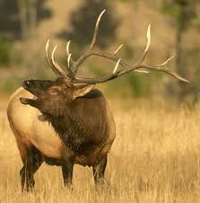
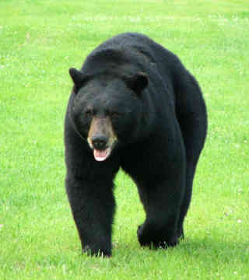
Hunting Elk, Bear, Deer

Slide 44
Waterfowl

Slide 45
Cranberry

Slide 46
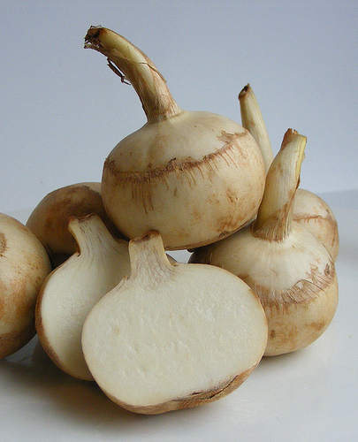
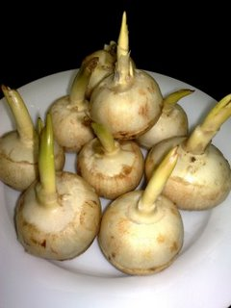
Swamp Potato
Notes:
arrowhead

Slide 47
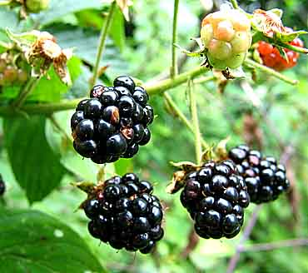
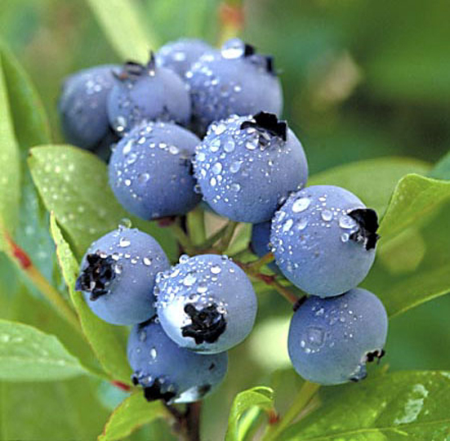
Berry Picking
Notes:
Blackberry, blueberry, saskatoon

Slide 48
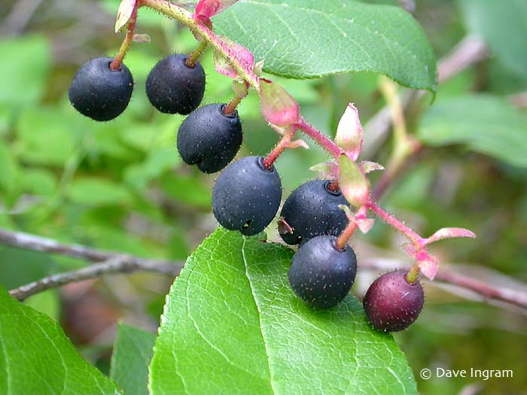
Salal

Slide 49
Oregon Grape

Slide 50
Winter

Slide 51
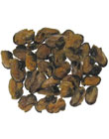
Dried seafood
Notes:
Dried clams and mussels

Slide 52
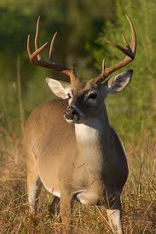
Hunting

Slide 53
Salmon
Notes:
chinook

Slide 54
Dried berries
Str

Slide 55
Waterfowl

Slide 56
Salal Berry Cakes

