Slide 1
Seasonal Round

Slide 2
What is important about Aboriginal Education?

Slide 3
Aboriginal Perspectives and Knowledge
British Columbia has long had the goal of improving school success for all Aboriginal students. Achieving this goal will require that the voice of Aboriginal people be heard in all aspects of the education system; the presence of Aboriginal languages, cultures, and histories be increased in provincial curricula; and leadership and informed practice be provided.
At the same time, British Columbia’s education transformation therefore incorporates the Aboriginal voice and perspective by having Aboriginal expertise Aboriginal perspectives and knowledge are a part of the historical and contemporary foundation of British Columbia and Canada.se at all levels, ensuring that Aboriginal content is a part of the learning journey for all students, and ensuring that the best information guides the work. An important goal in integrating Aboriginal perspectives into curricula is to ensure that all learners have opportunities to understand and respect their own cultural heritage as well as that of others.
Over the past decade, British Columbia’s curriculum has integrated Aboriginal content into specific courses. The redesigned curriculum builds on what has been learned and extends Aboriginal perspectives into the entire learning journey, rather than into specific courses or grade levels. This means that from Kindergarten to graduation, students will experience Aboriginal perspectives and knowledge as part of what they are learning. And because Aboriginal perspectives and knowledge are embedded in the curriculum, they will naturally influence the ways in which students will be assessed.
The First Peoples Principles of Learning provided a crucial lens for teacher teams when drafting curricula, and all curriculum teams included Aboriginal representation. The teams put great effort into embedding Aboriginal knowledge and worldviews in curriculum in authentic and meaningful ways. Curriculum material was reviewed by Ministry staff as well as by Aboriginal teachers and other experts.
References to Aboriginal perspectives and knowledge are both explicit and implicit in the redesigned curriculum and are evident in the rationale statements, goals, learning standards, and some of the elaborations. Rich instructional samples to inspire teaching and learning will be collected and shared online to provide examples of relevant teaching units and place-based learning. In all of the areas of learning, teachers are encouraged to teach in ways that respect the place in which the students are — to teach from within the school and its surrounding community.

Slide 4
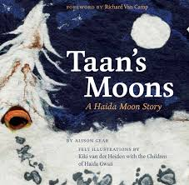
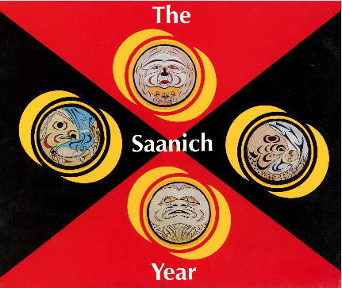
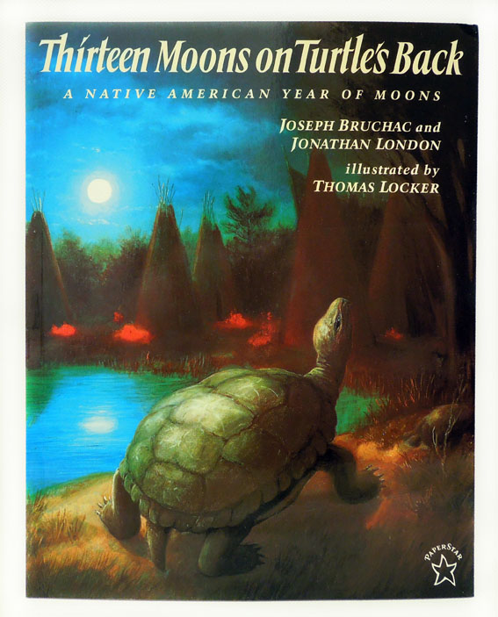
Moons
Make a connection to this moon with your group

Slide 5
SD71 Aboriginal Education Resources
SD71

Slide 6
My Seasonal Round

Slide 7
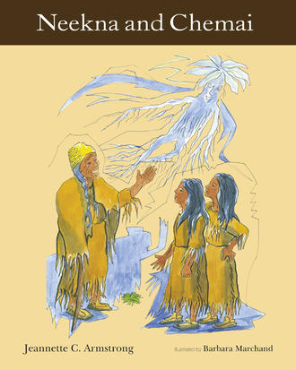
Lesson 1 – What Is a Seasonal Round?
Imagine not having any calendars or not knowing the date.
How would you know the seasons were changing just by looking around you?
What do you know about the seasons?

Slide 8
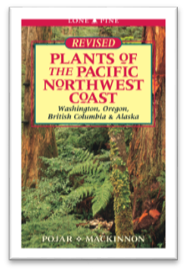
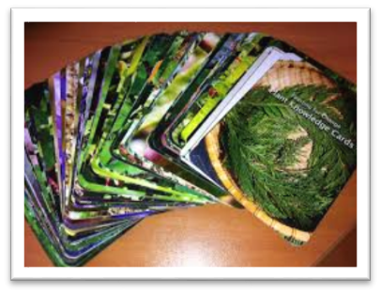
Plants

Slide 9
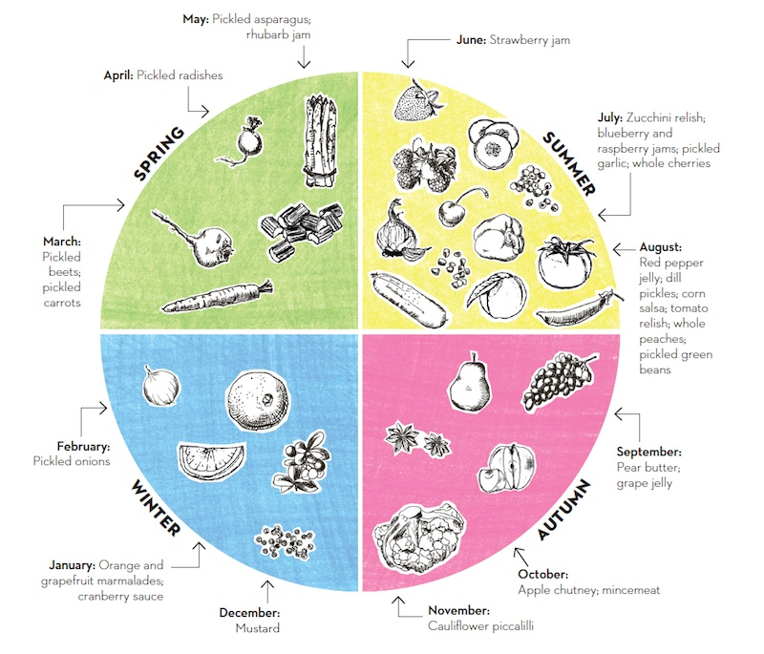
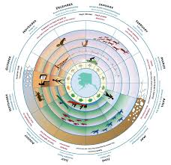
Seasonal Round Examples

Slide 10
Lesson 2 – How Do Seasonal Changes Affect Plants and Their Habitats?
What kinds of habitats do plants live in? (Forests, oceans, cities, etc.)
What is a microhabitat?
What happens to plants when the seasons change?

Slide 11
Indigneous Plant Diva
See One Year in One Minute

Slide 12
Lesson 3 – How Do Seasonal Changes Affect Animals and Their Habitats?
Why are there different habitats?
Why is it important to have different habitats?
Why do animals live in different places?
What physical characteristics and behaviours do animals have that help them survive in their habitats?
How do the needs of a particular animal relate to its habitat?

Slide 13
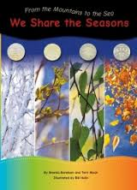
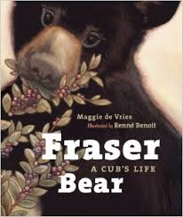

Slide 14
Lesson 4 – What Are the Four Geographic Regions of BC?
Why are there different landforms in the province?
What plant and animal habitats would be found in different regions of BC?
What living and non-living things would be found in the different habitats?
How does climate of the different regions affect the seasonal round?
How do the various landscapes across the province affect the seasonal round?

Slide 15
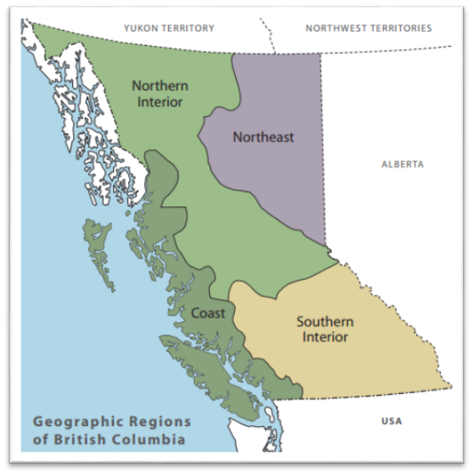
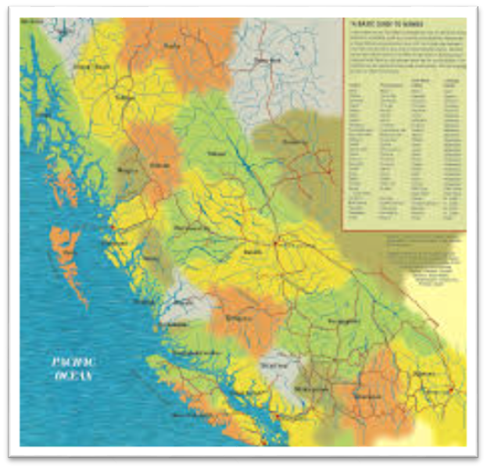

Slide 16
Tourism BC

Slide 17
Lesson 5 – What Does a Seasonal Round Look Like?
What animals would be hunted for food? • What plants or berries could be harvested? • Are there fish available? • How does the landscape of the region affect the seasonal round? • What would the weather be like in each season? • What shelter would people need? • What materials might they use to build shelter? • How do people travel from one place to another? • What resources would need to be harvested to make clothing, footwear, baskets, tools, etc.? • How might First Nations groups celebrate the seasons?

Slide 18
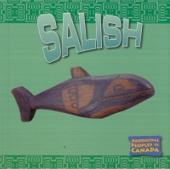
Land And Resource Connection
Time Immemorial

