Slide 1
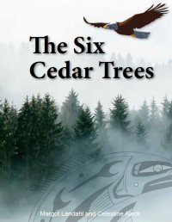
Six Cedar Trees Animals Kwak’wala and Sliammon Language
Inspired by the book Six Cedar Trees by Margot LandaHl and Celestine Aleck
Adapted from Shannon.Campbells@sd71.bc.ca original powerpoint, Animals from the Northwest Coast, by Lynn.Swift@sd71.bc.ca
Lelaina.jules@sd71.bc.ca and Gail.martindale@sd71.bc.ca

Slide 2
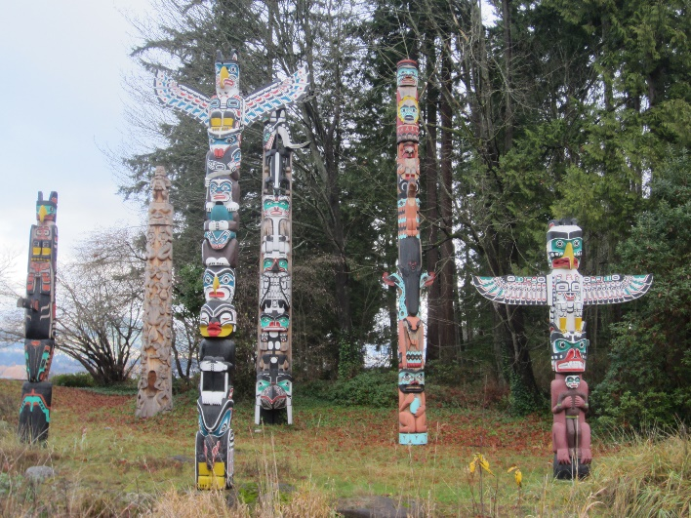
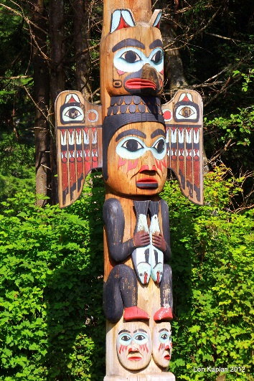
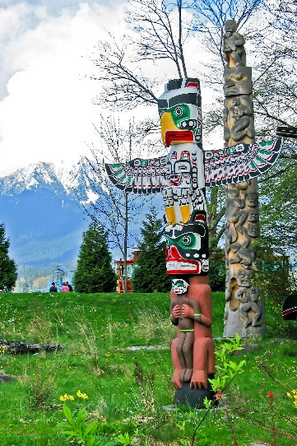
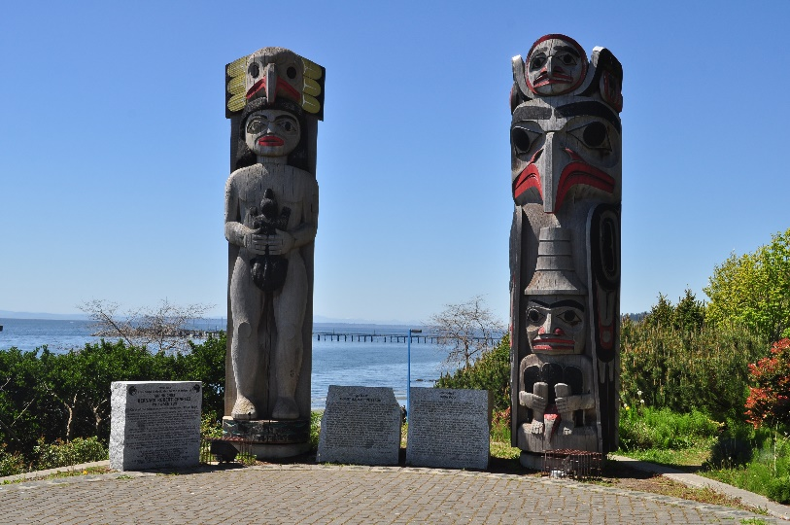
Animal Symbolism
Different animals symbolize and represent human traits, values and characteristics.
On many totem poles, animals often represent families crests or clans and are used to tell a story.

Slide 3
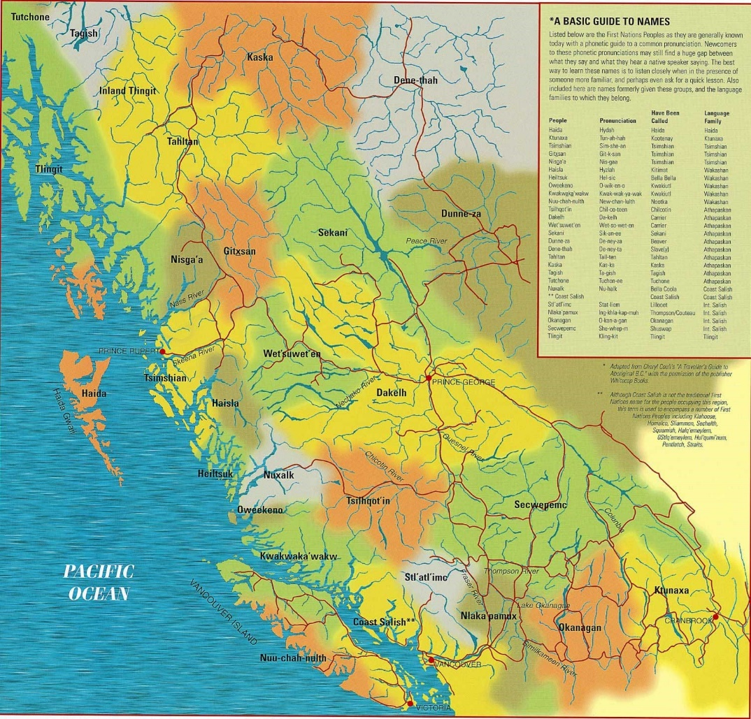
Language
Two cultures are identified in the K’omoks First Nation community: Coast Salish (Island-Comox speaking peoples) and Kwakwaka'wakw (Kwak̓’wala speaking peoples).
Sliammon is one of the Coast Salish Languages.
Traditionally the K’omoks First Nation territory is Coast Salish Territory and the original language spoken in this area is Pentlatch. There are no fluent Pentlatch speakers in this territory, today. The most similar language spoken today is Sliammon from Powell River.
*language information is as we understand it at this time. Please check in periodically to see if our understandings have changed or if you have information to help improve our understanding.

Slide 4
Namwayut
Using the philosophy of namwayut and the book Six Cedar Trees we see an example of combining worldviews and principles from the environment and land we live.
The core competencies guide teachers in the importance of social and emotional learning with our students and this connects directly to the First Peoples Principles of Learning.
Animal symbolism, in some form, and/or all connection to the land, guides how many Indigenous people have lived with this land for thousands of years in relationship to all living things.
The animals represented here are some of the northwest coast animals and are important to many of the people who live in this area. The descriptors are generalized and not specific to one culture. The meanings are important to an individual as well as families and groups.
we are all one
all living things are connected

Slide 5
First Peoples Principles of Learning

Slide 6
Kwak’wala t̕sawi
Beaver
Creative
Artistic
Determined
Sliammon qowut

Slide 7
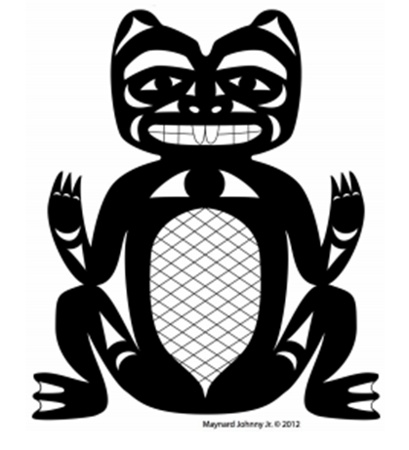
Beaver
Beaver is a diligent collaborator.
Beaver represents the ways of knowing our
Social Responsibility.
Through Beaver, we can learn to care for our community and environment by valuing diversity, advocating for others and working together for a greater good.

Slide 8
Kwak’wala t̕ła'yi
Strength
Learned Humility
Motherhood
Teaching
Sliammon
mɛχaɬ

Slide 9
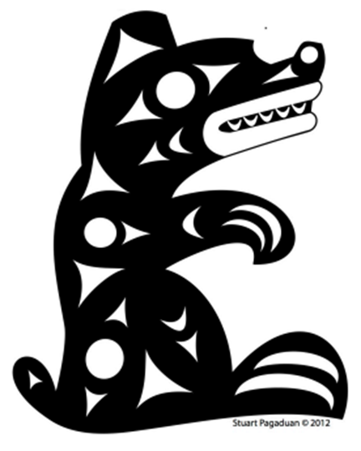
Bear
Bear is a great protector.
Bear represents the ways of knowing our
Personal Awareness
and Responsibility.
Through Bear, we can learn to nurture our own personal well-being by valuing ourselves and our accomplishments; understanding our feelings and making good choices that demonstrate respect for ourselves and others.

Slide 10
Kwak’wala max̱'inux̱
Orca
Traveller
Guardian
Symbol of Good
Sliammon nənqəm

Slide 11
Orca
Orca is our guardian and navigator of the sea.
Orca represents the ways of learning our
Positive Personal and
Cultural Identity.
Orca teaches us about who we are, where we come from, and to understand our own personal histories by learning the ways of our ancestors

Slide 12
Sliammon p’oho
Raven
Kwak’wala ǥwa'wina
Creation
Knowledge
Bringer of the Light
Trickster

Slide 13
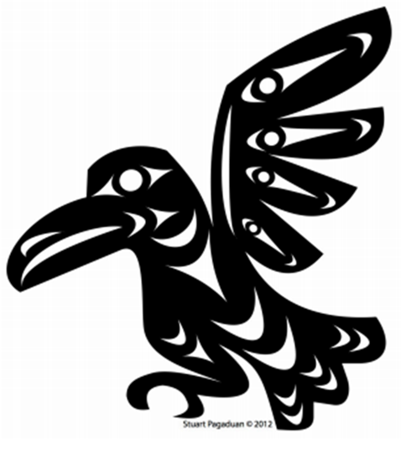
Raven
Raven is a creative thinker.
Raven represents how we
Think Creatively.
Raven teaches us to be creative and playful in all that we do.

Slide 14
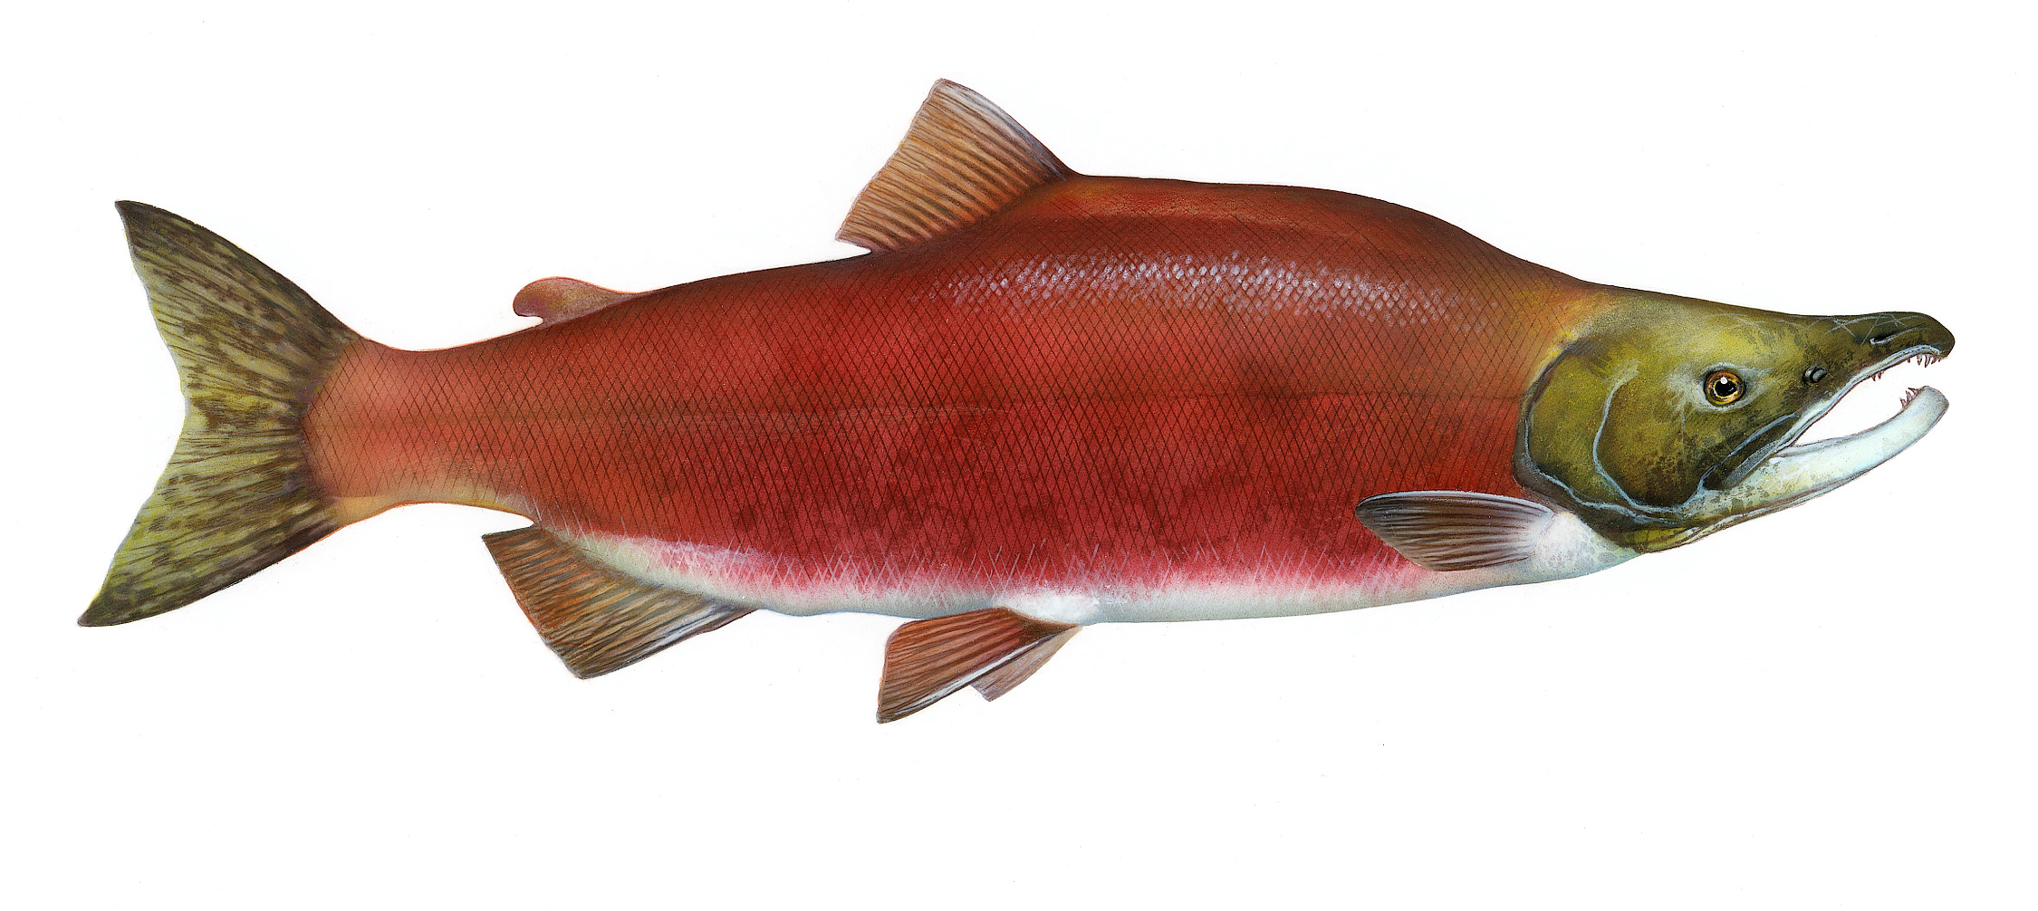
Kwak’wala k̓uta̱la
Salmon
Dependability
Renewal
Provider
Sliammon θəqay
Notes:
Spring salmon

Slide 15
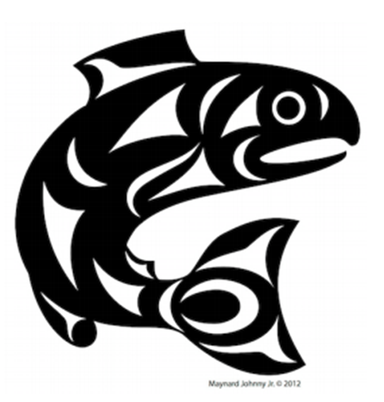
Salmon
Salmon is a Critical Thinker.
Salmon represents how we
Think Critically.
Through Salmon, we learn to observe, analyze and critique information and experiences. Our inquiries, allow us opportunities to question and investigate as well as develop and design plans.

Slide 16
Kwak’wala atła'na̱m
Wolf
Intelligence
Leadership
Strong Sense of Family
Sliammon ƛaɬom

Slide 17
Wolf
Wolf is a great communicator.
Wolf represents how we
Communicate.
Through Wolf, we can learn to connect and engage with others; gather and share information; and cooperate with others by listening to and respecting each other.

Slide 18
For more info…
First Voices: (words from this slideshow were obtained from this sit.
https://www.firstvoices.com/
K’omoks First Nation:
http://www.komoks.ca/about-us
Tla’amin First Nation Language:
http://www.tlaaminnation.com/language/
For Teaching resources and connections to the curricular competencies.
https://deltalearns.ca/thesixcedars/
See the following websites:...

