Slide 1
Aboriginal Animal Uses
What are some of the ways that Aboriginal
people traditionally used animals?

Slide 2
Thinking Sheet Name_________
jj
What is your
thinking?
Background Knowledge
Connections?
Inferences?
What are the big ideas?
What pictures/
visualizations do you have in your head?
What are some of the ways that Aboriginal people used animals?
First thoughts
Gallery Walk/ Video
Inference Pictures

Slide 3
Gallery Walk
Question:
How do you see animals being used/ how can you imagine they would be used?

Slide 4
Discuss Gallery walk/ add to thinking sheet in a second colour:
What new uses of animals did you spot?
Point to specific items.

Slide 5
YouTube Hide Tanning
http://www.youtube.com/watch?v=4eAnCwd1NYU

Slide 6
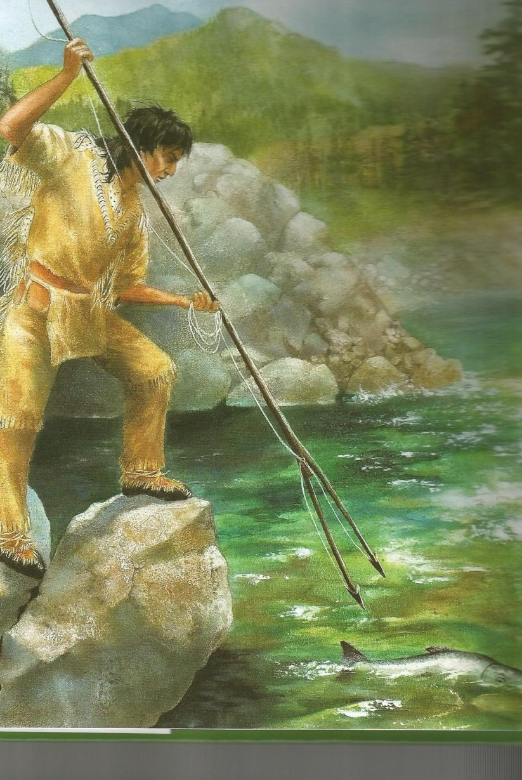
What use of animal can you infer from the picture?
Notes:
Pg 14

Slide 7
Inference Pictures:
Evidence + (What I see in the picture) | My Brilliant Thinking = (connections, background knowledge etc) | My Inference (What I have figured out)

Slide 8
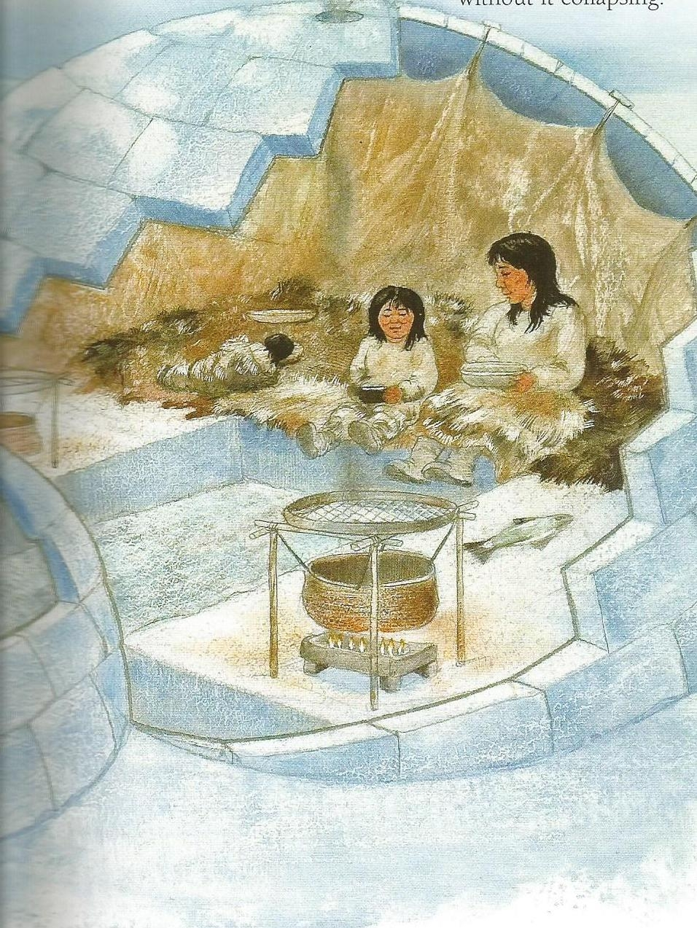
What use of Animal can you infer from the picture?
Notes:
Pg 25

Slide 9
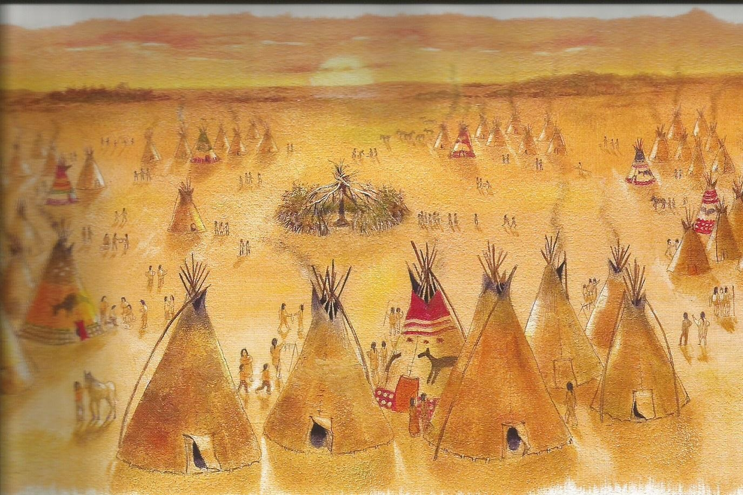
What use of animal can you infer from the picture?
Notes:
Pg 23

Slide 10
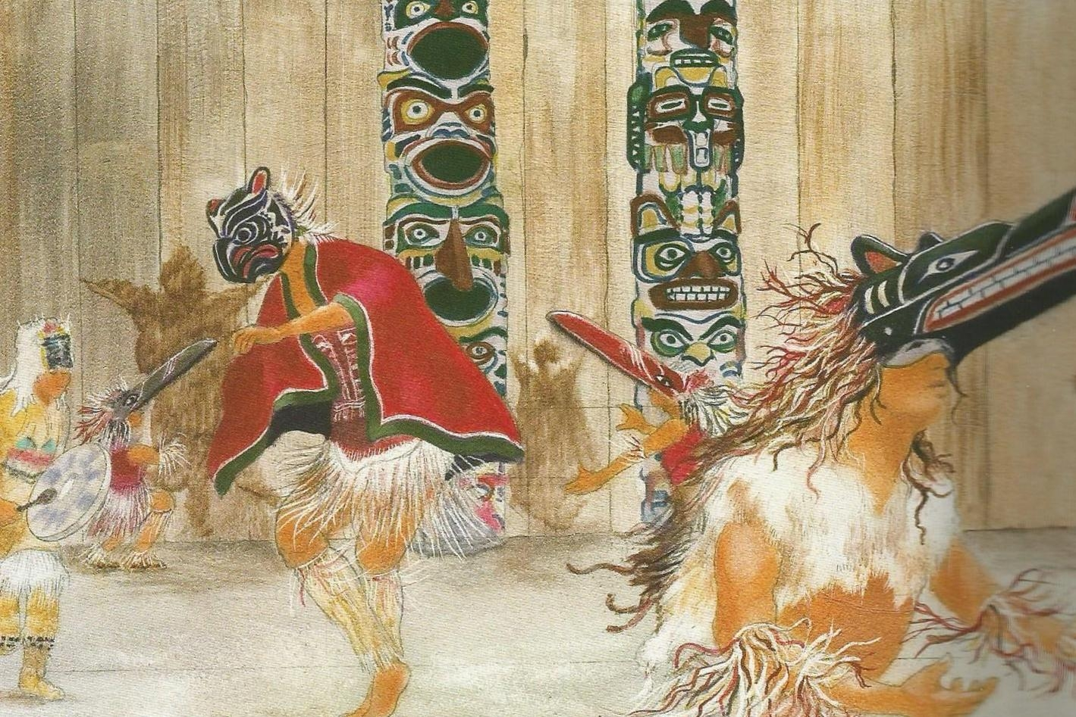
What use of animal can you infer from the picture?
Notes:
Pg 10

Slide 11
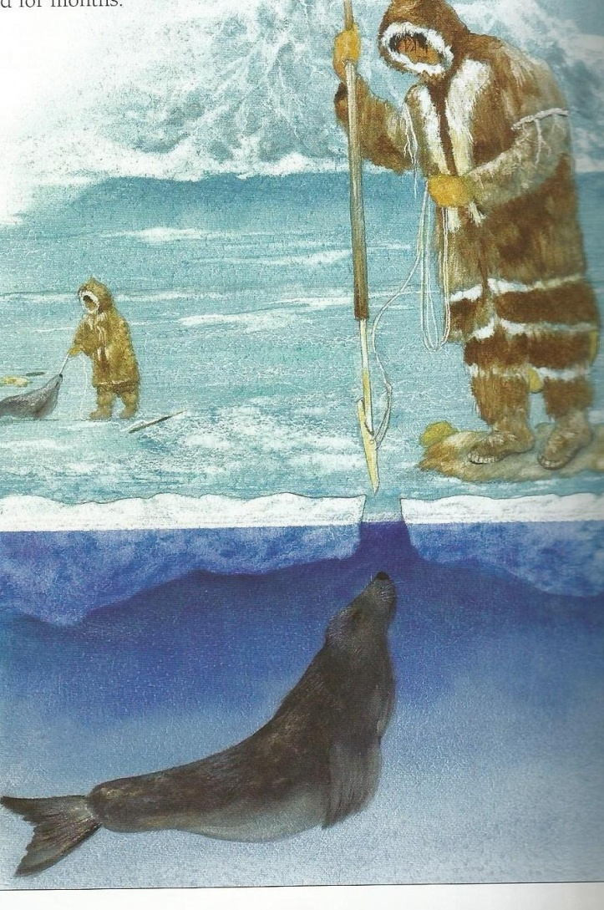
What use of animal can you infer from the picture?
Notes:
Pg 26

Slide 12
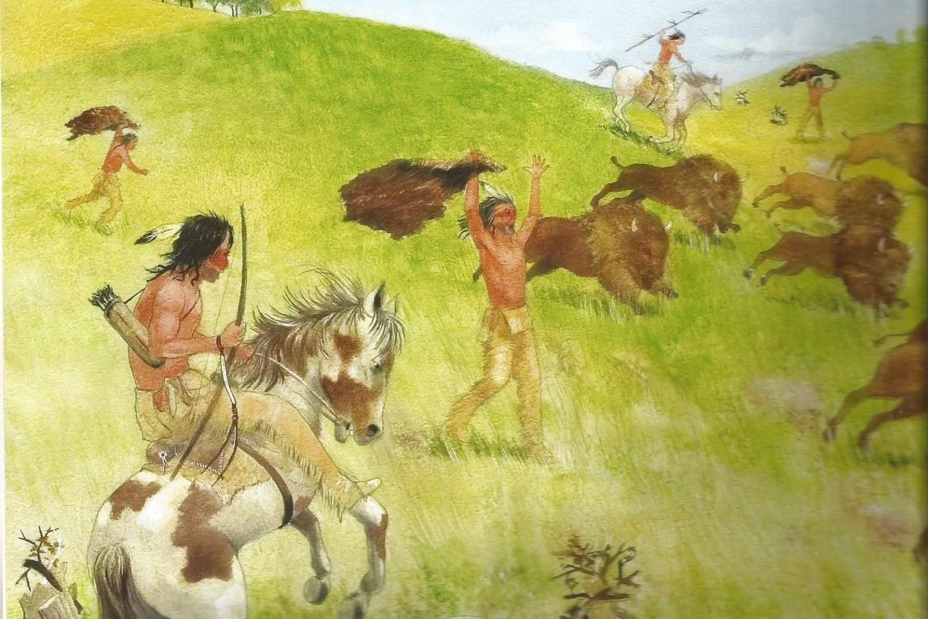
What use of animal can you infer from the picture?
Notes:
Pg 20

Slide 13
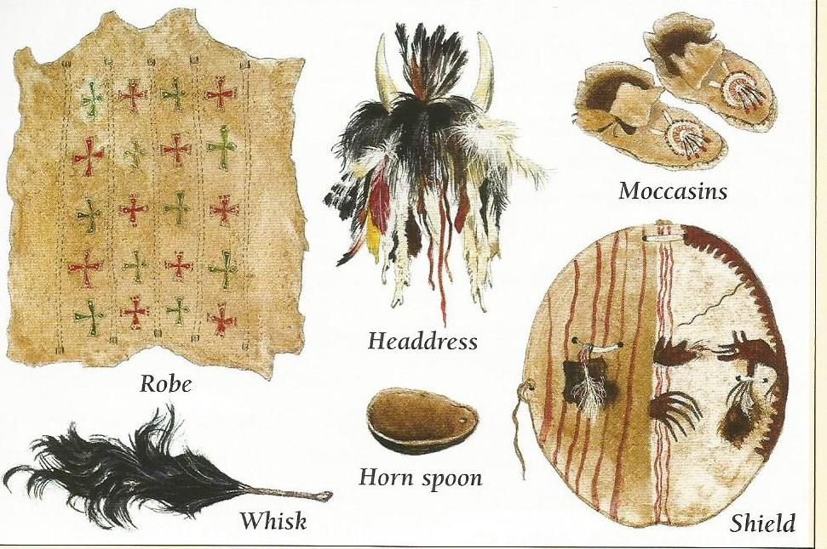
What use of animal can you see?
Which animal do you think these items came from?
Notes:
Pg 21

Slide 14
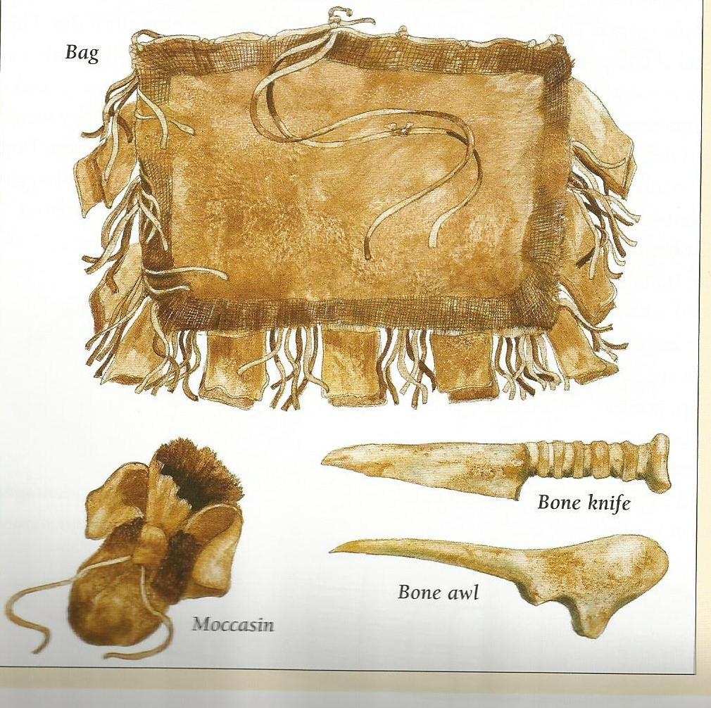
Which animal parts and which animal do you think these items were made from?
Notes:
Pg 33

Slide 15
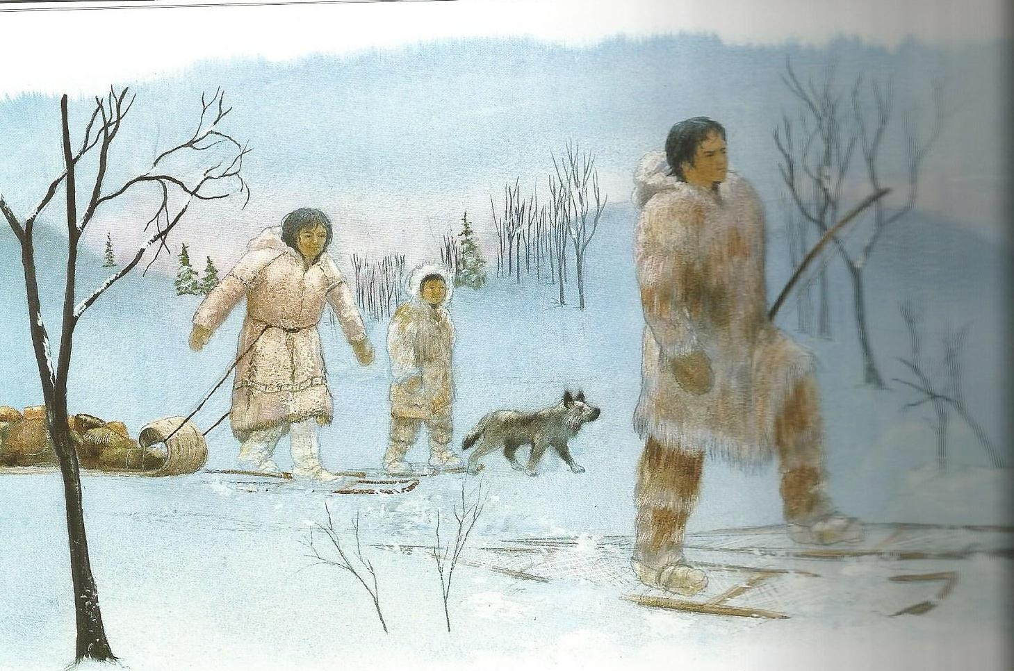
What use of animal can you infer?
Notes:
Pg 34

Slide 16
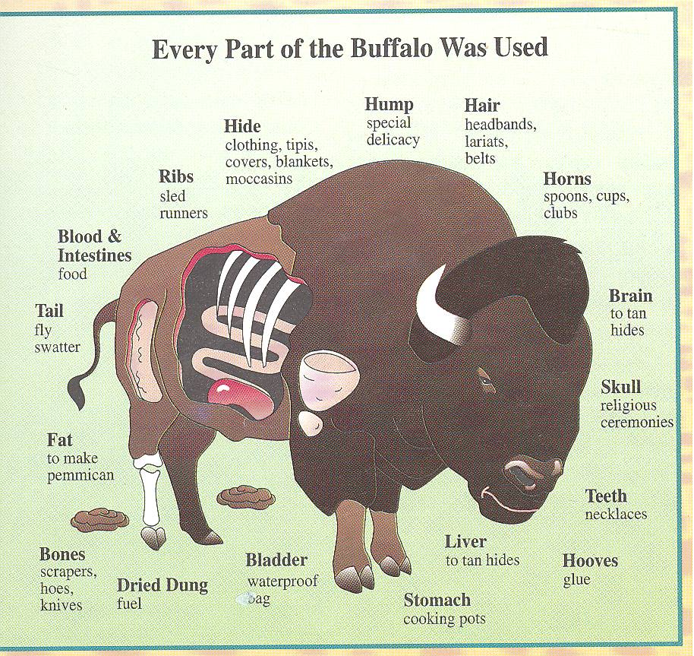

Slide 17
Final Question/Ticket out the Door:
What can you say (in one sentence or less!) to sum up how Aboriginal people traditionally used animals?

