Slide 1
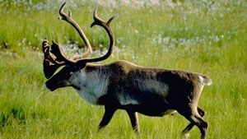
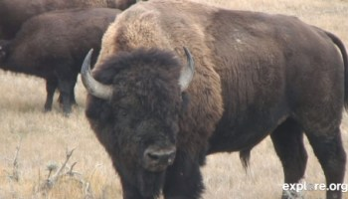
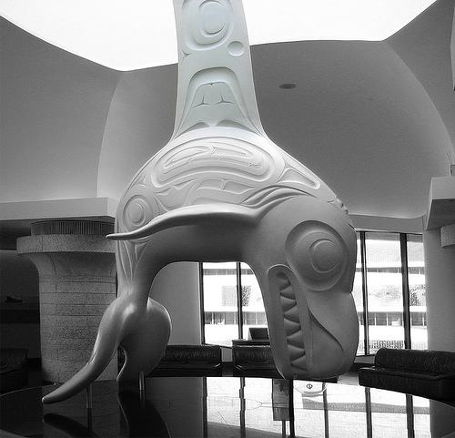
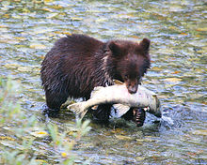
How are animals important to Aboriginal people?
Notes:
Ask students if they can identify any of the animals in the picture?
Left top: caribou (an important food source to many First Nations and Inuit people), bison (main resource of First Nation of the prairies and plains), Totem poles in front of the new K’omoks First Nation administration building depticting animals that represent the 4 clans of the K’omoks people, whale carving, bear and salmon.

Slide 2
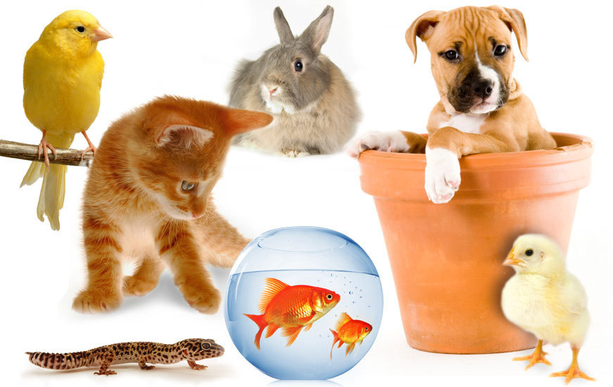
What is the relationship between animals and people.
Notes:
People use animals as pets, for companionship and comfort

Slide 3
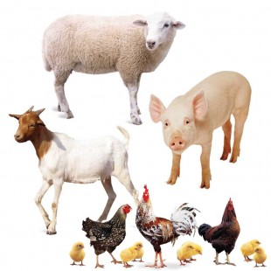
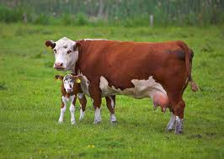
What is the relationship between animals and people.
Notes:
People use animals on the farm, for meat, milk. Eggs and to help work the farm.

Slide 4
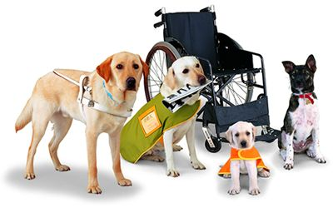
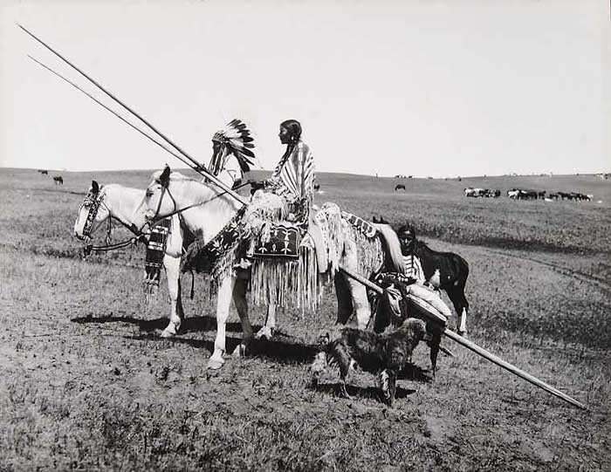
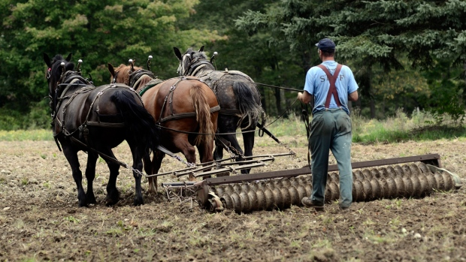
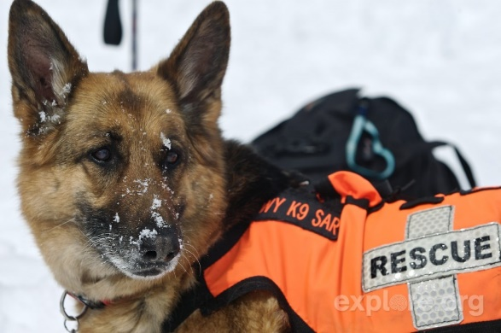
What is the relationship between animals and people.
Notes:
People use animal to help them with jobs: seeing eye dogs, rescue dogs, avalanche dogs, pack horses, plow horses etc.

Slide 5
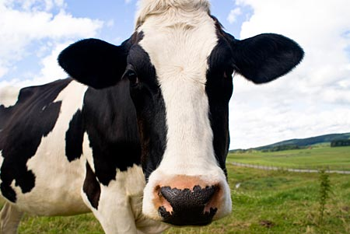
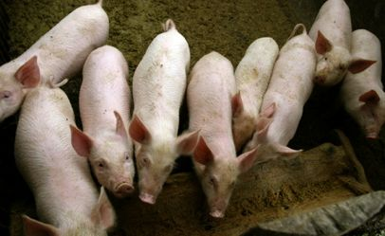
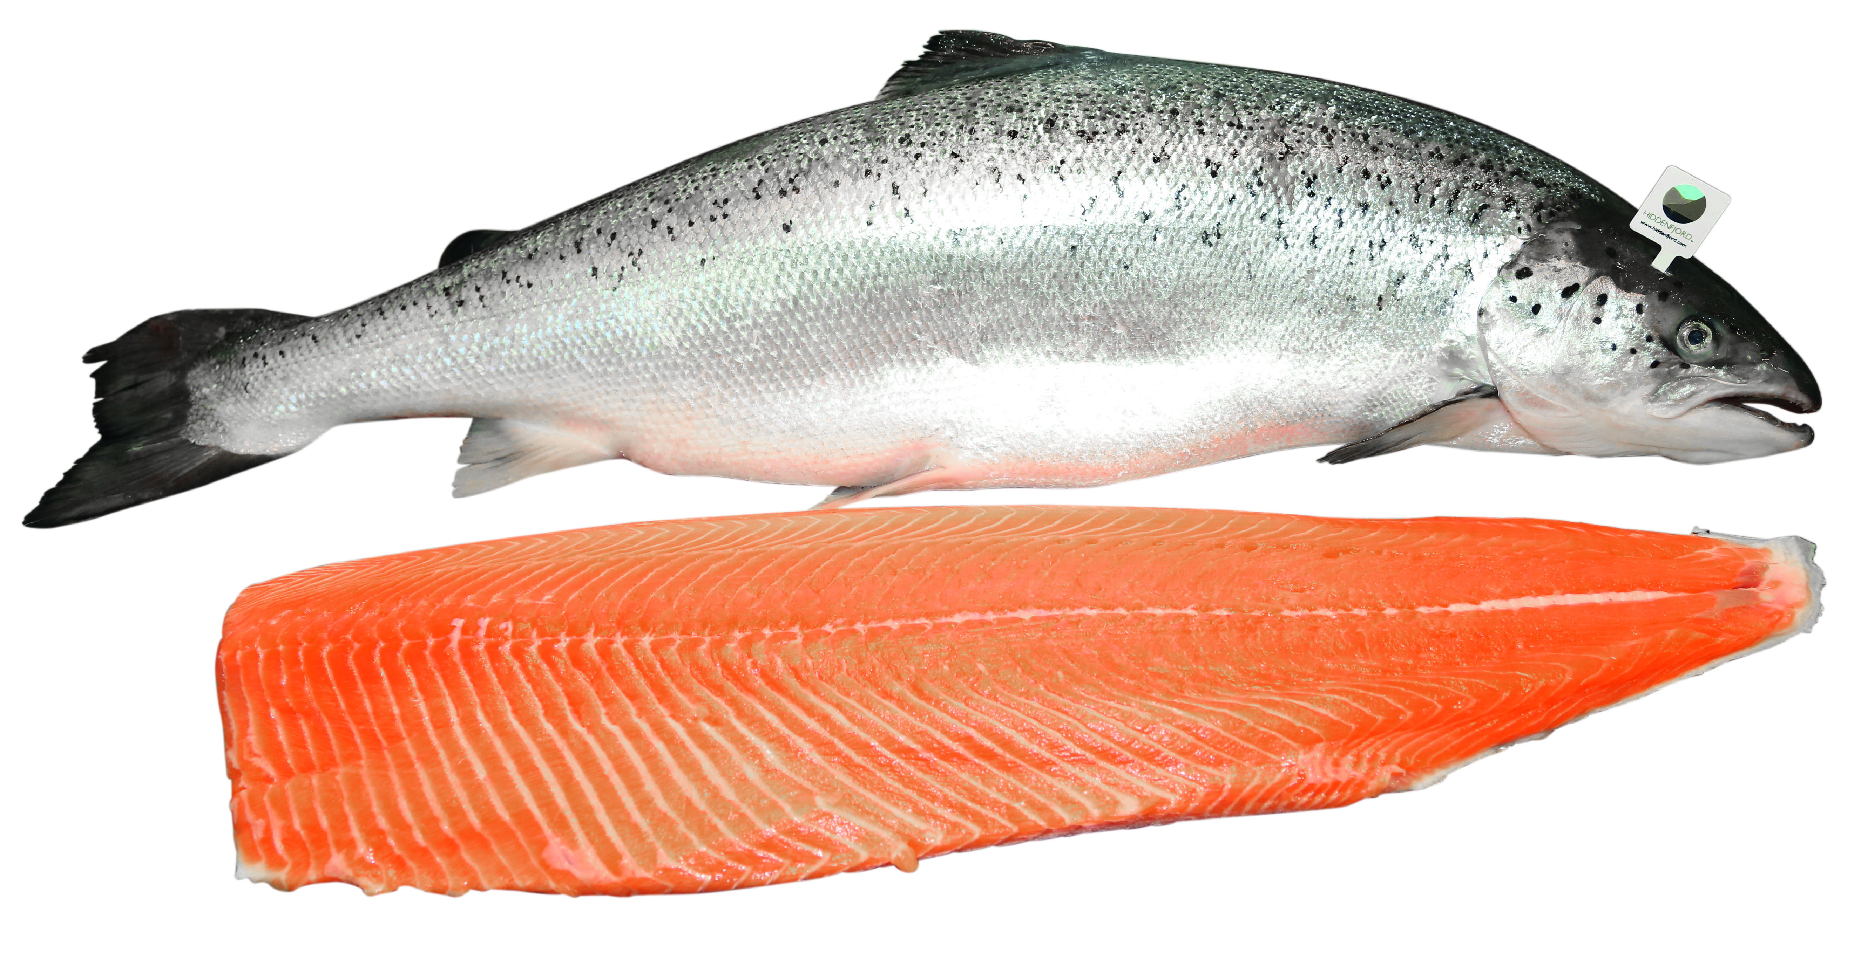
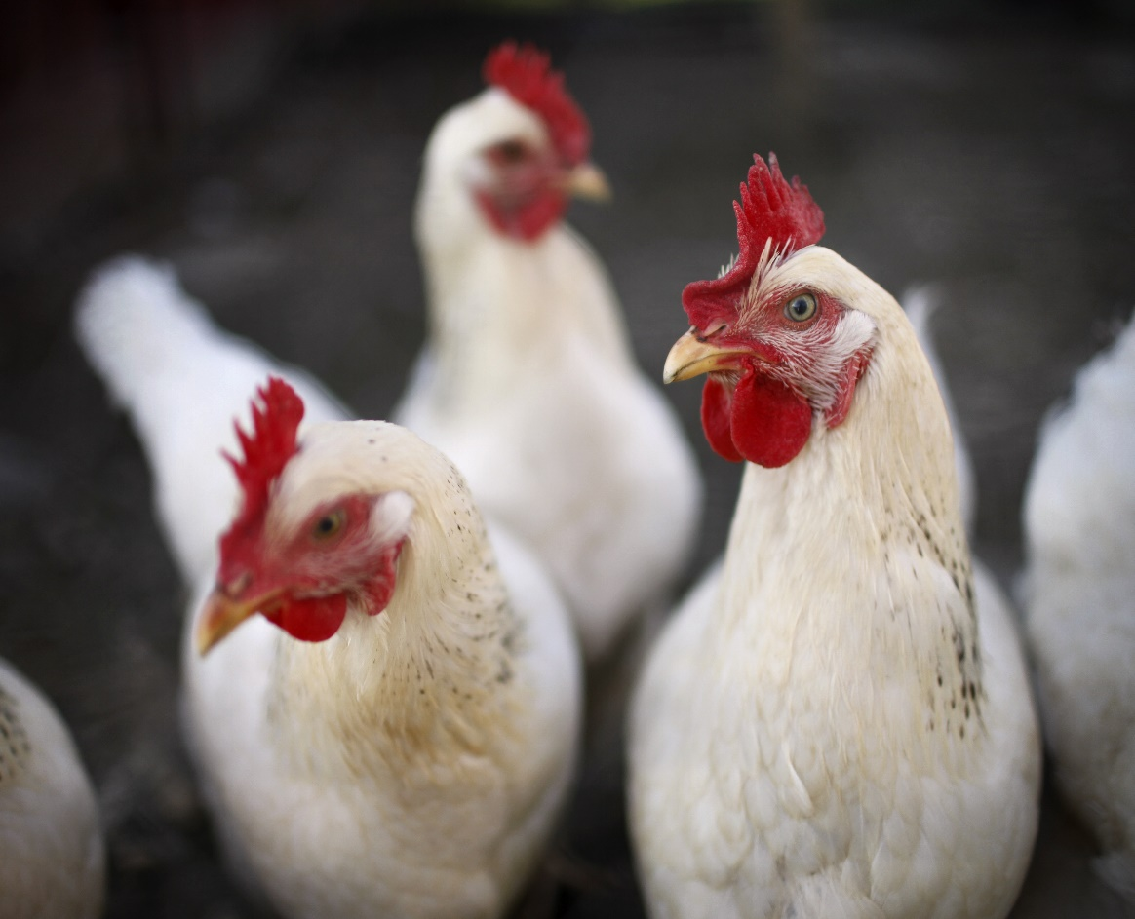
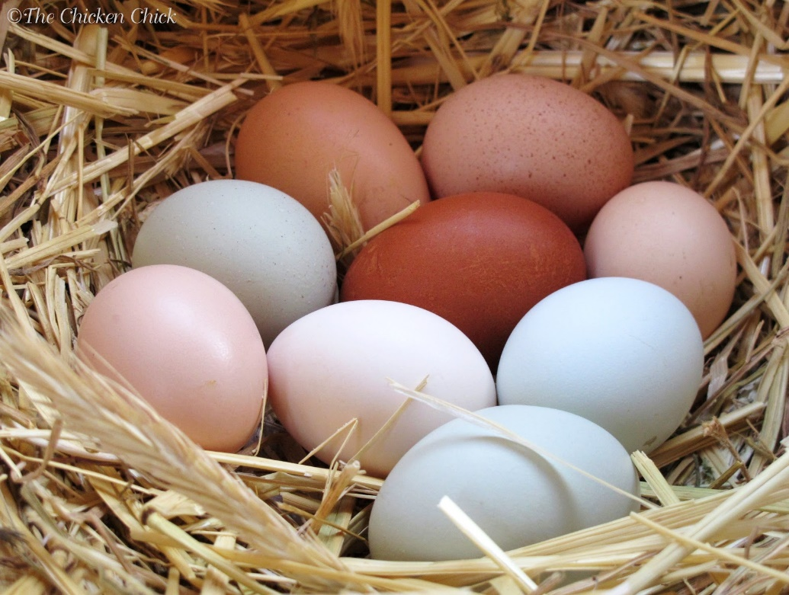
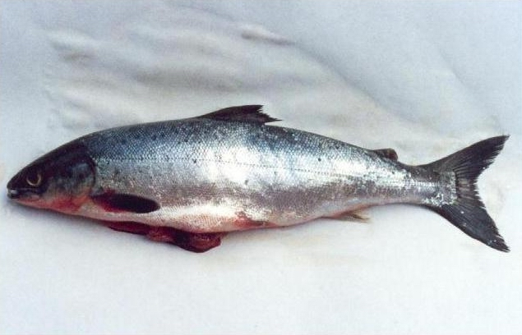
What is the relationship between animals and people.
Notes:
People use animals as food. Steak, bacon, ham, chicken nuggets, scrambled eggs etc. all come from animals.

Slide 6
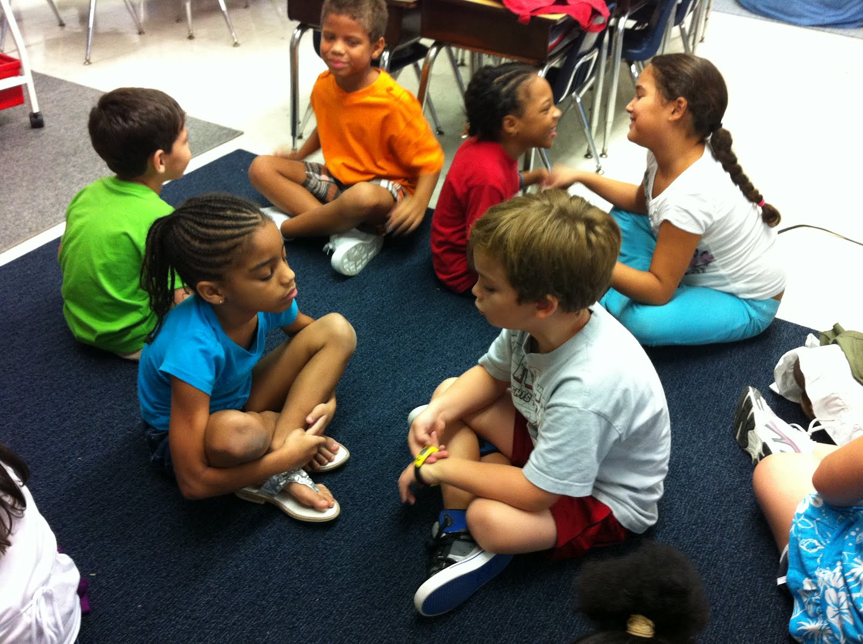
Turn and Talk to a partner: What are all the ways that animals are important in your life?

Slide 7
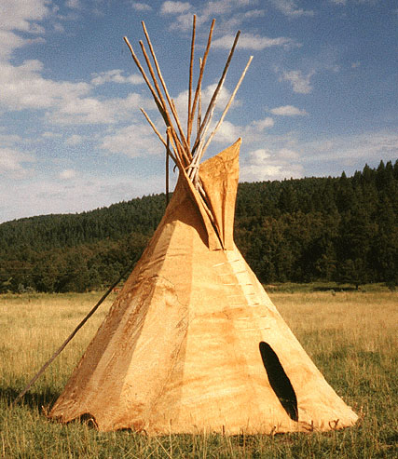
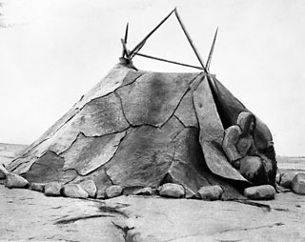
Animals have also been important in the lives of Aboriginal people in the past and today.
Animals were used for shelter.
What part of an animal do you think is used to cover this teepee?
Inuit home covered with caribou hide.
Notes:
Aboriginal people have used animals to help them survive for many, many years. They give thanks to the animal for giving its life so that they survive.
Aboriginal people used all parts of an animal if they killed it. They used animal meat as food, used the bones and antlers for tools and weapons, used the hides for shelter and clothing, sinew for rope and snowshoes.

Slide 8
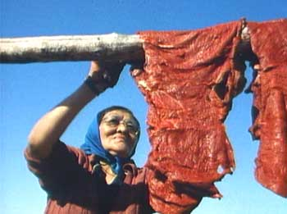
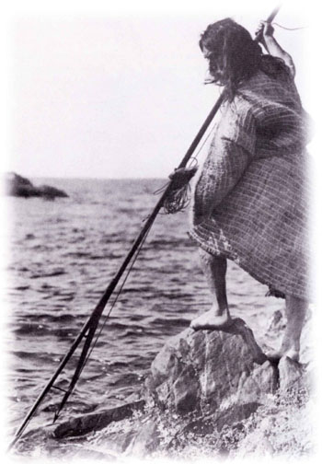
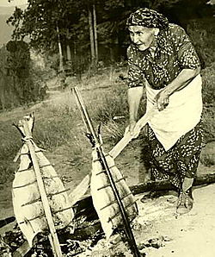
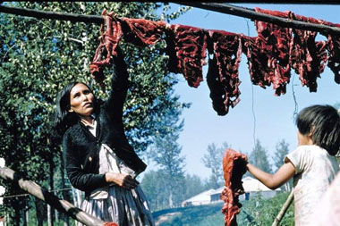
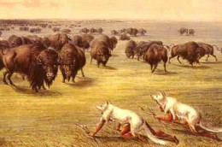
Animals were used for food.
Notes:
Animals were the main food source for First Nations people. As hunters and gatherers, First Nations people followed a seasonal round. They harvested food (caribou, bison, deer, fowl, fish, shellfish, small mammals, whale, urchins etc) in season and dried and preserved it for winter use.

Slide 9
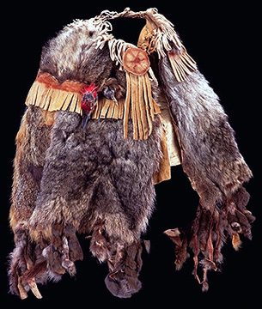
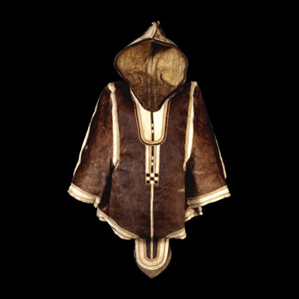
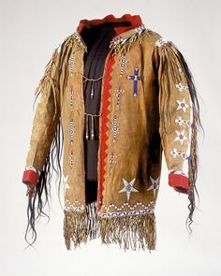
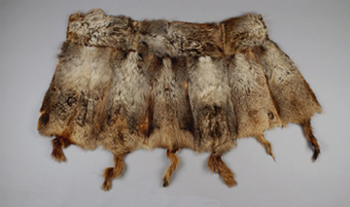
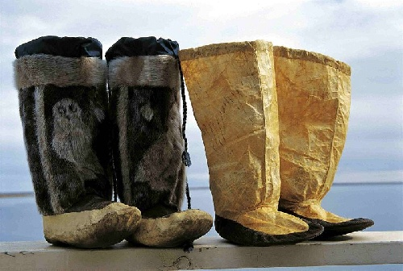
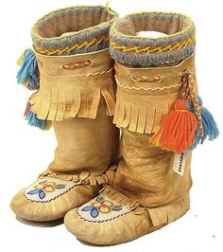
Animals used for clothing.
Notes:
Animal hides, furs and sinew were used to make clothing.

Slide 10
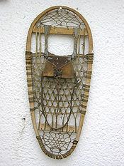
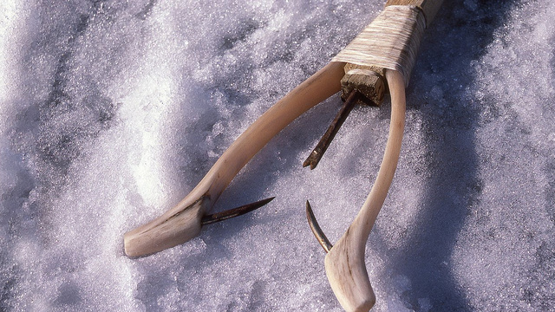
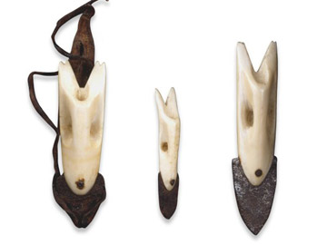
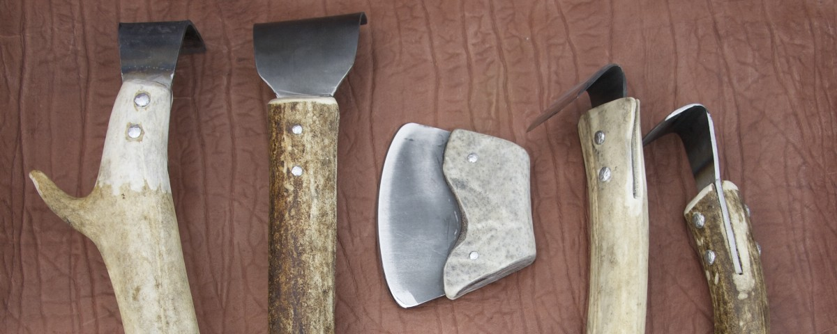
Animals used for tools and technology.
Snowshoes were made out of dried hides called rawhide. They also used animal sinew to sew parts of the snowshoes together.
Notes:
Animal bones, antlers and sinew were used to make tools and weapons.

Slide 11
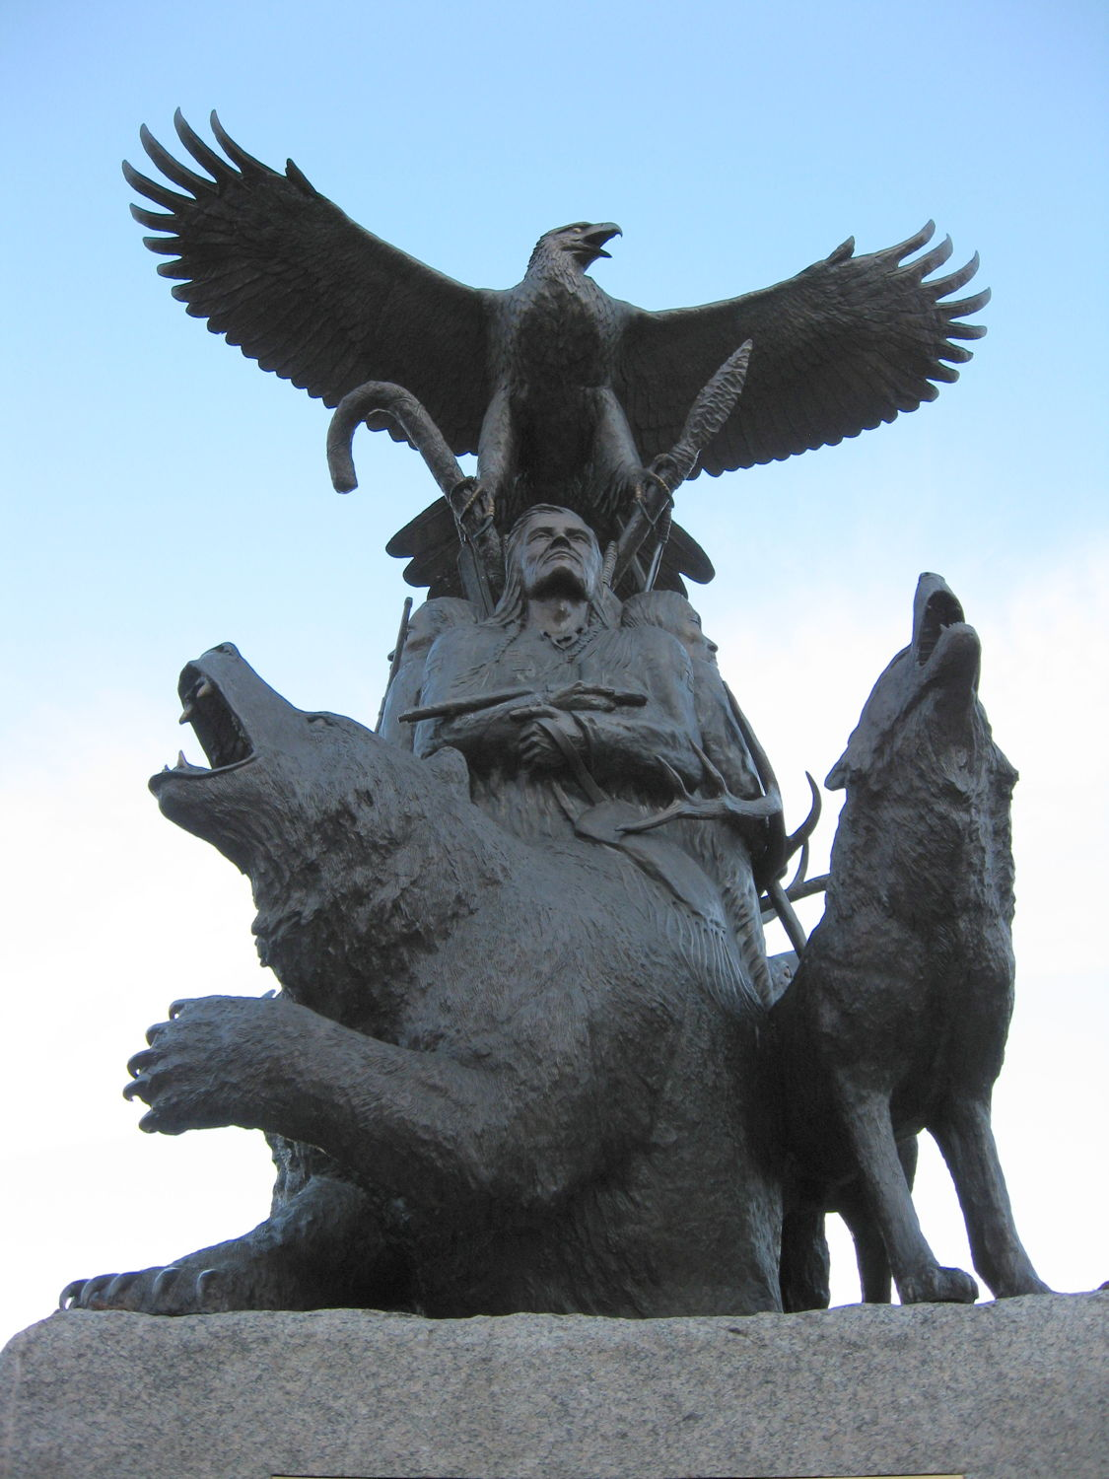
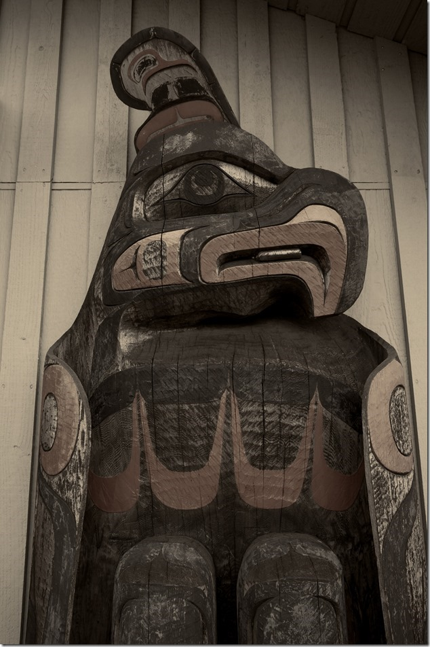
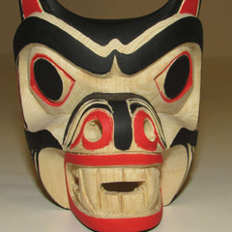
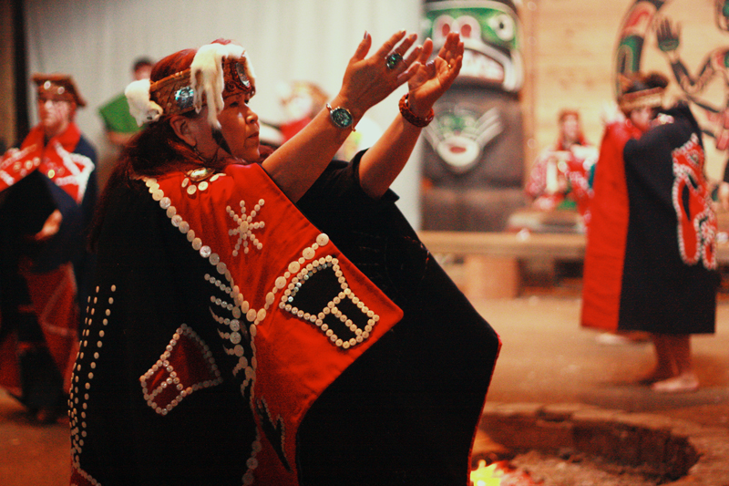
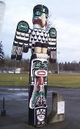
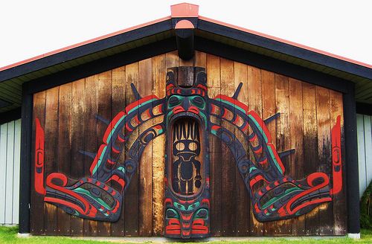
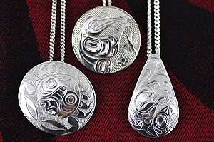
Importance of animals reflected in Aboriginal art.
Notes:
Animals are so important to Aboriginal people that they show up in carvings, monuments, totem poles, jewelry, on button blankets and visual arts.

Slide 12
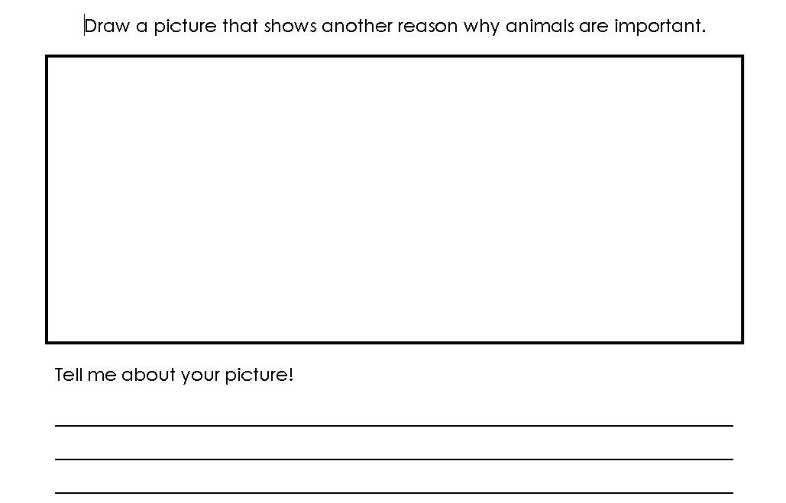
Notes:
Print off and have students journal about how animals are important in their lives.

