Slide 1
Northwest Coast Animal Symbols and Kwak’wala
Presentation by Shannon Campbell

Slide 2
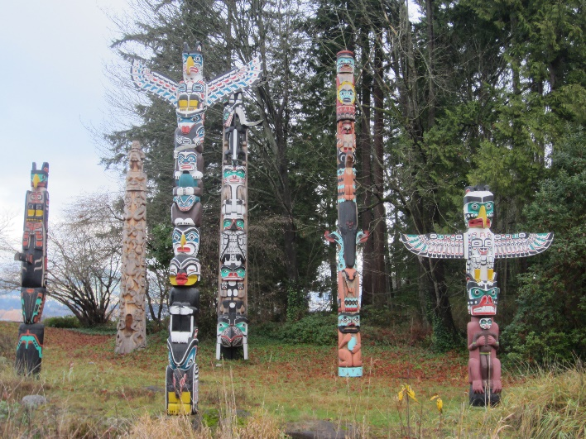
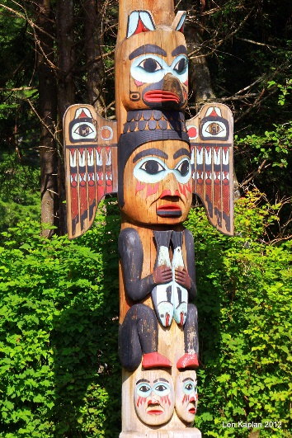
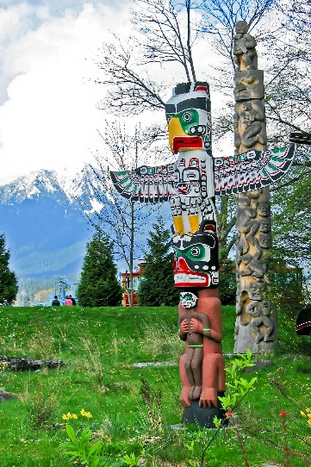
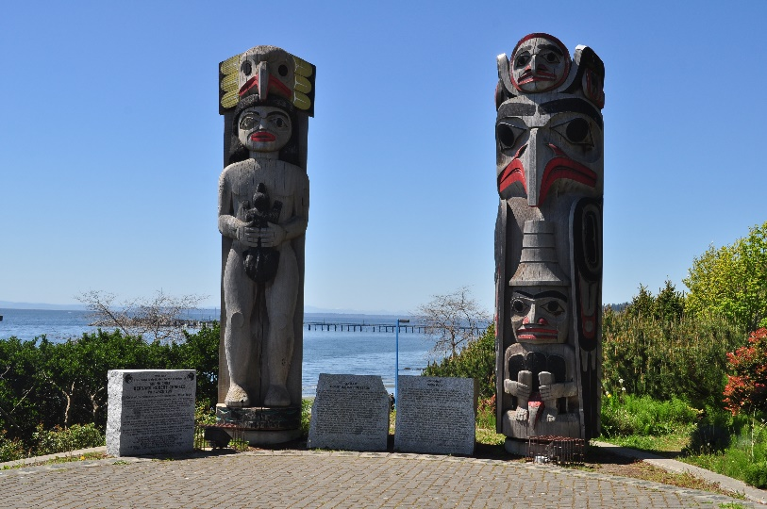
Animal Symbols
Different animals symbolize and represent human traits, values and characteristics
On totem poles, animals represent families or clans and are used to tell a story

Slide 3
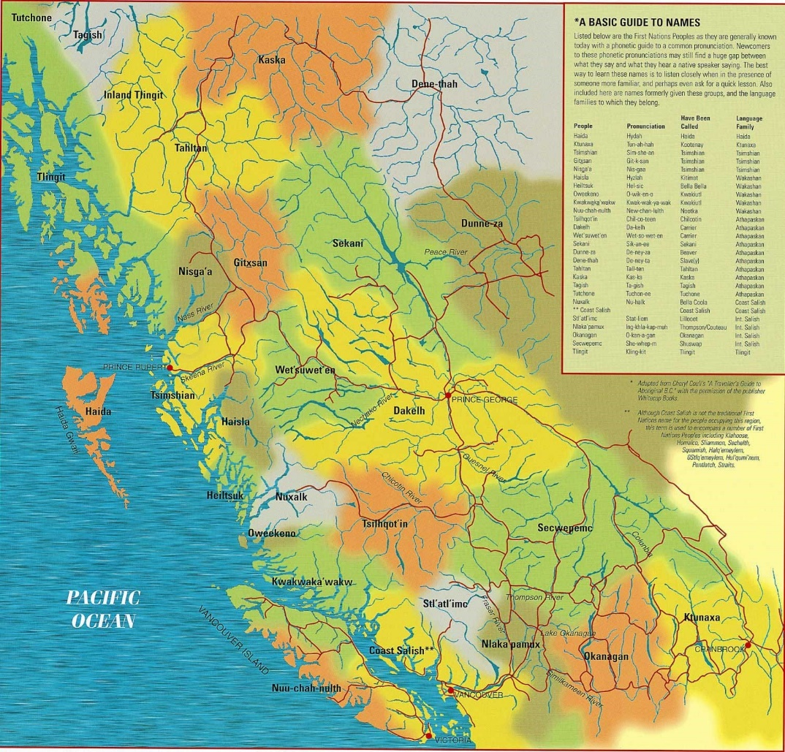
Kwak’wala Language
Spoken by the Kwakwaka’wakw people
The K’omoks people have adopted this language
K’omoks means “the land of plenty” in Kwak’wala

Slide 4
Beaver t̕sawi
Creative
Artistic
Determined

Slide 5
Black Bear t̕ła'yi
Strength
Learned Humility
Motherhood
Teaching

Slide 6
Bumblebee ha̱mdzalat̕si
Honesty
Pure Thinking
Willingness
Drive

Slide 7
Dogfish x̱wa̱lǥwa̱m
Persistence
Strength
A Born Leader

Slide 8
Dove / Pigeon ha̱'mu
Love
Gentleness
Kindness

Slide 9
Dragonfly mamak̕wa
Ever-Changing Life

Slide 10
Eagle kwikw
Great Strength
Leadership
Prestige

Slide 11
Frog wa̱ḵ̓es
New Life
Communicator
Stability

Slide 12
Halibut p̓o'yi
Life Protector
Strength
Stability

Slide 13
Hawk mama’na
Strength
Far Sighted

Slide 14
Heron
Patience
Graceful
Easy Going

Slide 15
Hummingbird k̕wa̱'ak̕wa̱mt̕a
Love
Beauty
Intelligence
Spirit Messenger

Slide 16
Killer Whale max̱'inux̱
Traveller
Guardian
Symbol of Good

Slide 17
Kingfisher k̓a̱da̱lawi
Luck
Patience
Speed
Agility

Slide 18
Loon x̱awi
Peace
Tranquility
Generous Giving Nature

Slide 19
Otter x̱wa̱mdi
Trusting
Inquisitive
Bright
Loyal Friendship

Slide 20
Owl da̱xda̱xa̱lułamł
Wisdom

Slide 21
Raven ǥwa'wina
Creation
Knowledge
Bringer of the Light
Trickster

Slide 22
Salmon k̓uta̱la
Dependability
Renewal
Provider

Slide 23
Seal
Bright
Inquisitive
Organized

Slide 24
Thunderbird kwa̱nkwa̱nxwa̱lige‘
Powerful
Mystical
Leader

Slide 25
Wolf atła'na̱m
Intelligence
Leadership
Strong Sense of Family

