Slide 1
West coast trolling around Haida Gwaii.
Photo credits: Jesse Sewell, Roger Sewell, Gordon McMahon.

Slide 2
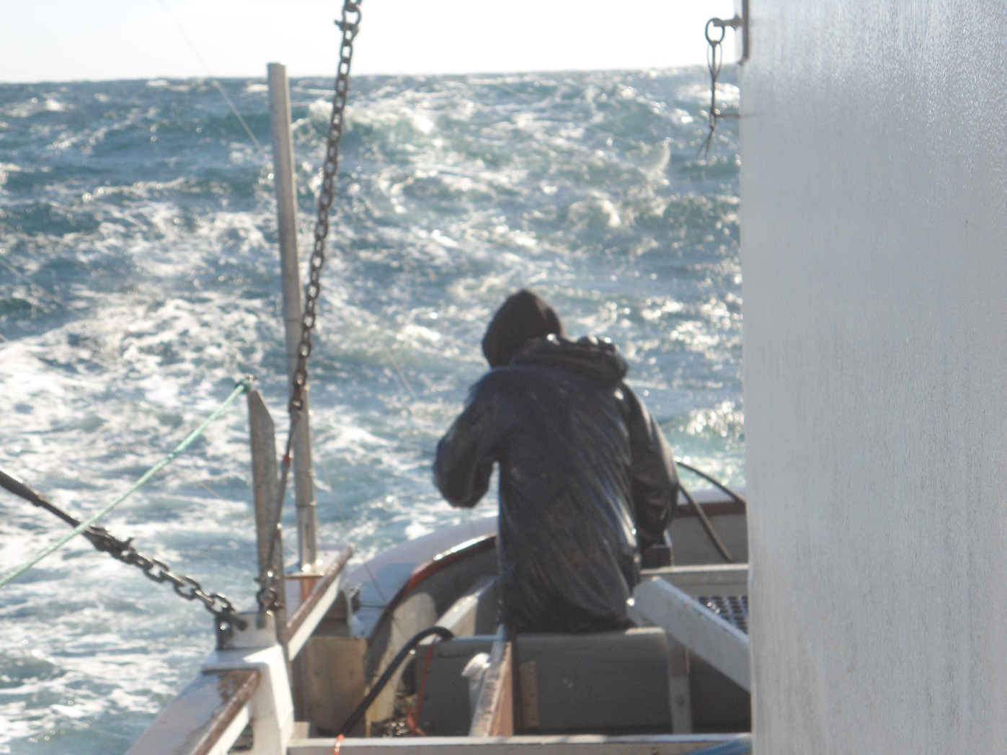
Trolling is hazardous and exciting. We fish in all kinds of sea conditions.

Slide 3
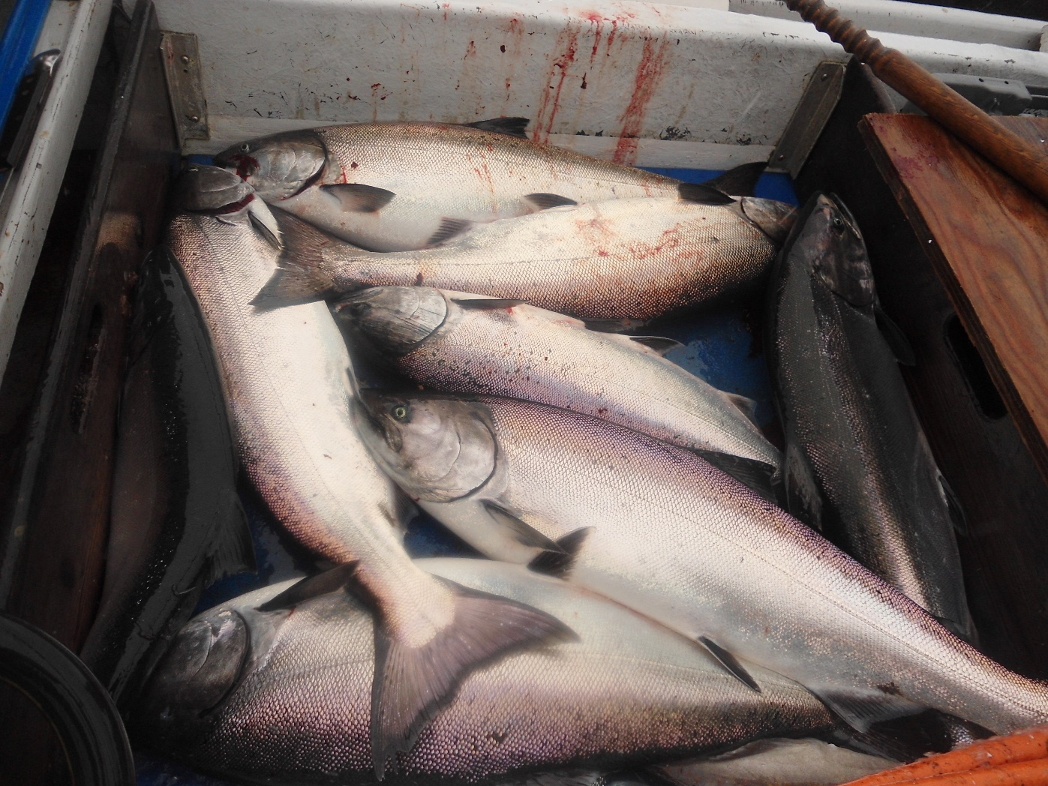
Spring, or chinook salmon are very valuable to trollers. They are strictly managed as a quota fishery.

Slide 4
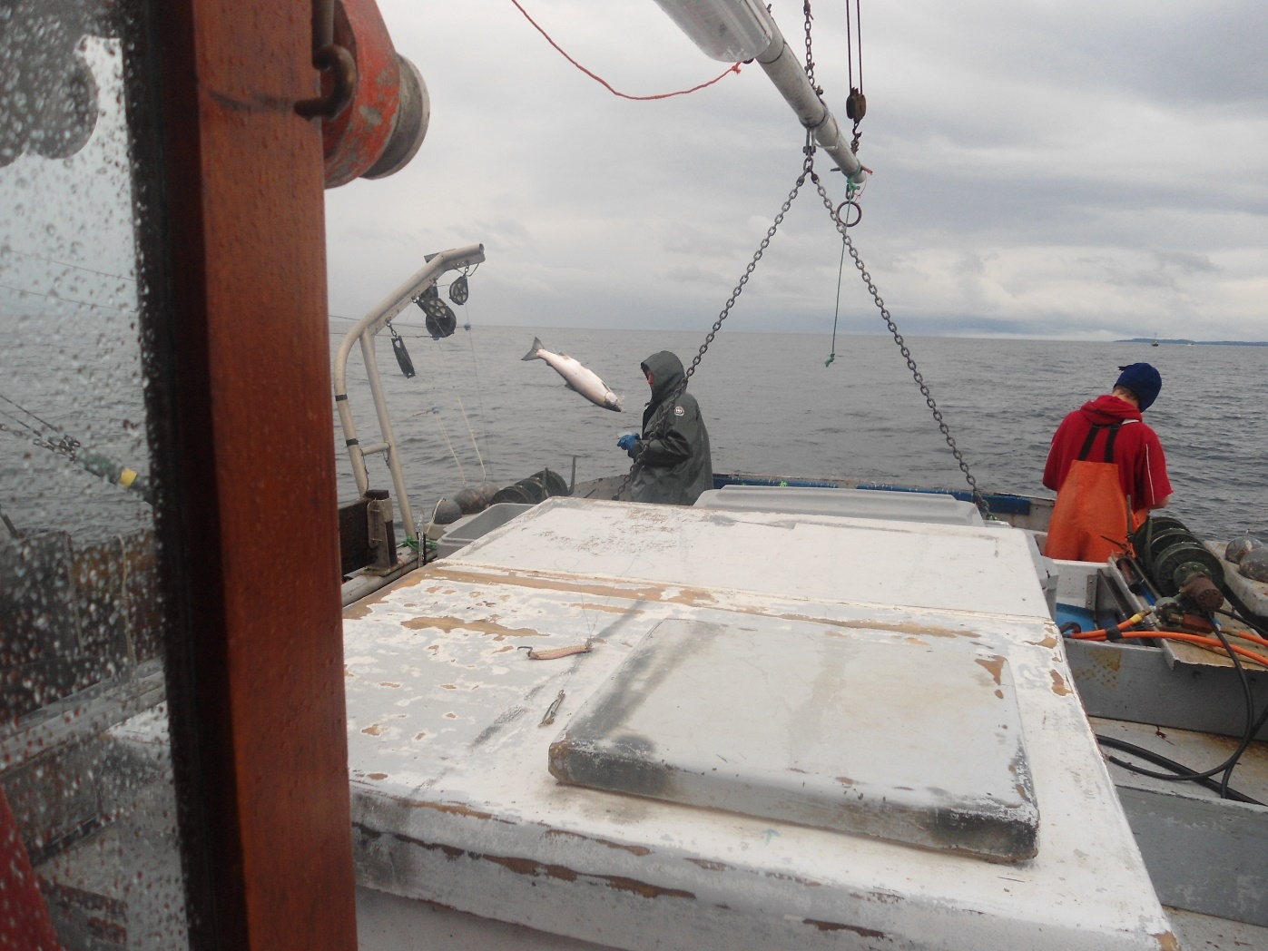
Each fish is caught individually on a barbless hook. If a fish is well hooked and not too large it can be simply lifted into the boat.

Slide 5
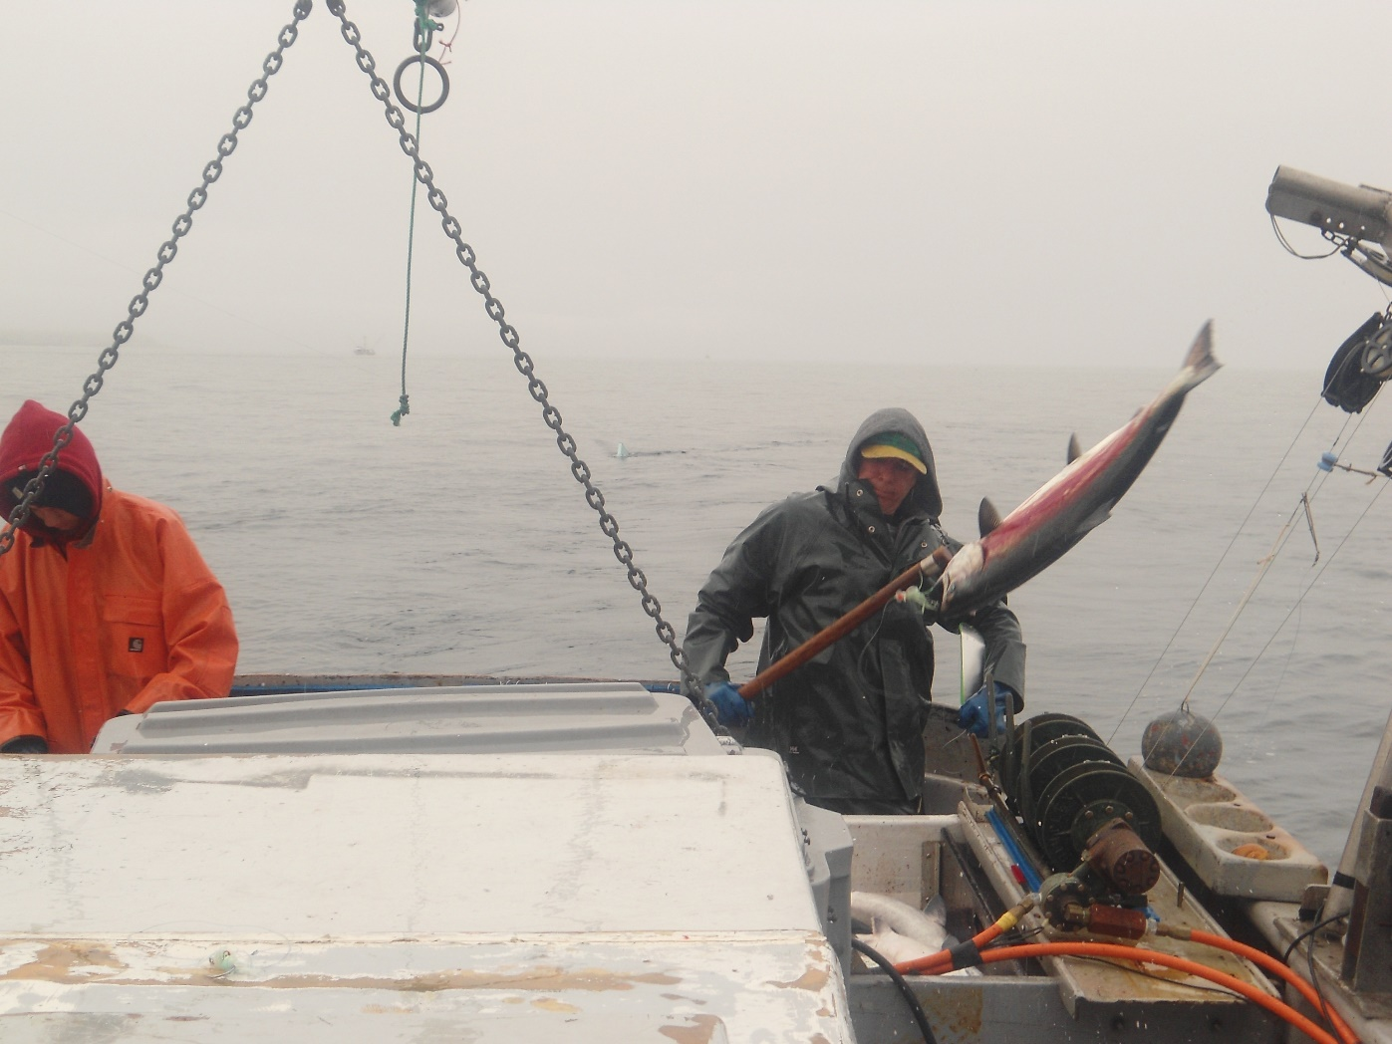
Larger fish must be landed with a gaff.

Slide 6
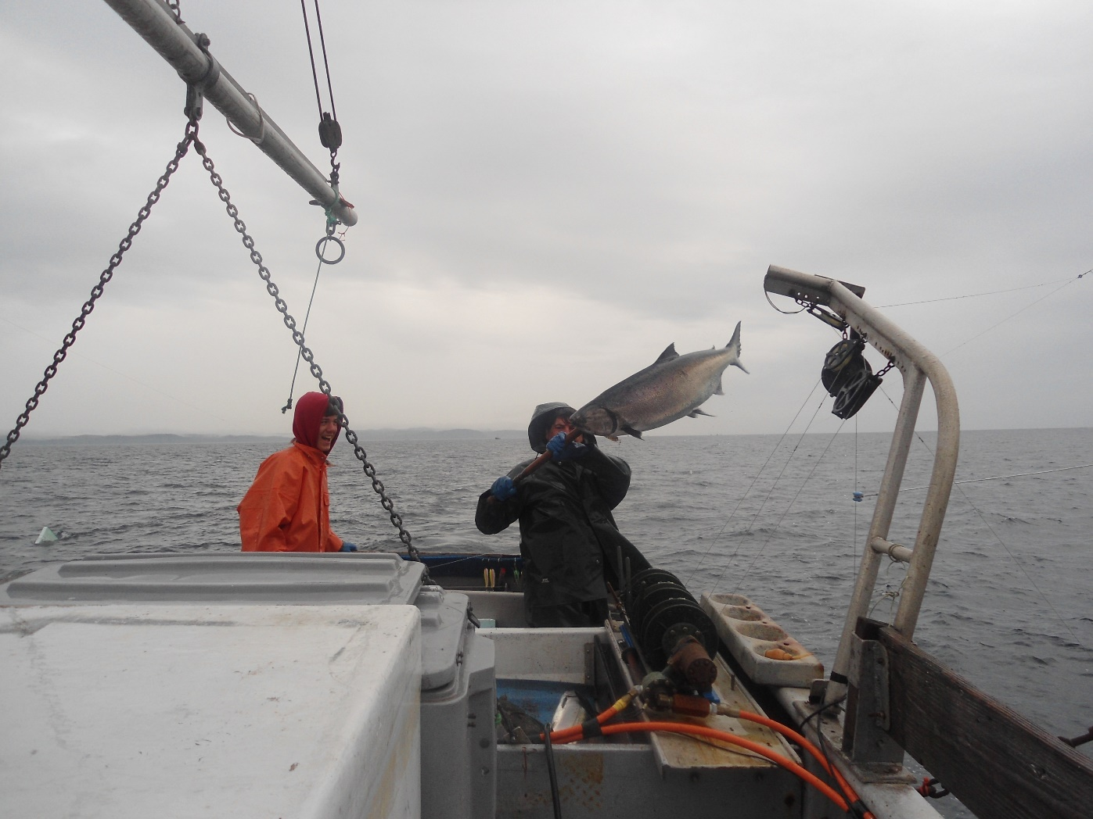
It takes lots of practice to acquire the skills needed to land a mature spring with just a hand held line and a gaff.

Slide 7
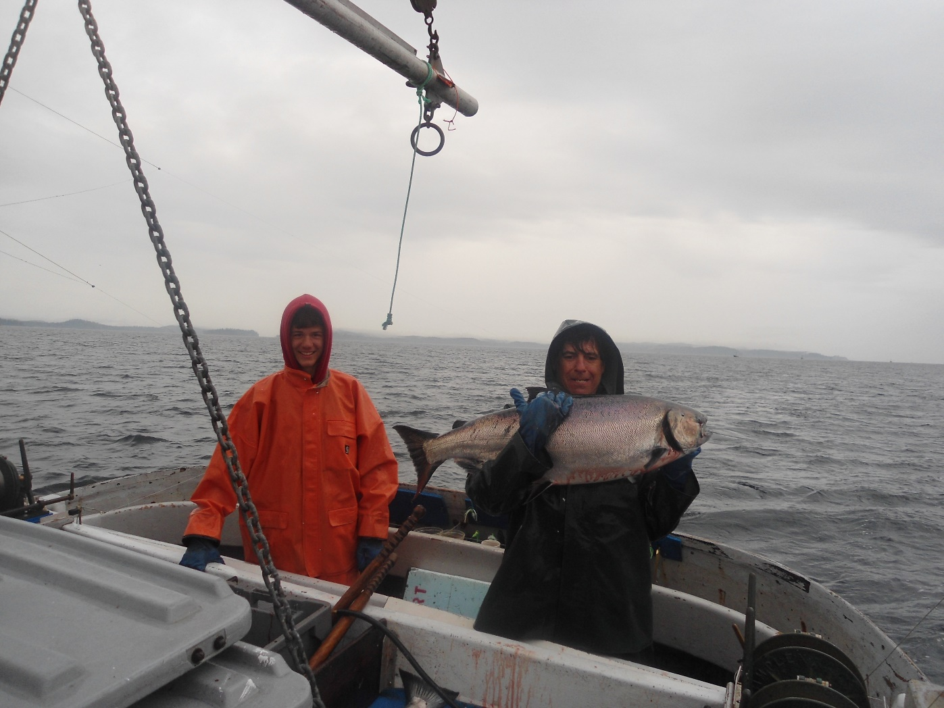
In the jargon of the industry a spring over 12 pounds dressed weight is called a “smilie” because the crew can’t help but grin at such a beautiful catch.

Slide 8
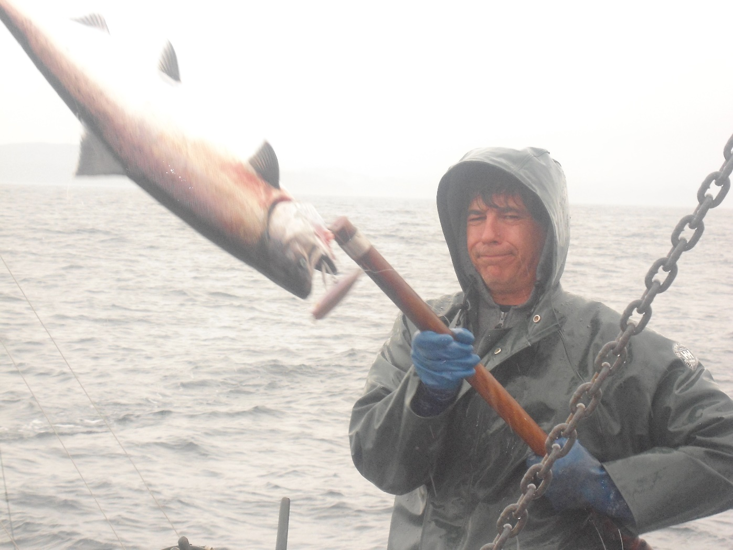
This one bit a plug, a lure that imitates a large herring.

Slide 9
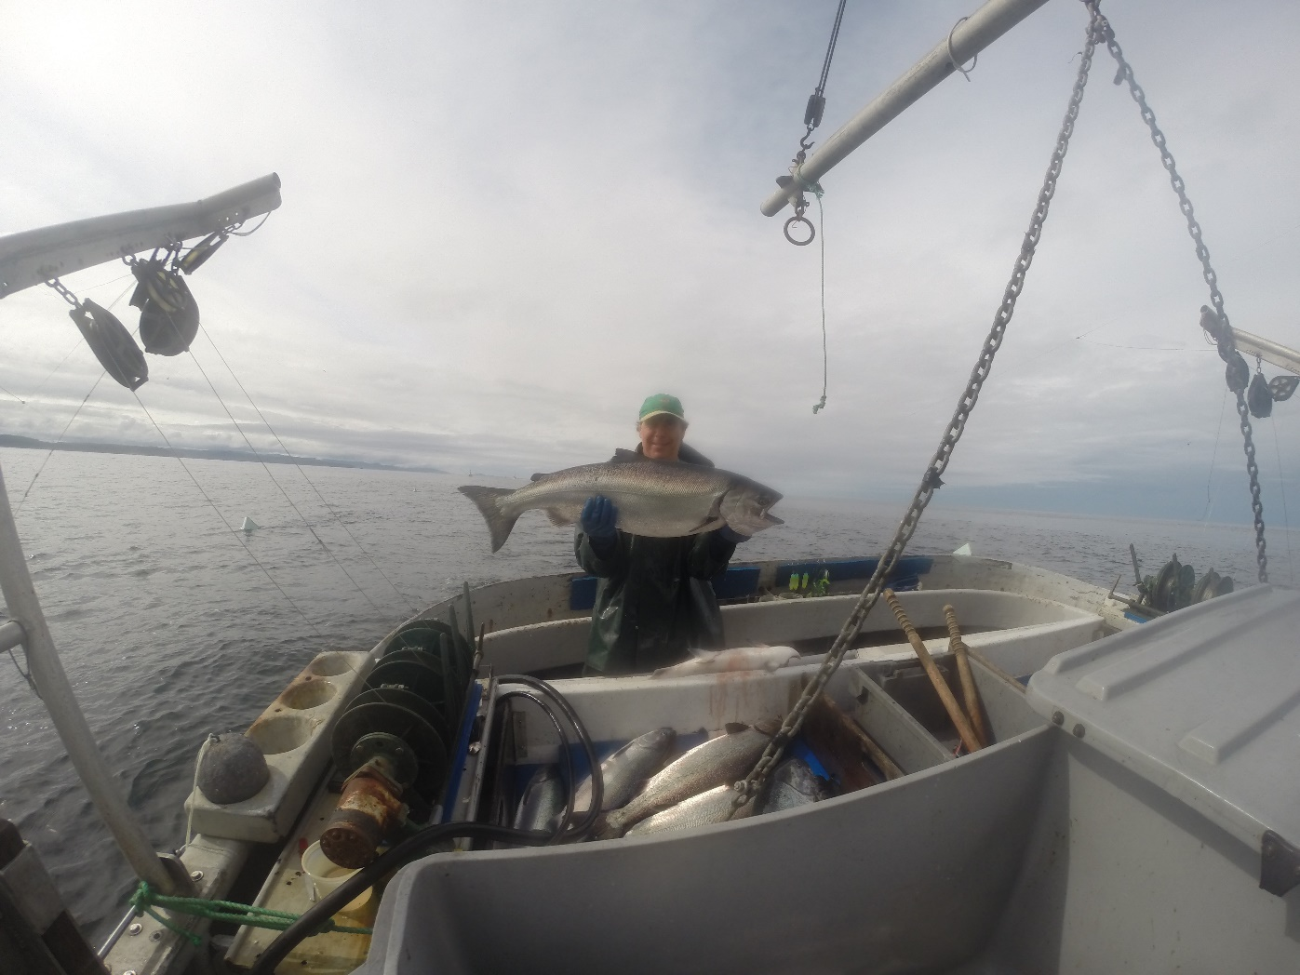
Springs usually bite best early in the morning and late in the evening.

Slide 10
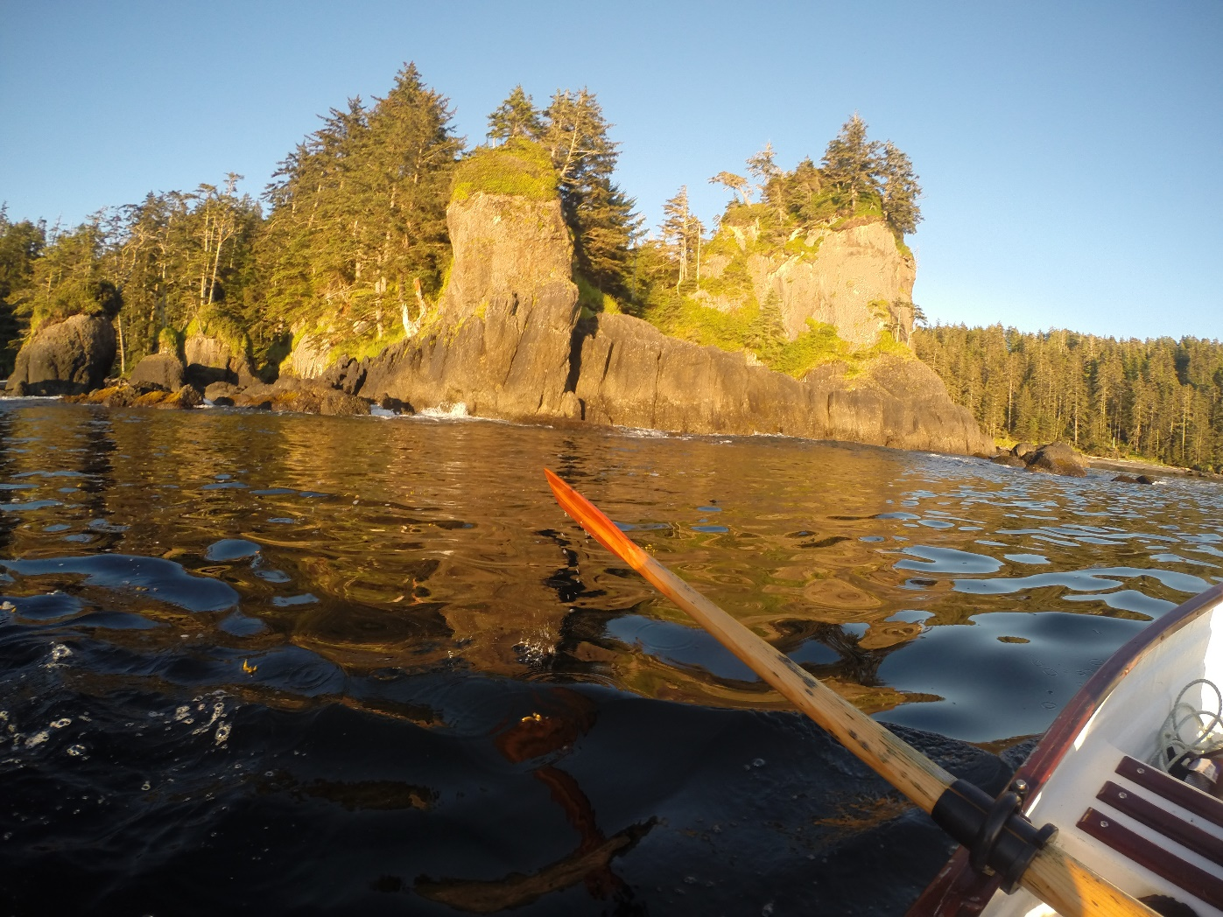
Cloak Bay was ground zero of the sea otter fur trade in the 19th century.

Slide 11
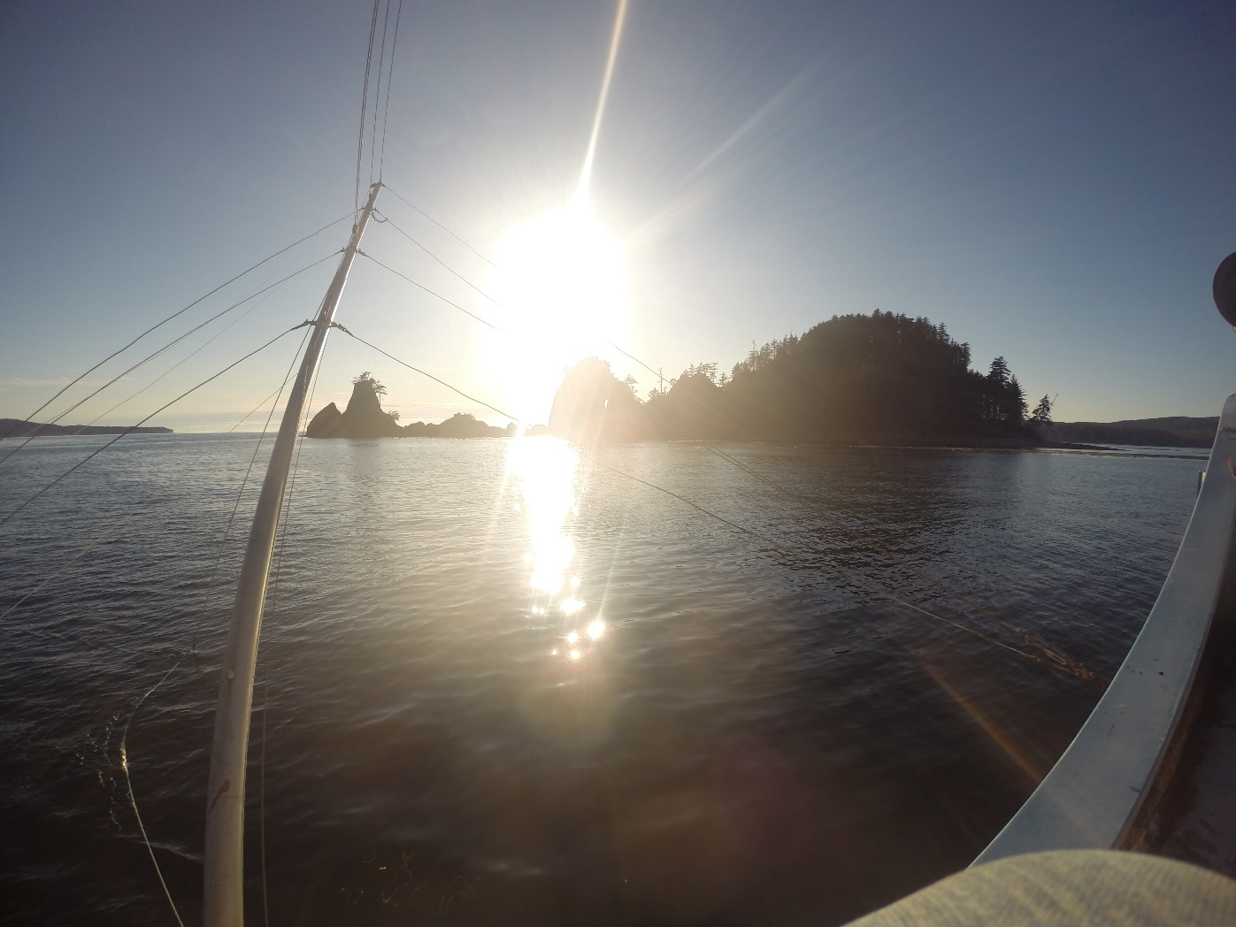
It affords marginal protection from the wild ocean on the west side of Haida Gwaii.

Slide 12
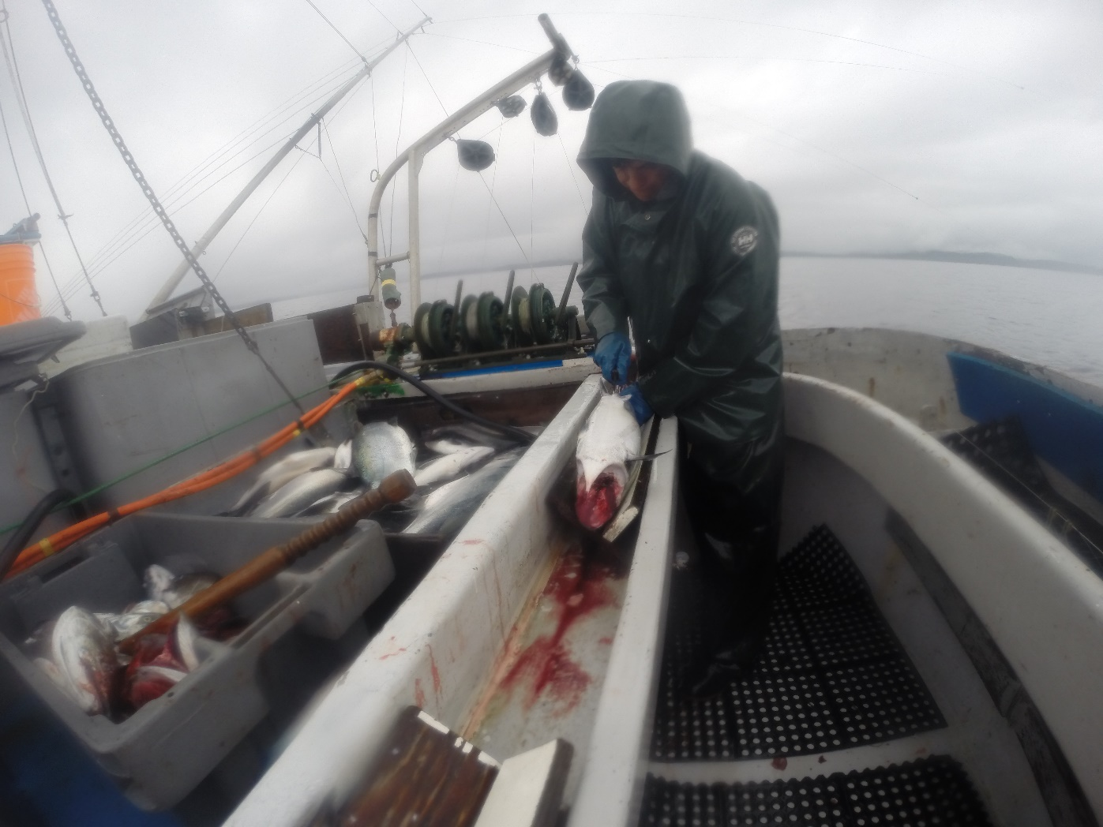
Dressing the catch before it is flash frozen is a big part of the crew’s daily work.

Slide 13
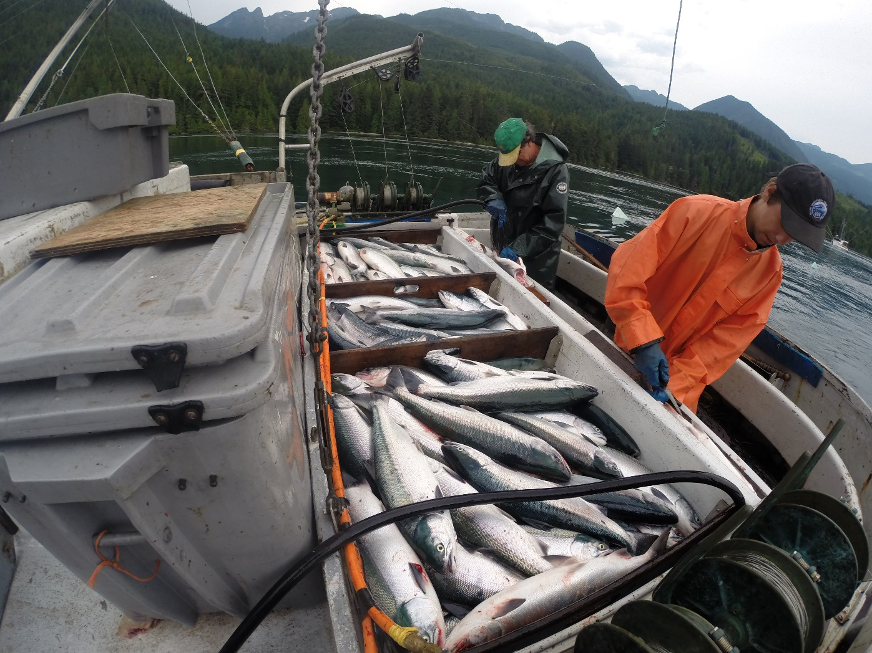
Sockeye bound for the Fraser River are often an important part of the troll season.

Slide 14
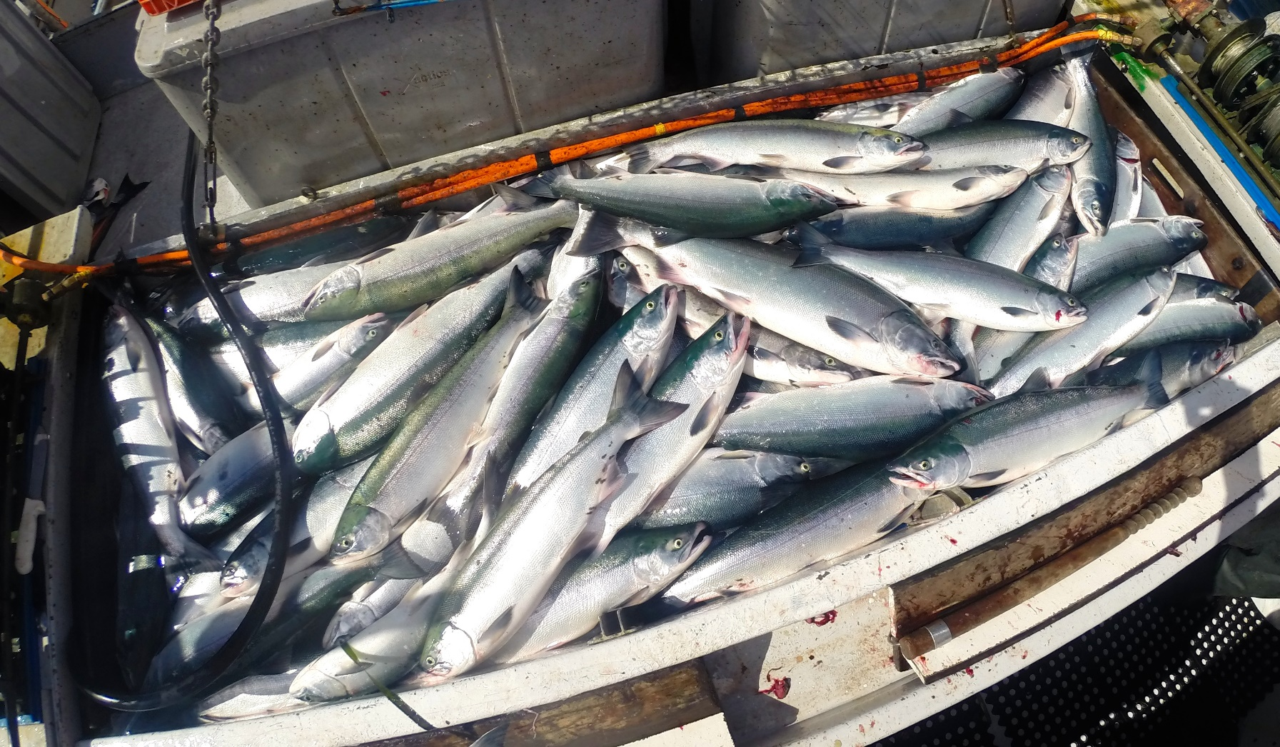
These prime Adams River sockeye were caught in Johnstone Strait near Alert Bay.

Slide 15
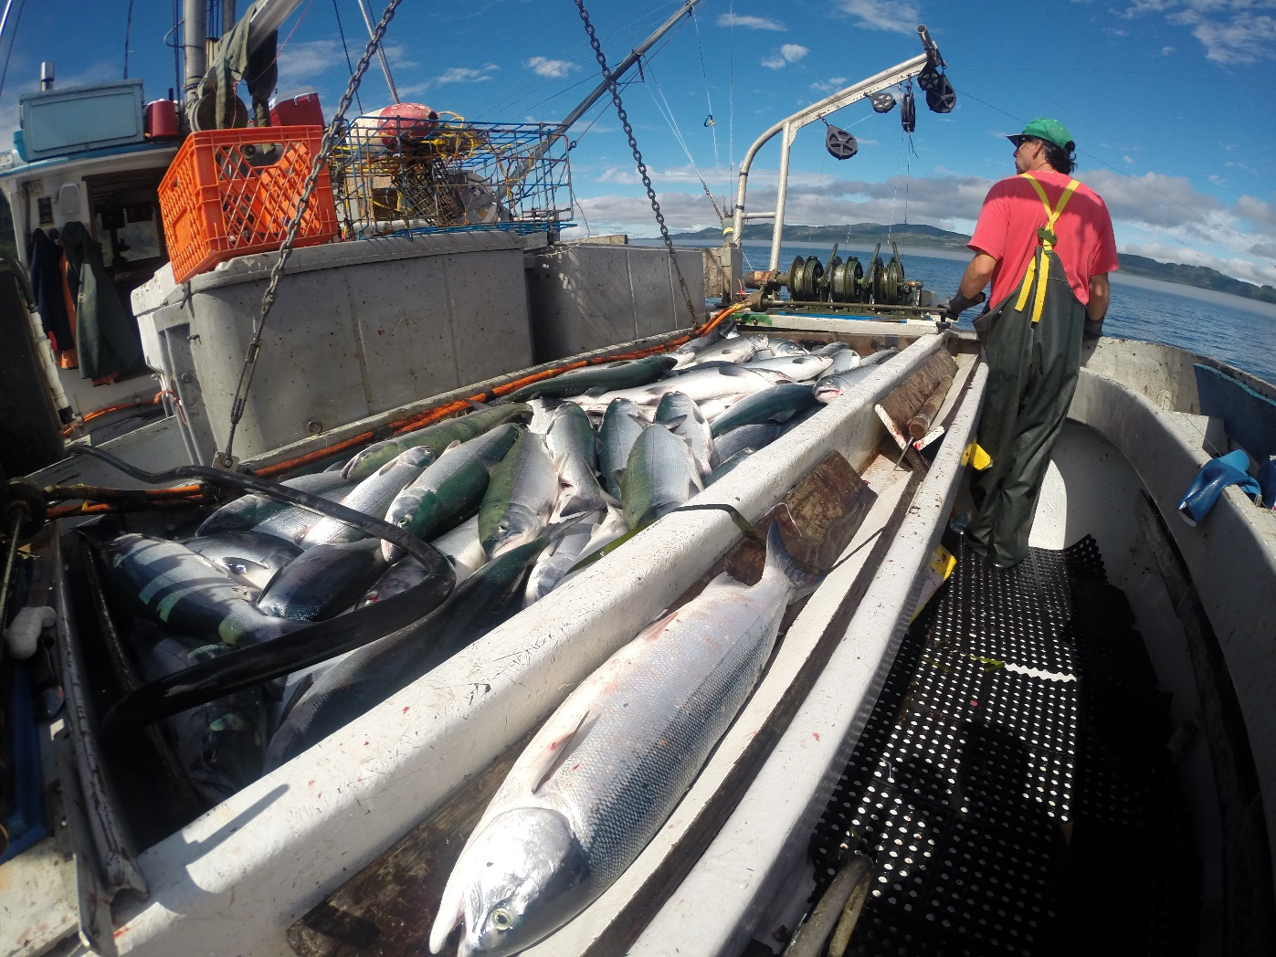
Sockeye are prized by chefs and fish lovers for their rich oil content and deep red flesh.

Slide 16
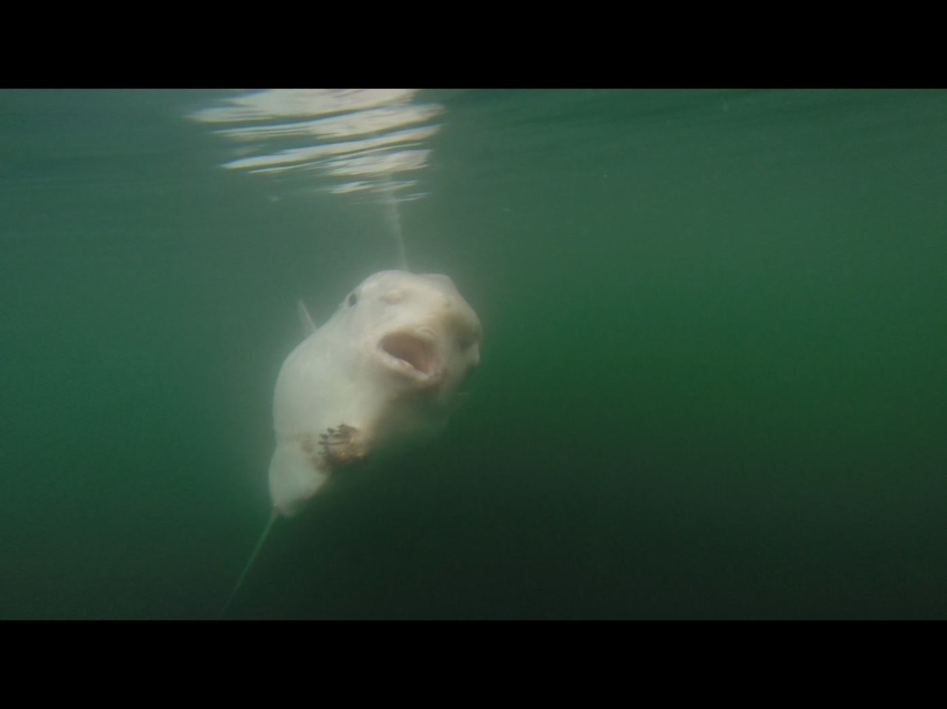
We see many strange and wonderful sea creatures during a season.

Slide 17
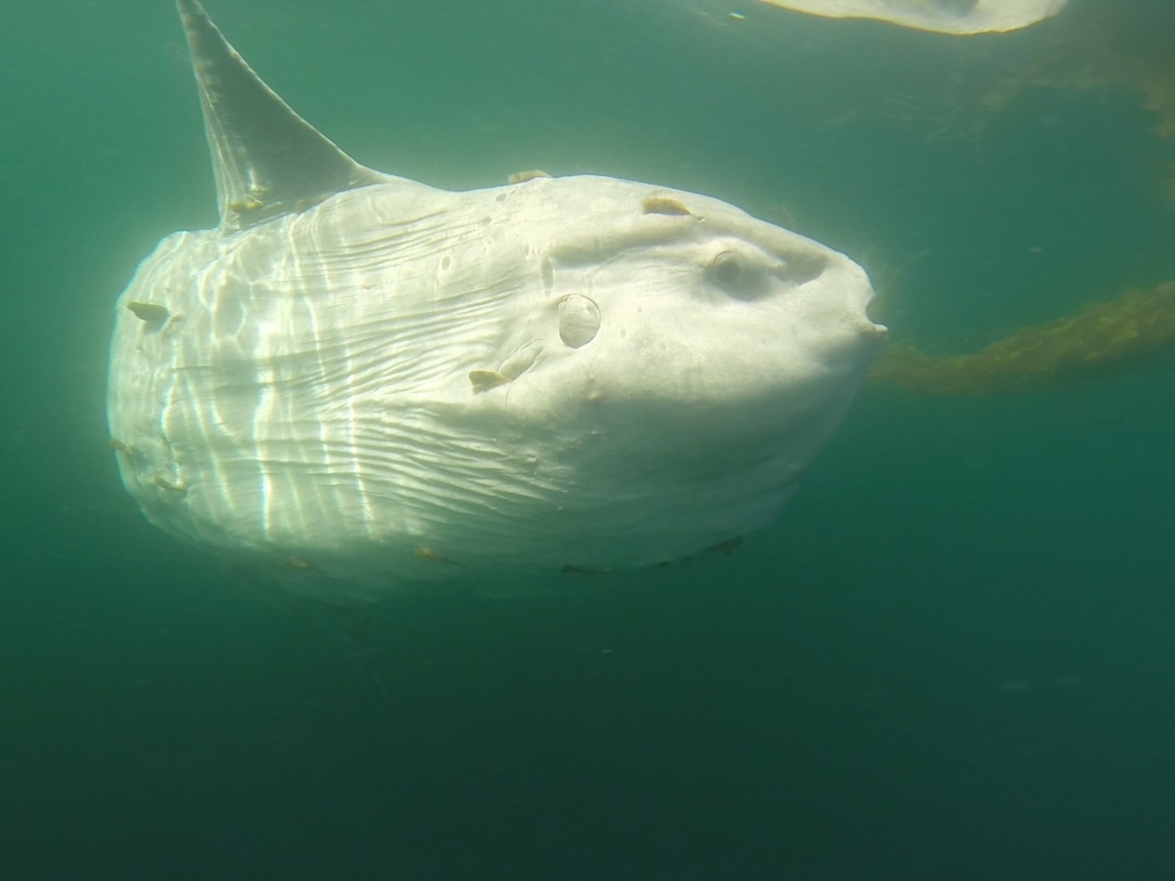
Ocean sunfish, or mola mola, are the largest finned fish on earth, weighing up to 5600 pounds.

Slide 18
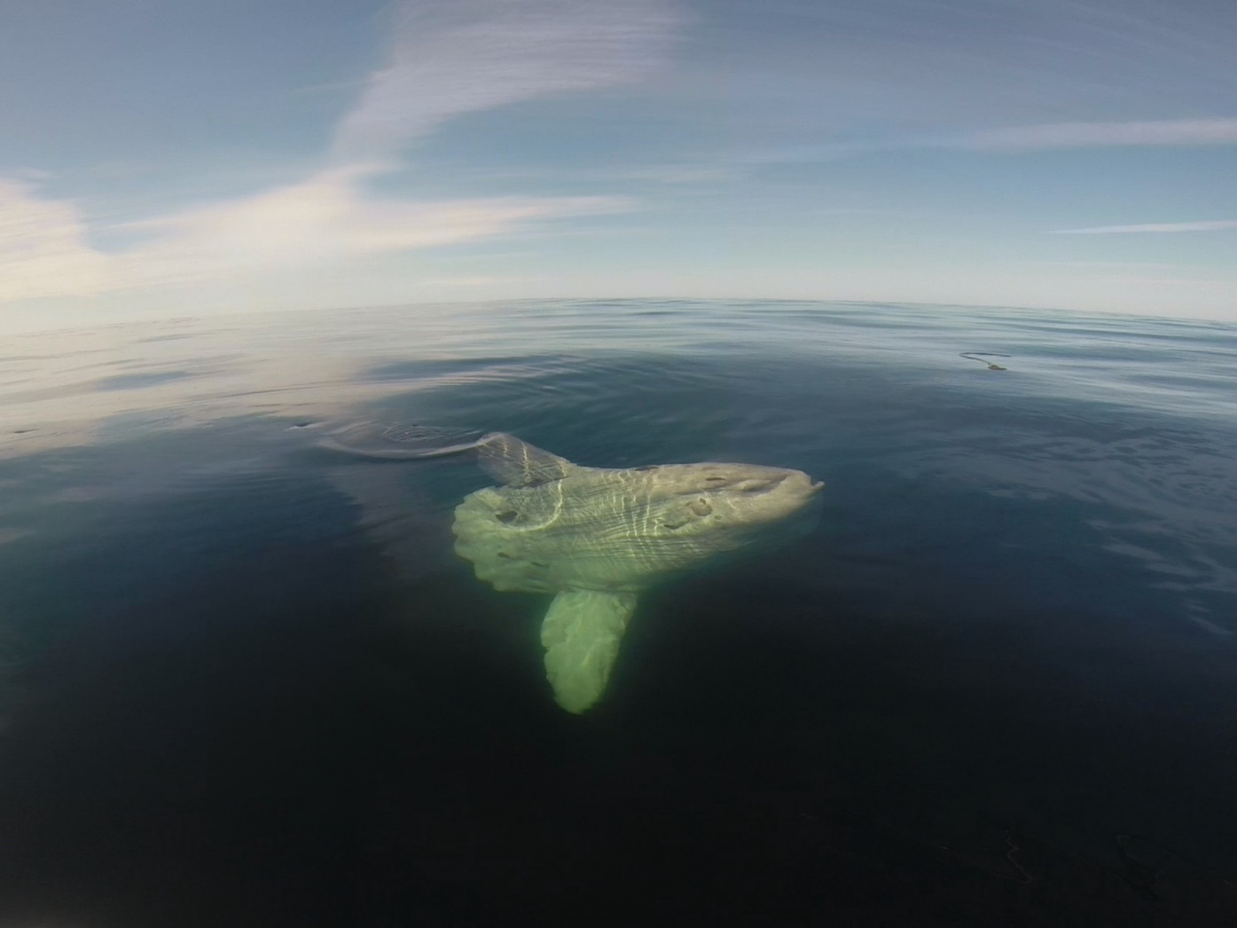
They are frequently seen off the B.C. coast in late summer.

Slide 19
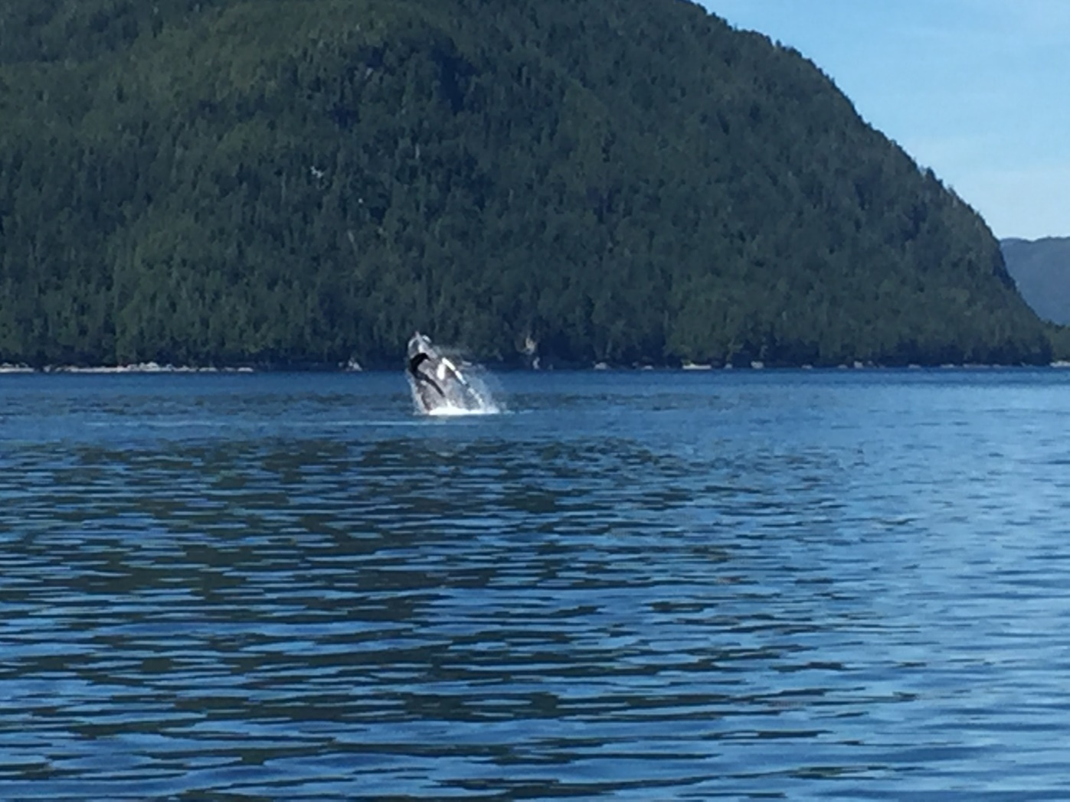
Humpback whales are a common sight in northern B.C. waters.

Slide 20
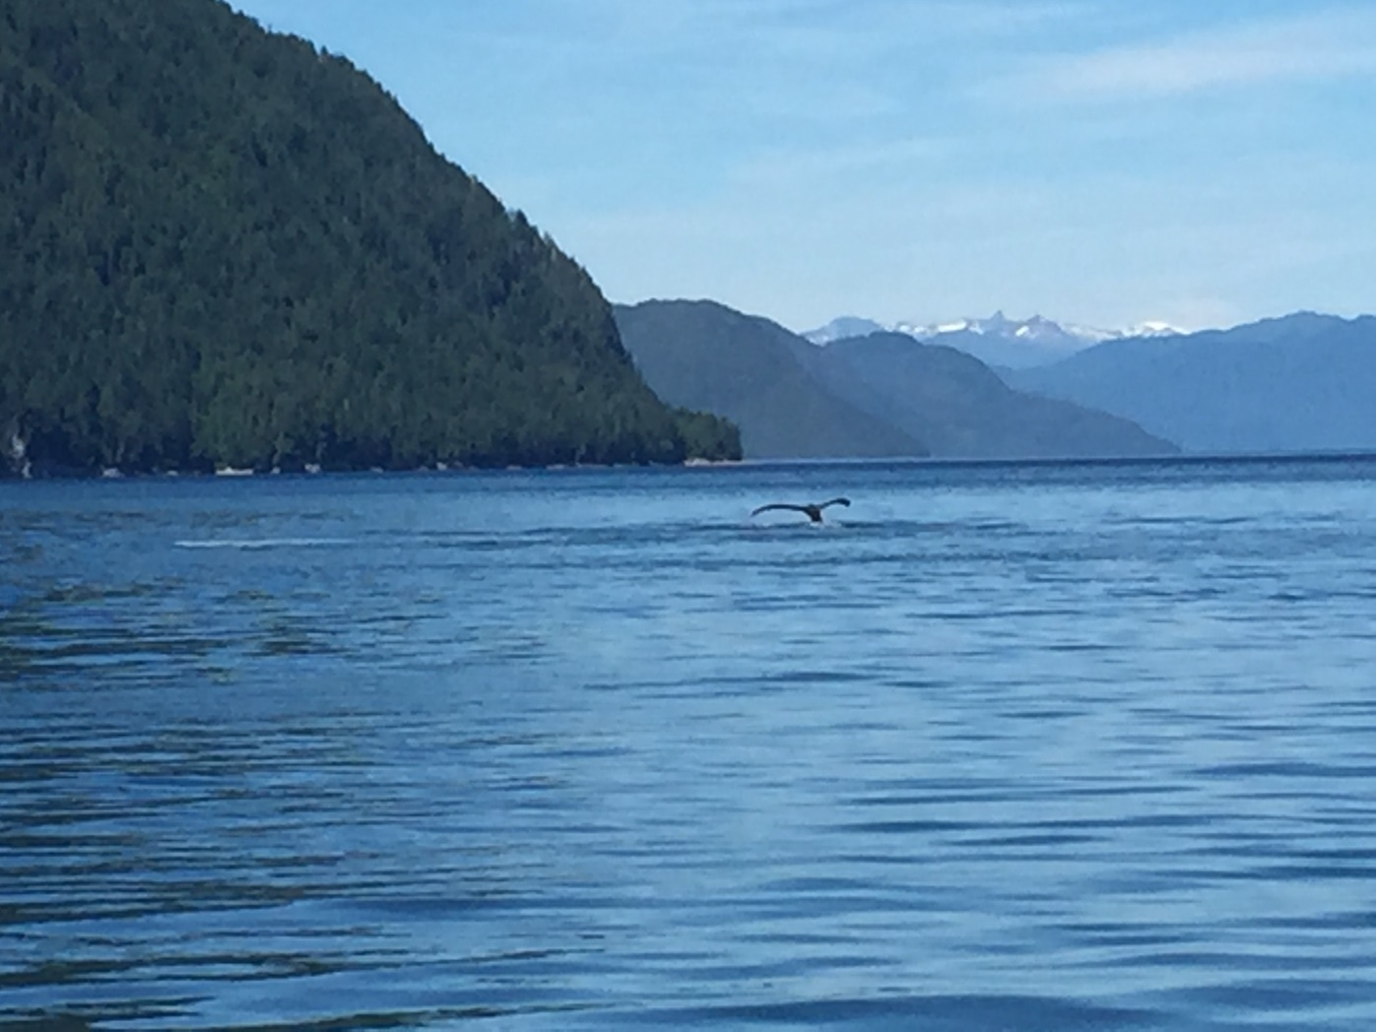
This pod is feeding in Wright Sound, on the proposed Enbridge tanker route.

Slide 21
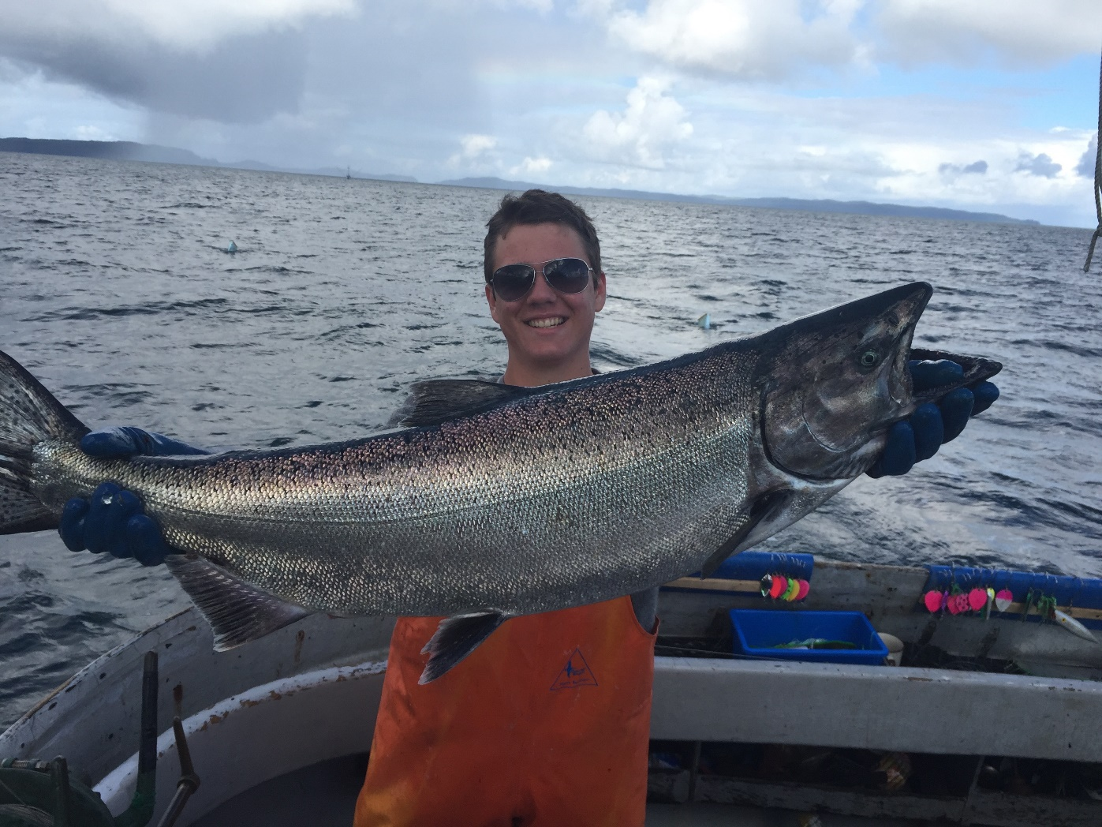
The presence of whales always signals abundant feed and good fishing.

Slide 22
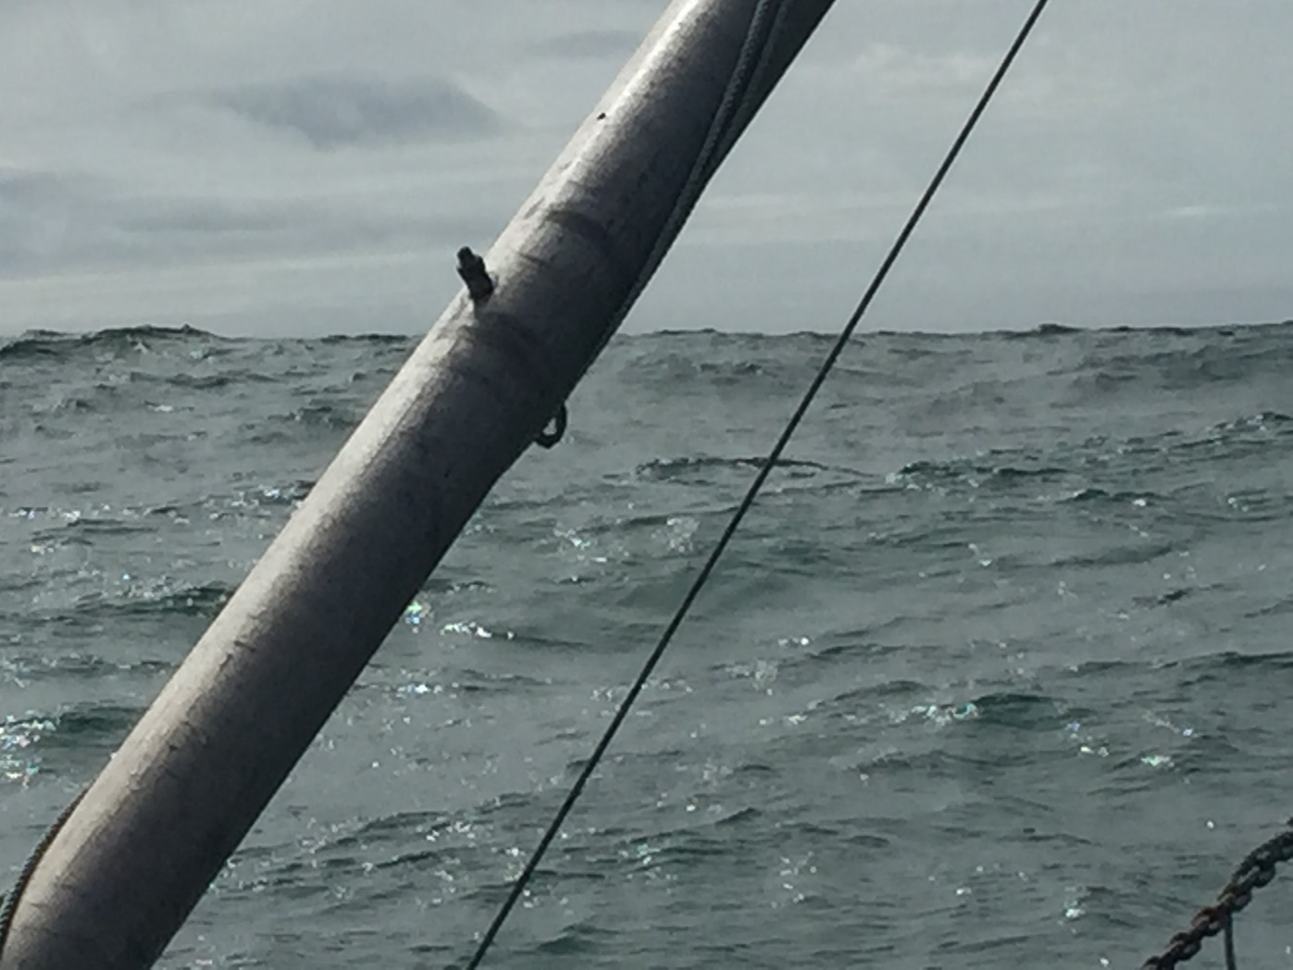
A big swell and brooding sky announce the end of summer.

Slide 23
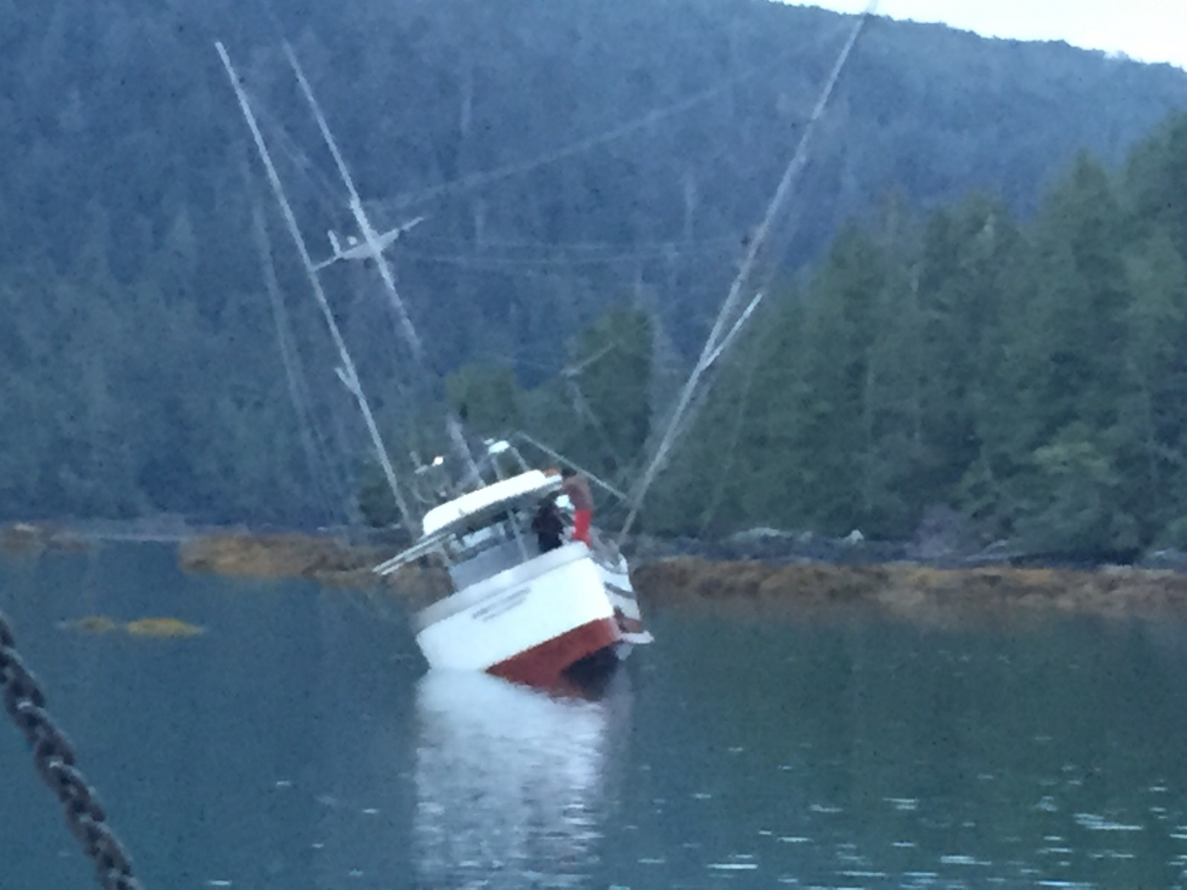
More hazards of the industry. The Amber Sunrise has hit an uncharted rock.

Slide 24
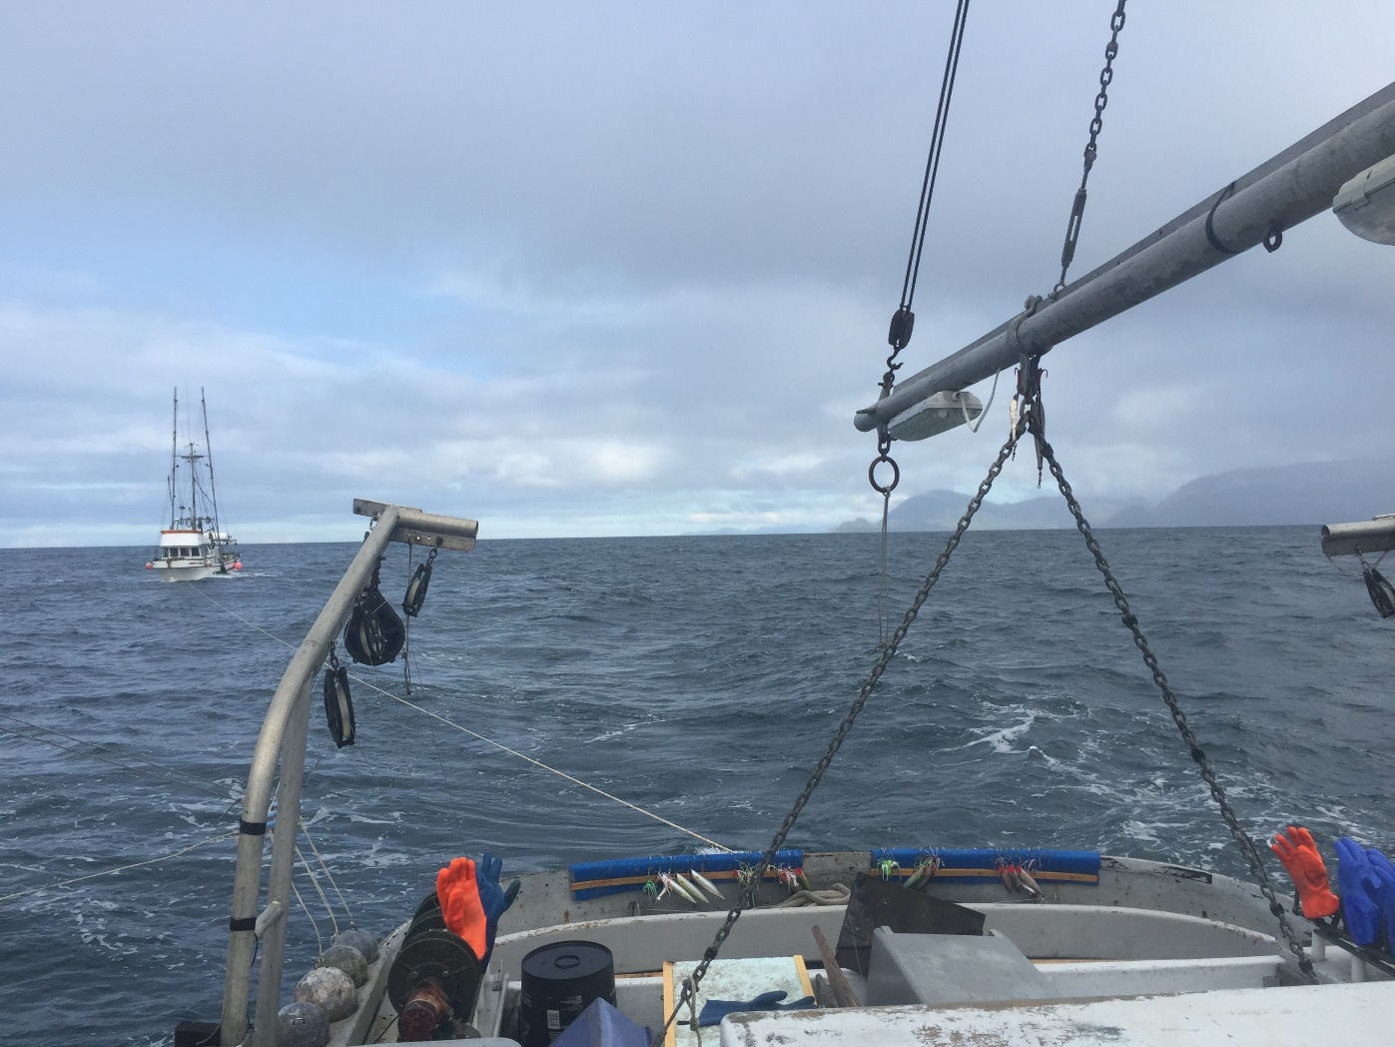
We tow them from Cape Chacon, Alaska, to Prince Rupert, a journey of 100 miles.

Slide 25
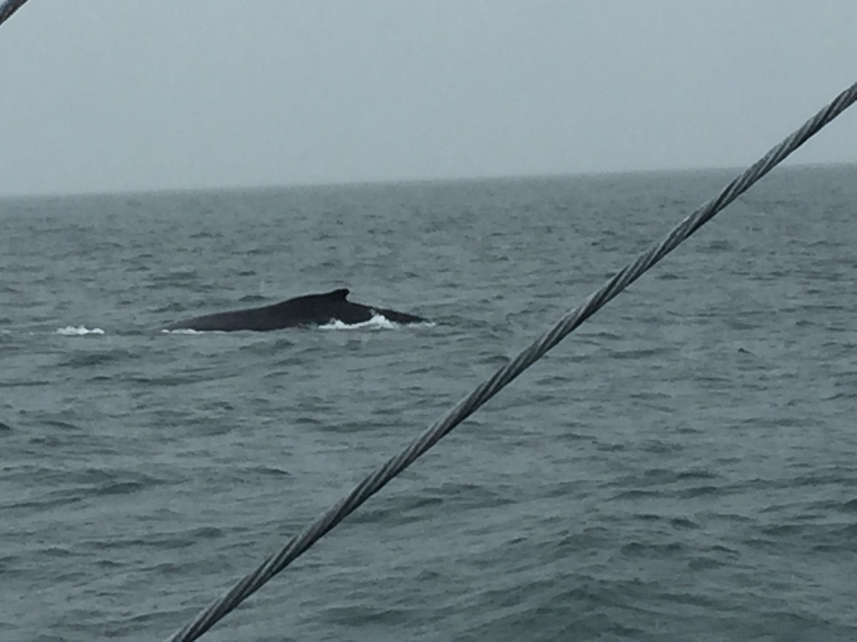
A huge bull humpback whale escorts us into Prince Rupert.

Slide 26
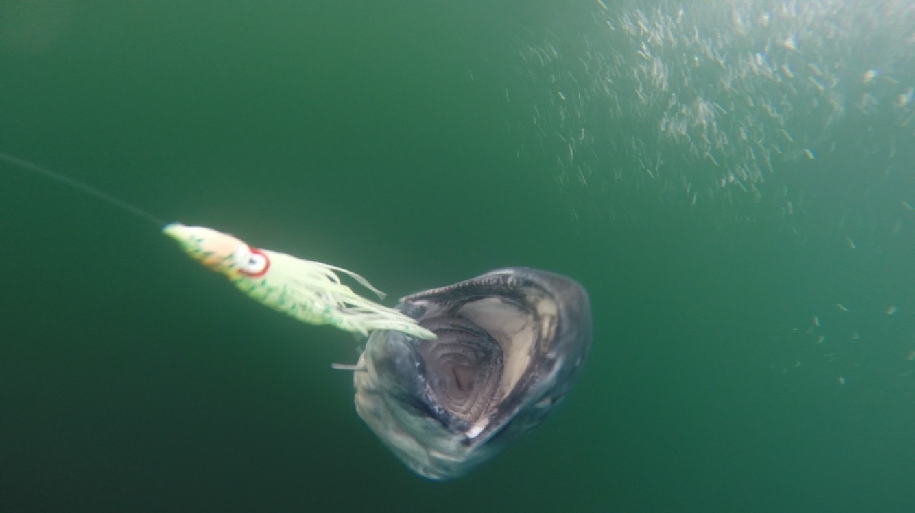
Back on the fishing grounds the bite is on. This Spring salmon took a green and white hootchie.

Slide 27
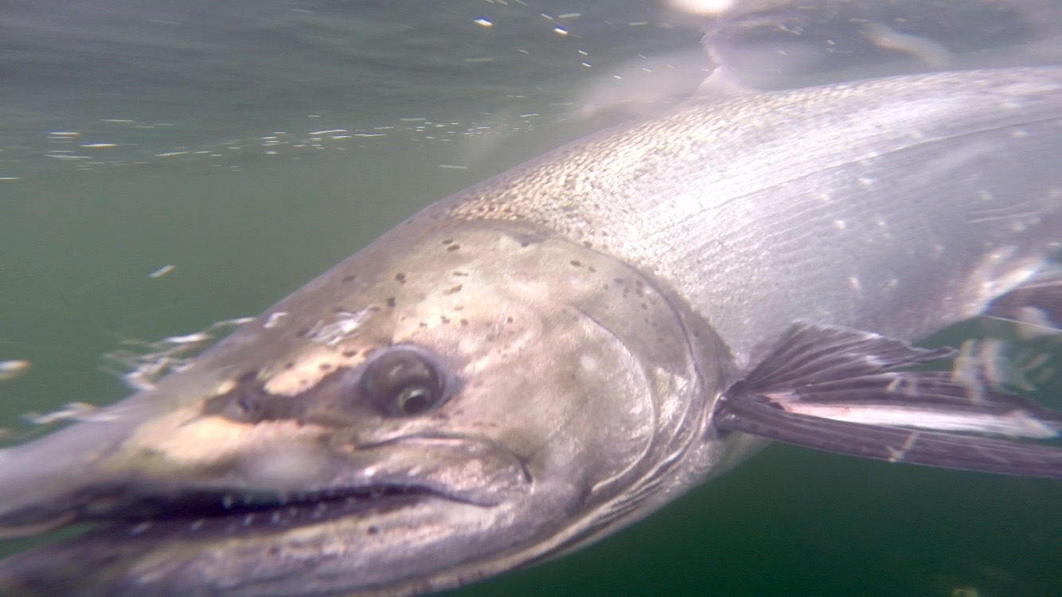
Our Gopro captures the underwater fury of a hooked spring salmon.

Slide 28
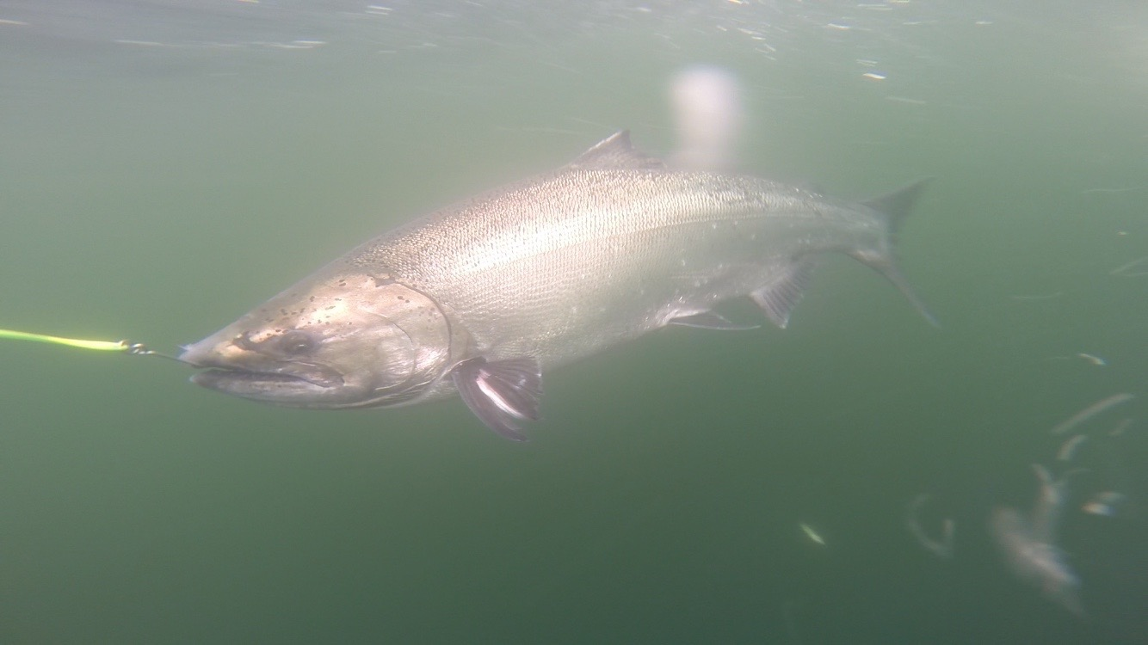
Spoons are another favoured lure for West Coast trolling.

Slide 29
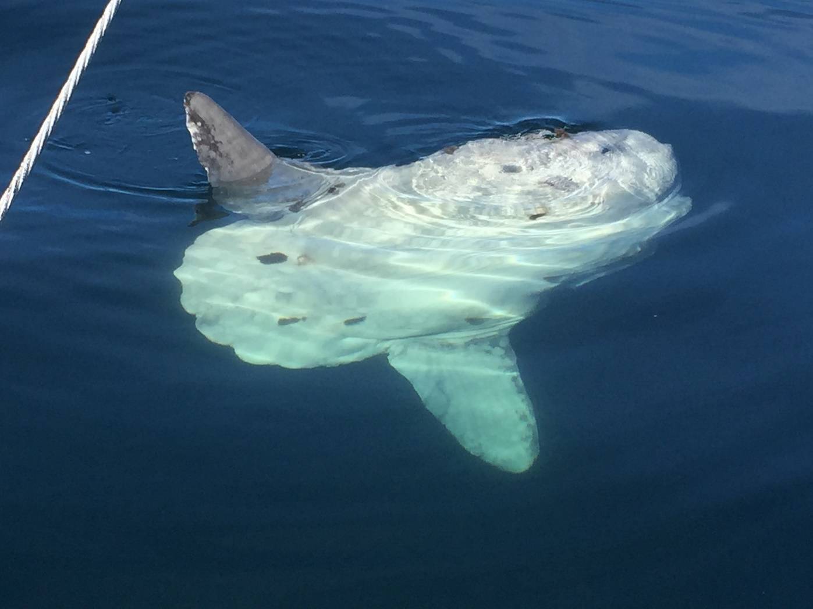
A large sunfish bids us farewell until next summer.

Slide 30
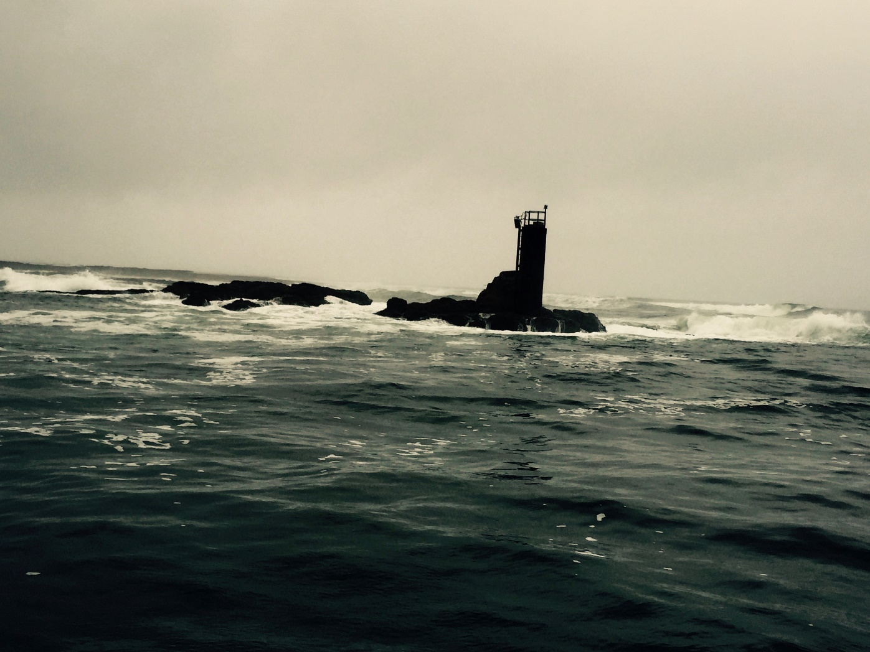
We seek shelter from worsening weather through a narrow gap in the rocks at Seven Mile.

