Slide 1
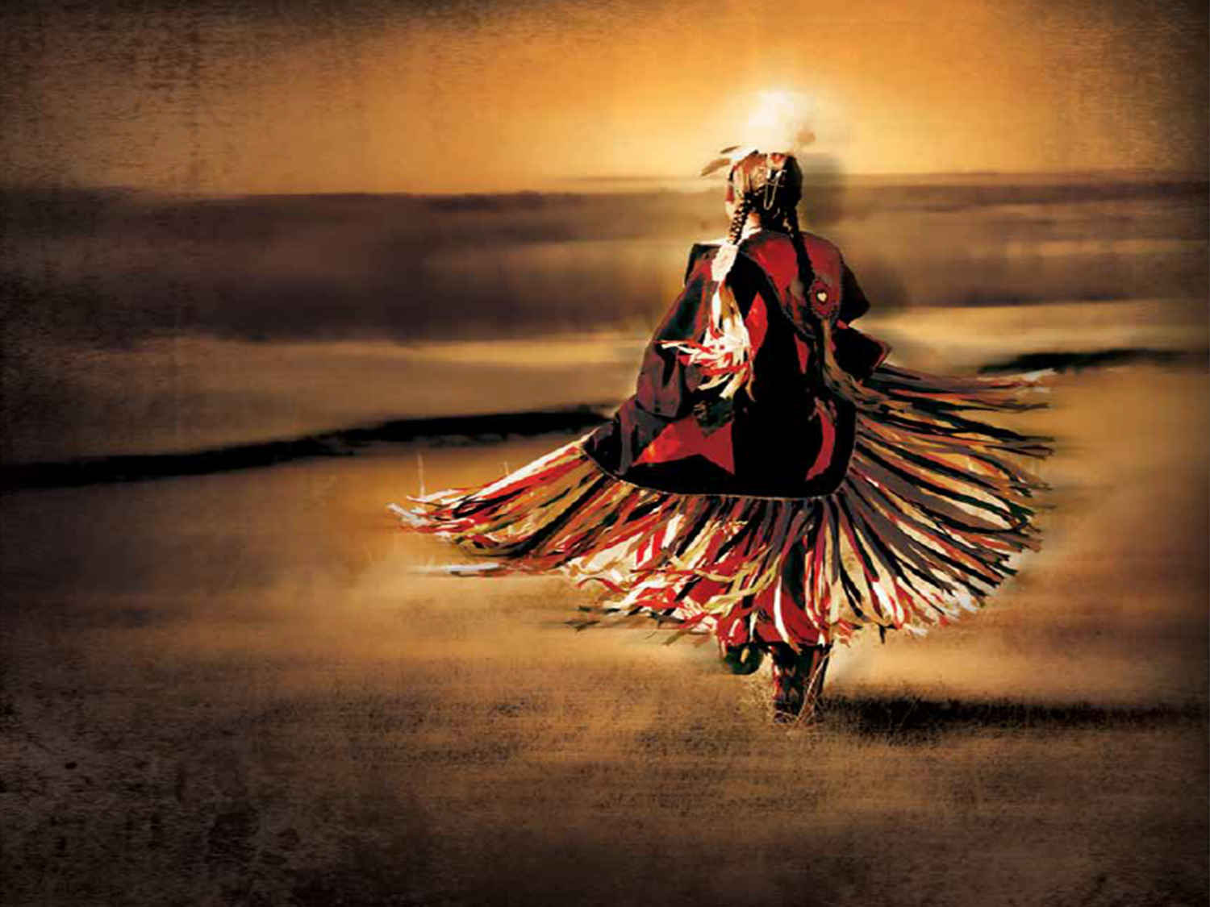
Do Canadian authorities care about missing and murdered Aboriginal women?

Slide 2
Information presented today come from two sources:

Slide 3
According to the World Health Organization, violence against women affects one-third of women around the globe and represents a health problem of “epidemic proportions.”

Slide 4
Females represented 32% of homicide victims (6,551 victims) across all police jurisdictions between 1980 and 2012.

Slide 5
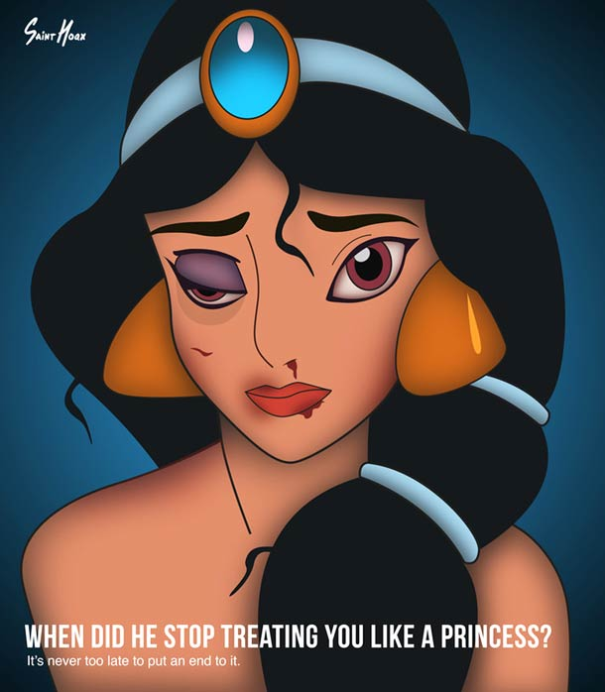
Aboriginal women are at a higher risk of being victims of violence than non-Aboriginal females.
According to the 2009 General Social Survey (GSS) on Victimization, nearly 67,000 Aboriginal females reported being a victim of violence in the previous 12 months.

Slide 6
The rate of victimization among Aboriginal females was close to three times higher than that of non-Aboriginal females.

Slide 7
There were 1,017 Aboriginal female victims of homicide (between 1980 & 2012), which represents roughly 16% of all female homicides.

Slide 8
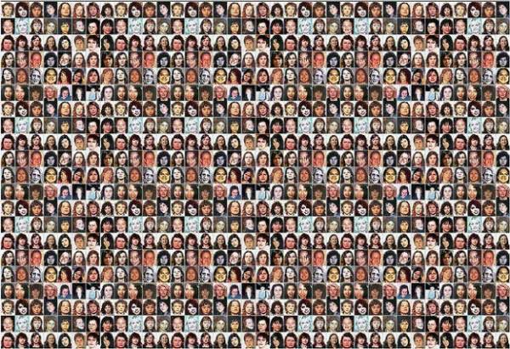
Police-recorded incidents of Aboriginal female homicides and unresolved missing Aboriginal females in this review total 1,181 - 164 missing and 1,017 homicide victims.

Slide 9
Over-representation of Aboriginal female homicide victims appears to hold for most provinces and territories

Slide 10
Missing Women
Canadian Police Information Centre (CPIC) provides police officers with nine “probable cause” options to categorize why a person has gone missing:
abduction by a stranger;
accident;
wandered off/lost;
parental abduction with a custody order;
parental abduction — no custody order;
runaway;
unknown;
other; and,
presumed dead.

Slide 11
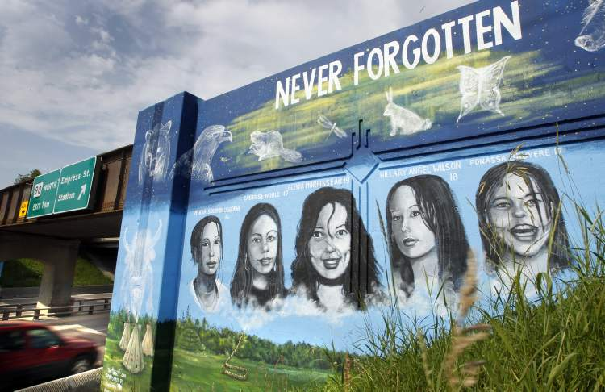
164 instances of reported missing women were assessed to be unresolved cases of missing Aboriginal women as of November 4, 2013.

Slide 12
The RCMP report concludes (among other things) the following:
Police-recorded incidents of Aboriginal female homicides and unresolved missing Aboriginal females in this review total 1,181 - 164 missing and 1,017 homicide victims.
The total indicates that Aboriginal women are over-represented among Canada’s murdered and missing women.
The total number of murdered and missing Aboriginal females exceeds previous public estimates.

Slide 13
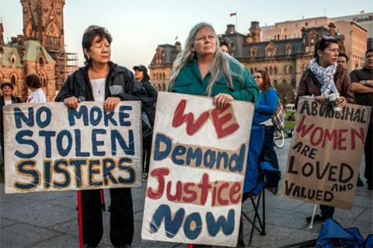
Fact Sheet: Missing and Murdered Aboriginal Women and Girls
Native Women’s Association of Canada (NWAC) has created a database of missing and murdered Aboriginal women and girls.

Slide 14
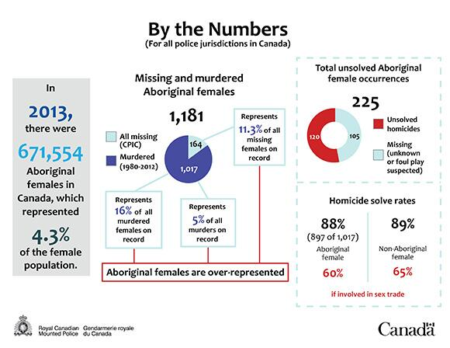
The statistics presented here are based on NWAC’s database as of March 31, 2010.
The number of missing and murdered Aboriginal women and girls in Canada is disproportionately high.

Slide 15
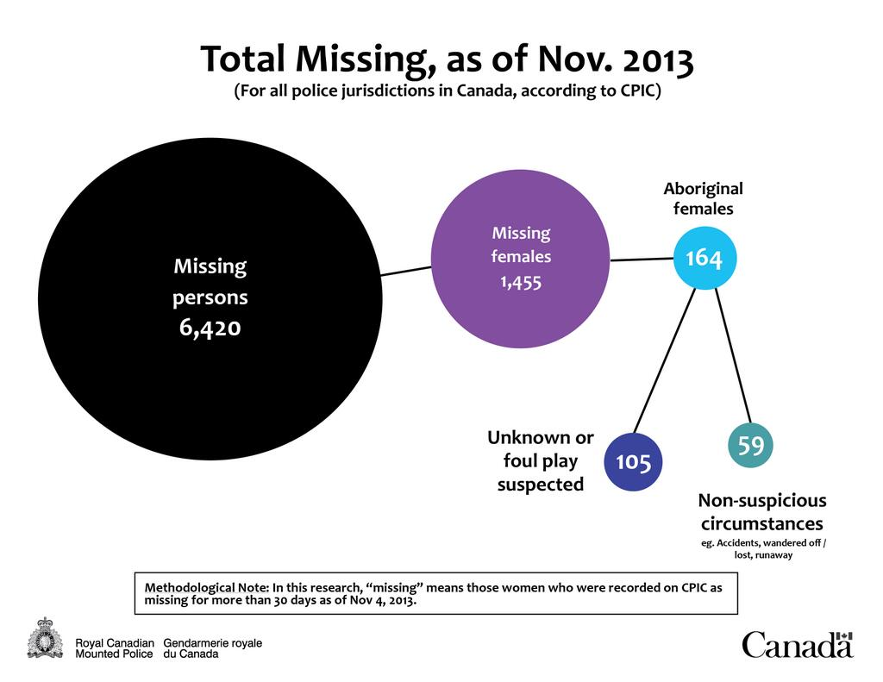
NWAC’s research indicates that, between 2000 and 2008, Aboriginal women and girls represented approximately 10% of all female homicides in Canada.
However, Aboriginal women make up only 3% of the female population and most of the cases involve young women and girls.

Slide 16
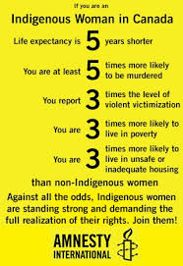
Just over half of the cases (55%) involve women and girls under the age of 31, with 17% of women and girls 18 years of age or younger.
Only 8% of cases involve women over 45.

Slide 17
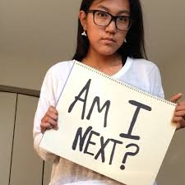
Nearly half of murder cases in NWAC’s database remain unsolved.
NWAC has found that only 53% of murder cases involving Aboriginal women and girls have led to charges of homicide.
This is dramatically different from the national clearance rate for homicides in Canada, which was last reported as 84%.

Slide 18
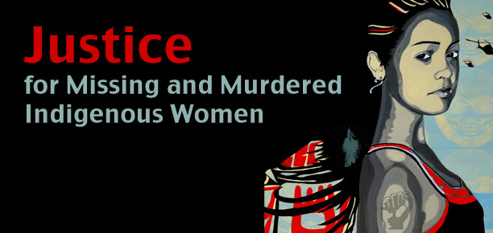
While a small number of cases in NWAC’s database have been “cleared” by the suicide of the offender or charges other than homicide, 40% of murder cases remain unsolved.

Slide 19
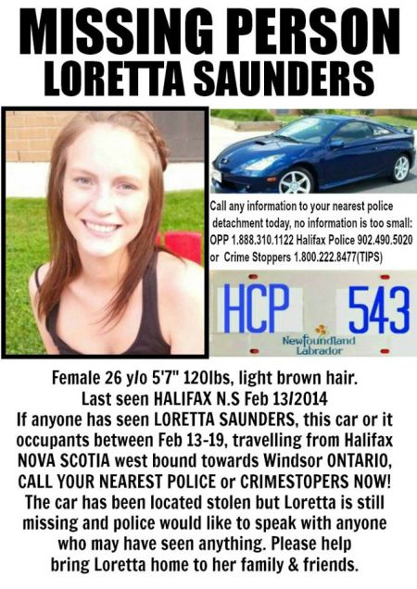
Clearance rates are low but differ by province.
NWAC has found that clearance rates range from a low of 42% in Alberta to a high of 93% in Nunavut.

Slide 20
16.5% of offenders are strangers with no prior connection to the woman or girl ;
17% of offenders are acquaintances of the woman or girl (a friend, neighbour or someone else known to her); and
23% are a current or former partner of the woman or girl.

Slide 21
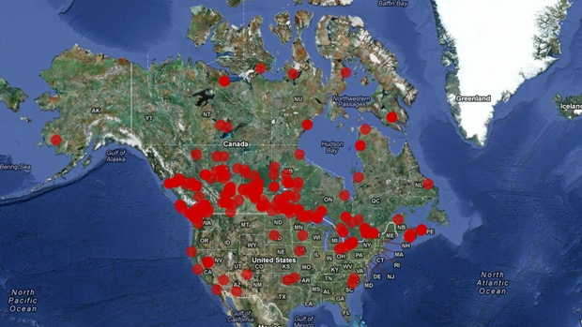
Why does this continue to happen?
Reinforcing stereotypical portrayals
Absence of media portrayals/coverage

Slide 22
Missing White Girl Syndrome
‘Missing White Woman Syndrome’ describes the fact that western media will focus on the murder, kidnapping, or disappearance of Caucasian females to the exclusion of minority, male, older, or disabled missing persons.

Slide 23
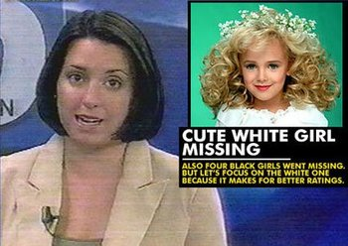
Satirical media understands the ethnic irony that is the ‘Missing White Girl Syndrome’.

Slide 24
Why is there under-reporting of murdered and missing women?
Studies in the United States have shown that darker-skinned women receive less coverage than White women, but so do women who are at higher risk for violence such as sex trade workers, women living in poverty and those with drug addictions.

Slide 25
Rilya Alerts
As with the Amber system, children whose disappearances are announced under the Rilya system must be:
17 or under,
reported missing to law enforcement and,
believed to be in danger.

Slide 26
A Canadian Outrage
It is called the “Highway of Tears”: an 800 kilometer stretch of highway in British Columbia where more than a dozen young women have disappeared since 1994.

Slide 27
Do Canadian authorities care about missing and murdered Aboriginal women?
Yes
The vision of the RCMP is to promote safe communities in their commitment to preserve the peace, uphold the law and provide quality service.
The RCMP Commissioner Bob Paulson has said “"We are making sure that unsolved cases are reviewed systematically and peer reviewed for avenues of investigation that perhaps have not been seen."
No
The number of murdered and missing Aboriginal women is a national disgrace and demonstrates gross negligence.
Media coverage does not serve the interests of the many Canadian families who are victims of violence.

Slide 28
How do we make change happen?
Share the missing persons ALERTS
Challenge media presentations
Write local, provincial and national authorities

Slide 29
Contact Your Member of Parliament
Right Honorable John Duncan
Email:
john.duncan@parl.gc.ca
Regular mail:
Unit F – 1250 Cedar Street, Campbell River, BC, V9W 2W5
Constituency Office Telephone number:
250 287 9388

Slide 30
Bibliography
http://www.rcmp-grc.gc.ca/pubs/mmaw-faapd-eng.pdf
Missing and Murdered Aboriginal Women: A National Operational Overview
http://www.nwac.ca/files/download/NWAC_3D_Toolkit_e_0.pdf
Fact Sheet: Missing and Murdered Aboriginal Women and Girls

Slide 31
Bibliography
http://www.cbc.ca/news/politics/number-of-murdered-missing-aboriginal-women-surprises-top-mountie-1.2645674
CBC news article titled: Number of murdered, missing aboriginal women surprises top Mountie
http://journalismcenter.org/when-a-child-dies/missing-white-girl.html
Scholarly article describing another way of reporting missing ethnic peoples

Slide 32
If he can react then so can you!
http://www.cbc.ca/news/canada/manitoba/billy-ray-reacts-to-canada-s-1-200-missing-aboriginal-women-1.2682746

