Slide 1
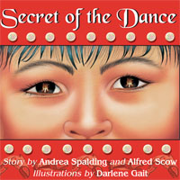
Secret of the Dance language arts and social studies activities for primary and early intermediate grades

Slide 2
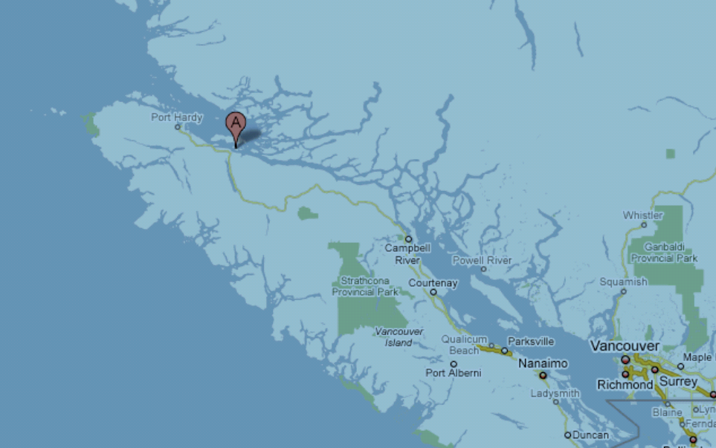
The story takes place on the east coast of Vancouver Island; Alert Bay is located on Cormorant Island by Pt. McNeil

Slide 3
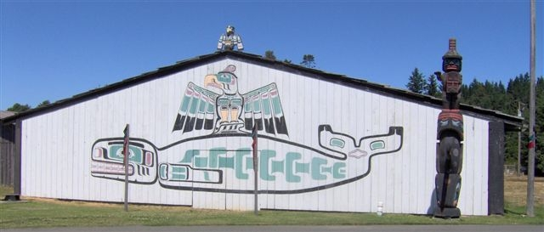
What is a potlatch ?
"A ceremony to mark special occasions such as marriage, naming children, and mourning the dead. It involves the performance of dances owned by the host, who distributes gifts to his guests. The potlatch lies at the heart of West Coast Aboriginal culture." from the glossary at the back of Secret of the Dance
Pull
Pull

Slide 4
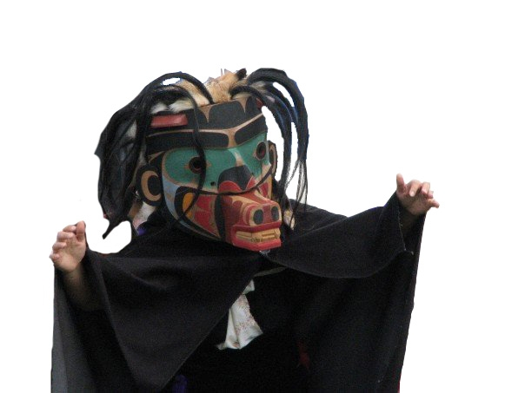
My Thinking
pictures in my head
words or phrases I heard
questions I have
my feelings

Slide 5
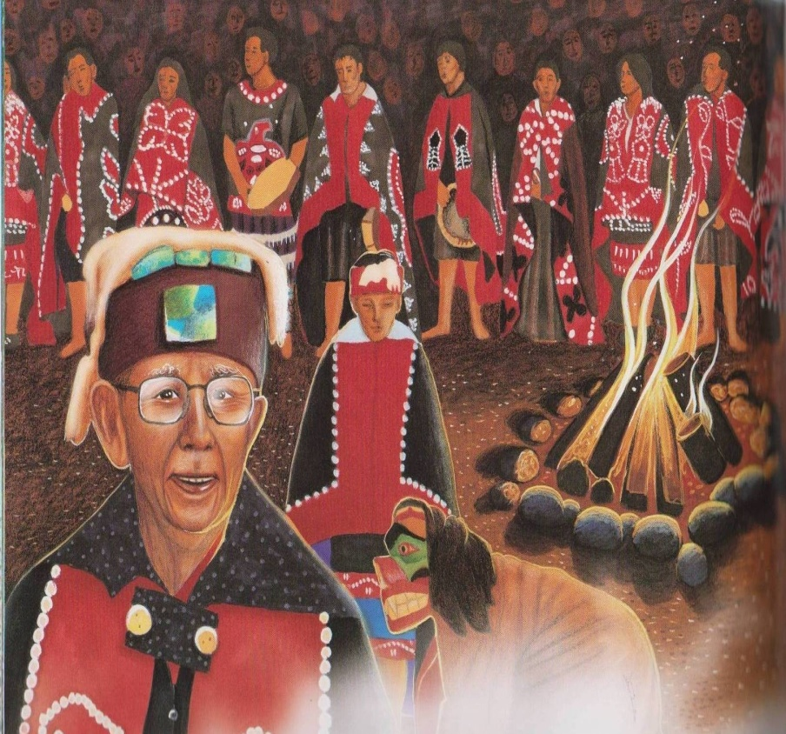
Have you ever been to a potlatch or special family gathering with lots of traditions like a wedding or christening?
No
Yes

Slide 6
potlatch
birthday celebration

Slide 7
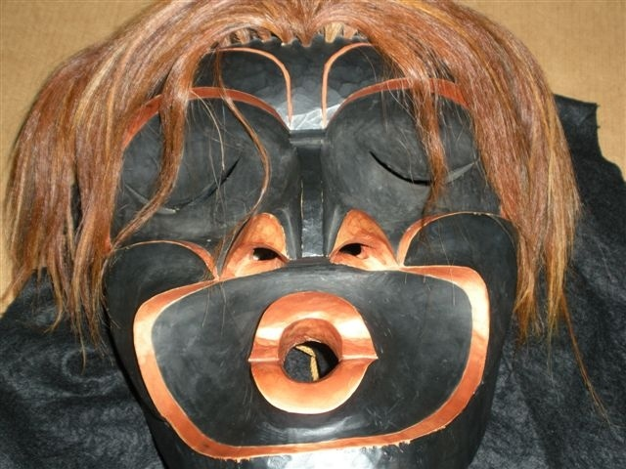
Either use "turn and talk" or "think/pair/share" with the following topics
1.How did Watl'kina
feel when he knew
they were doing
something against
the law ?
2. What kind of
a kid is he?
4. How did the artist's drawings help you understand the story?
3. Would you have
been brave enough
to go into the big
house?
*then click on the lower corner of each box to reveal a puzzle piece

Slide 8
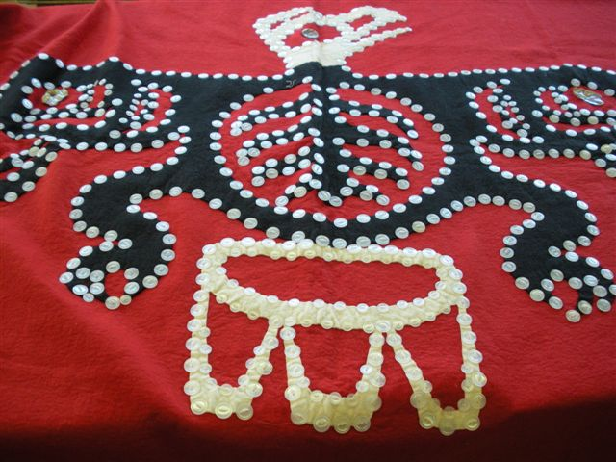
characters
setting
problem
solution

Slide 9
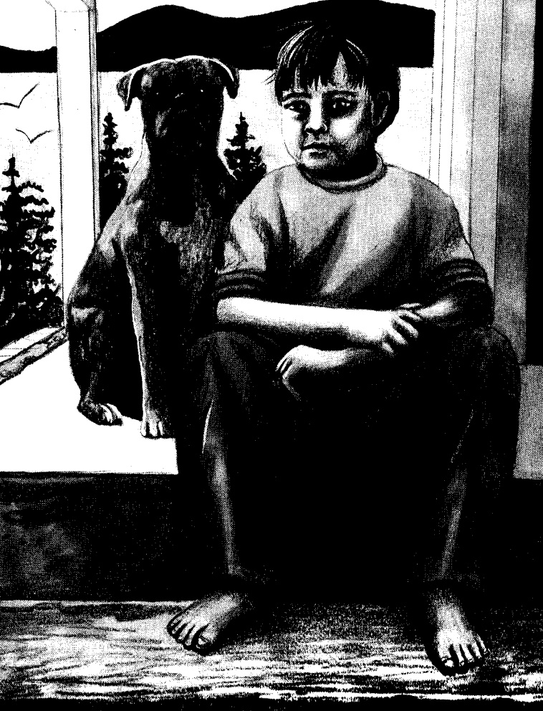
The beginning and ending parts of the book are quite different - how?

Slide 10
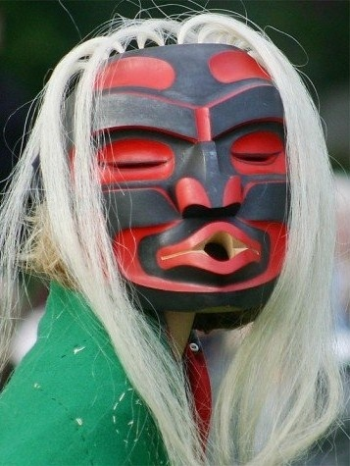
Riddle: What am I ?
- a mask , carved in wood
- a feared supernatural being
- she is said to carry off children
- Dzunukwa

Slide 11
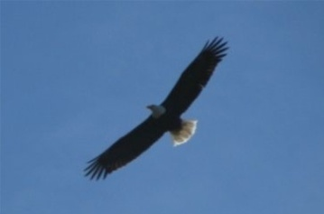
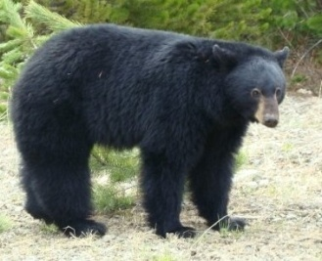
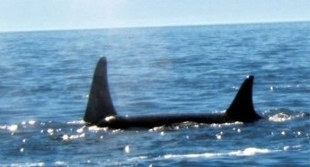
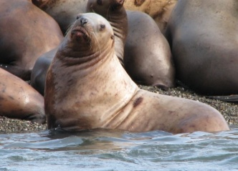
Vocabulary
kwakwa'ka'wakw - the nations of First Nations people
living along the upper east coast of Vancouver
Island and the west coast of the mainland
ghi'lakas'la - welcome
Ga' Gaas - grandmother
hamatsa- a supernatural being of great importance
all vocabulary definitions from the glossary section of Secret of the Dance

Slide 12
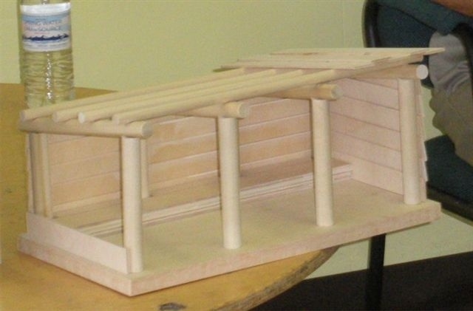
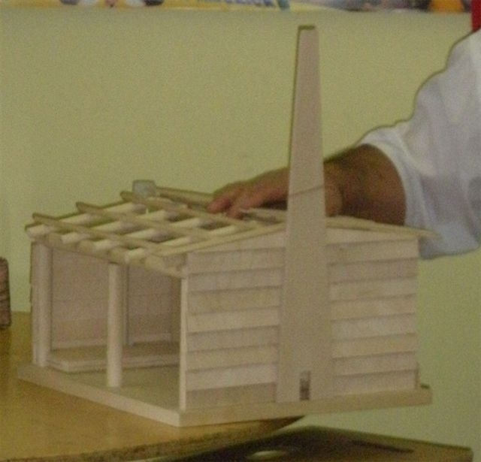
1. Look for similarities and differences between the Tsimshan and Kwakwa'ka'waka Big Houses
2. Where would you put the totem pole ?
Big House replicas were constructed by Elder Gordon Reid

Slide 13
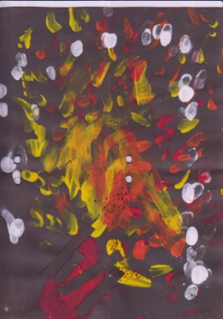
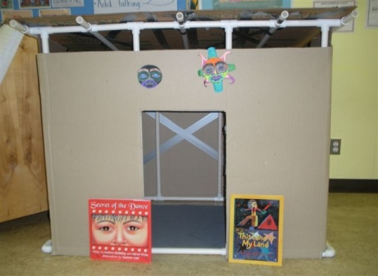
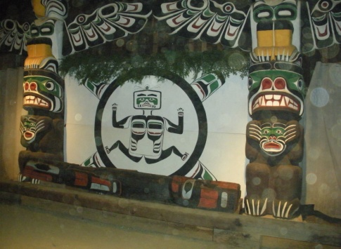
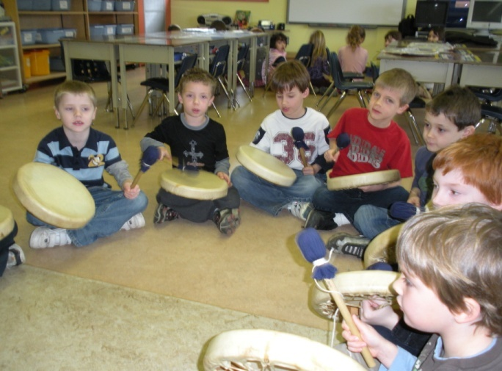
Lesson Extensions
building a big house replica for the class with pcv pipe and cover with cardboard;or individual with shoeboxes and craft sticks
fire finger painting: using yellow, orange
and red poster paints swirl fingers in
"dancing flame" motions, put a few
dots of white to look like ash; glue a
few strips of brown construction
paper for wood; add sparkles
teachertube has posted many videos on First Nations culture and legends i.e.:"Baby Bear and the Salmon" " Pacific Salmon of Lilloet"
visit your local big
house for a tour ; have a
story teller or Elder come into your room

Slide 14
Credits and links
the lesson plan and two book illustrations for Secret of the Dance, created by Colleen Devlin is being used with the expressed permission of Andrew Wooldridge, publisher of Orca Books
Links to publisher, author and illustrator:
http://www.orcabook.com/
http://www.andreaspalding.com/
http://www.darlenegait.com/
*photographs of the dancers are being used with the expressed permission of Andy Everson of the Kumugwe dancers of the K'omoks Nation

