Slide 1
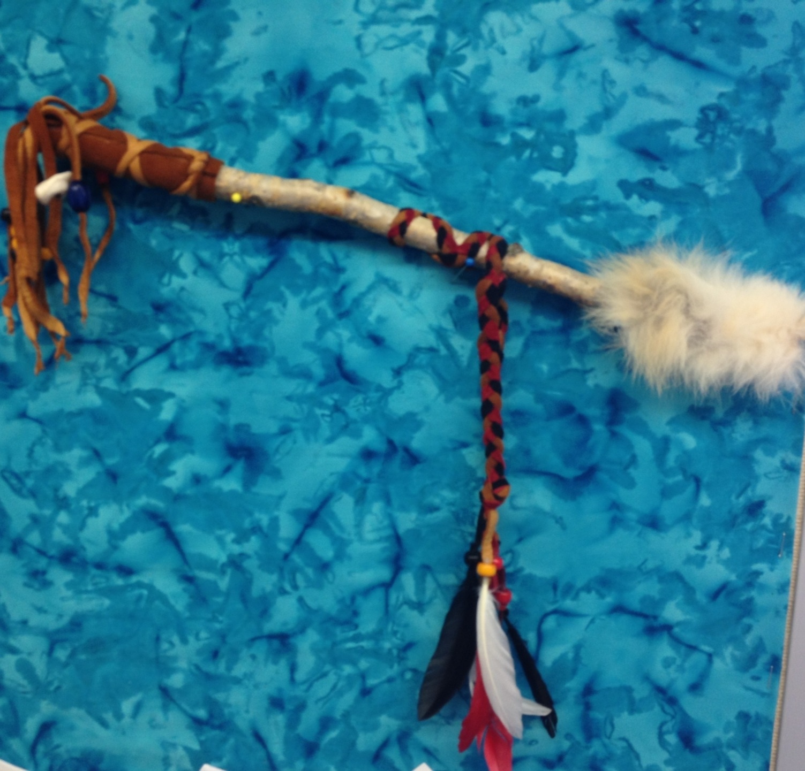
The Talking Stick and Talking Circles
What are they, and when are they used?

Slide 2
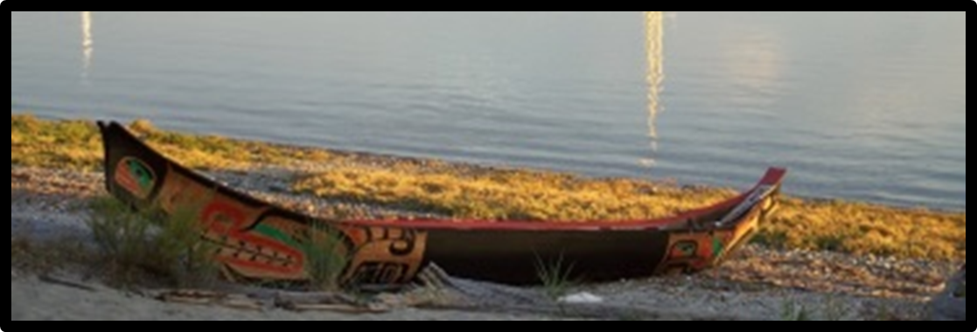
Recognition of Territory:
We would like to acknowledge that we are on the traditional territory of the K’ómoks First Nation

Slide 3
Learning intention:
To learn how to use a Talking Stick and understand how it can help us communicate with each other.

Slide 4
The Talking Stick:
Is a tool used traditionally by Aboriginal people, but lots of people use them today.
ONLY the person who holds the Talking Stick has the right to speak at that time.
The Talking Stick is a symbol of how important it is to listen to the person who is speaking.
The Talking Stick is passed around the circle from one person to the next until everyone who wants to speak has had a chance to.

Slide 5
The Talking Circle
A Talking Circle is used:
For meetings
To teach children
To solve problems
At a ceremony where lots of people will speak
From the age of three First Nation children are taught to “listen first”. This is an important skill for everyone to gain!
In a talking circle, you can disagree, but only when you have control of your words. What does this mean?

Slide 6
Talking Circle Protocol
How do I behave in a Talking Circle?
The person who is holding the talking stick is the only person allowed to speak. We wait, even if the person takes some time to think about what they are going to say.
In this territory talking circles goes counter-clockwise
You must wait your turn to say something in return.
No negative comments allowed. You can talk about how you feel, or things that you experienced.
Whatever you talk about must come from your heart, and it must be true. There are no lies in a talking circle.
A talking circle continues for as many rounds as you have set out, or until the conversation is finished.

Slide 7
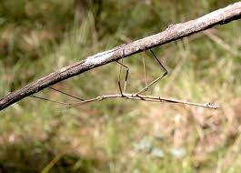
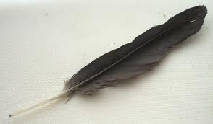
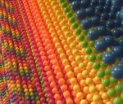
One way to create a Talking Stick
How will it look?
What type of wood should it use?
What feathers, hide or fur should it have?
What colours should be on it?
WHY did you choose these items?

Slide 8
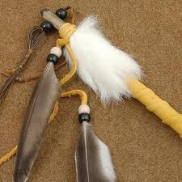
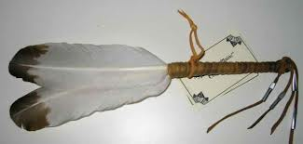
The Talking Stick
No two are ever the same!
Each part is unique and
special to the people who
made it.
The objects on the Talking Stick are symbols for those who made it.

Slide 9
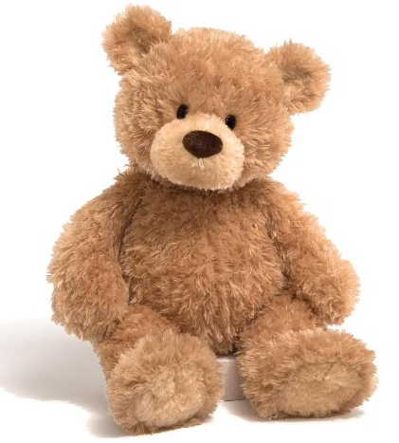
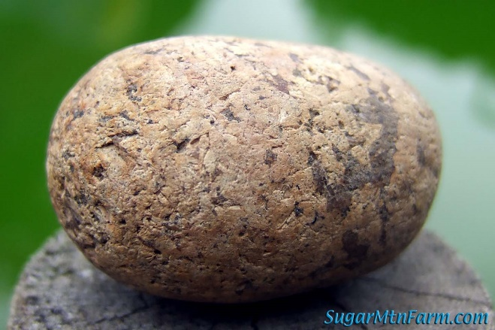
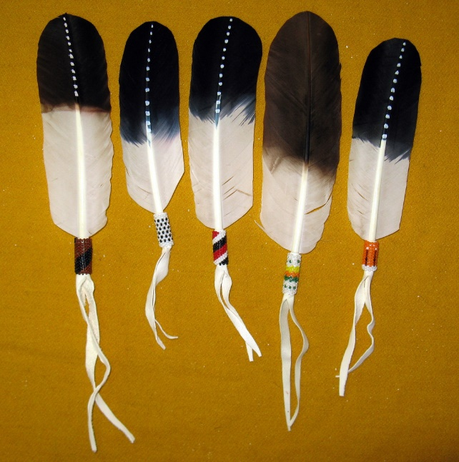
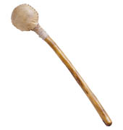
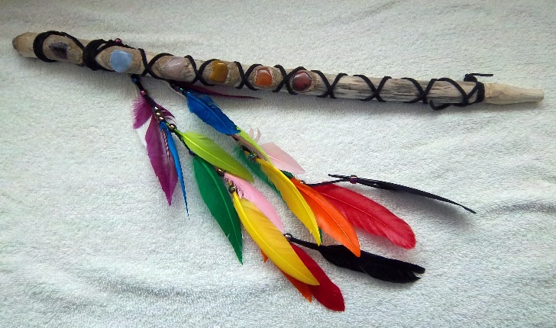
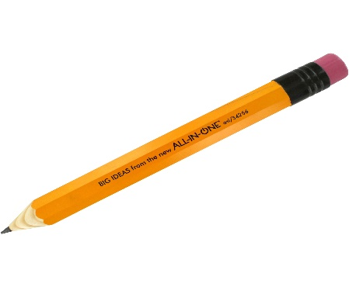
Other items to facilitate a talking circle:

Slide 10
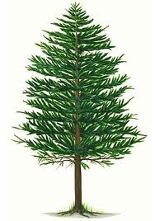
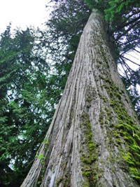
The Talking Stick
In some cultures the type of wood has meaning:
White pine= Peace
Birch = Truth
Evergreen= Growth of all things
Cedar= Cleansing
Aspen= Seeing Clearly
Maple = Gentleness and sweetness
Elm= Wisdom
Mountain Ash= Protection
Oak= Strength
Cherry= High Emotions/Love
Walnut= Energy

Slide 11
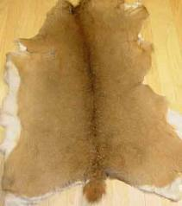
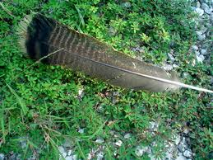
The Talking Stick
Fur or Hide Can also have Meanings:
They bring the healing qualities of that animal to the group.
Turkey Feathers=peace, and the give and take to problem solve
Eagle Feathers= Courage and wisdom to speak truthfully
Wolf fur= Pathfinder or Teacher
Rabbit Fur= Good listener
Deer Hide= Gentleness
Horse Hair= Connects to Earth and spirit of the wind.

Slide 12
The Talking Stick
The Colour of the Beads can also bring meaning to the Talking Stick
Red= Faith
Yellow=Love
Blue= Understanding
Green = Mental Power
Pink= Creativity
White= Personal Charm
Purple= Healing and Thankfulness
Grey= Friendship and Knowledge
Brown= Connected to the earth/Making good decisions
Orange= Feeling connected to living things
Black= Harmony and Listening
Clear= Clarity and Focus

