Slide 1
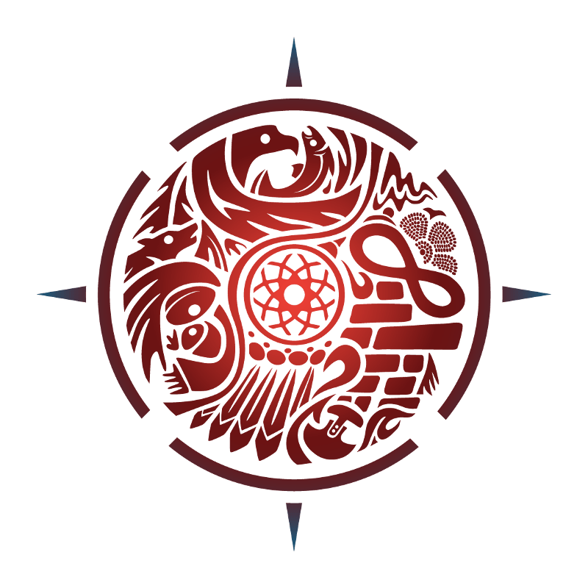
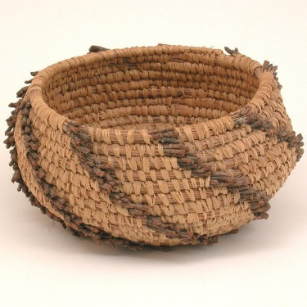
What does being Indigenous mean?
Taking a look at First Nations, Métis and Inuit people.
Bead timeline
Gerry Dudoward, Tsimshian

Slide 2
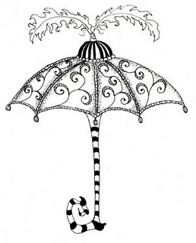
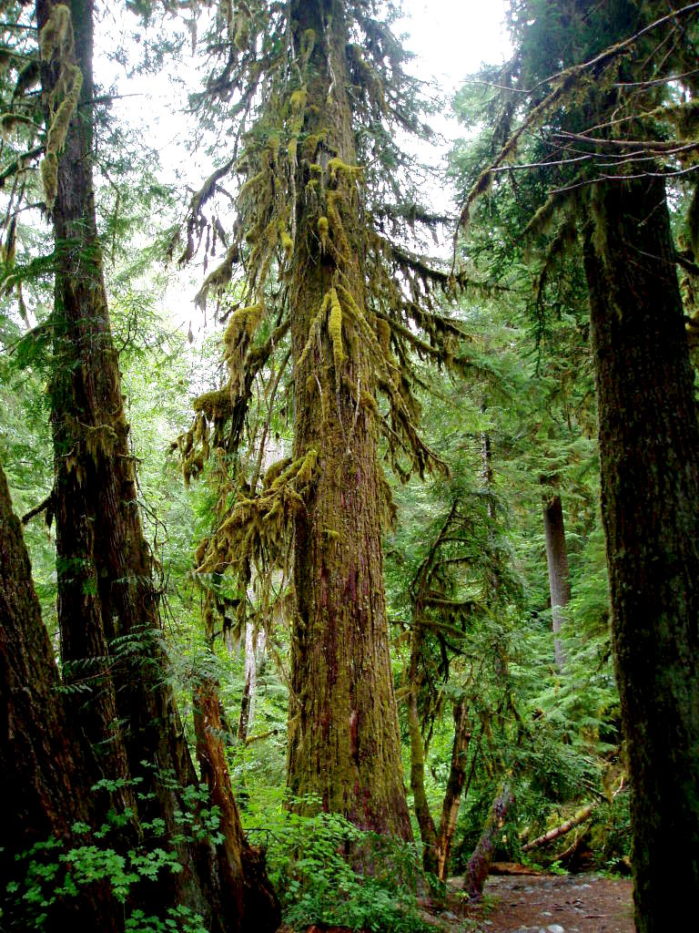
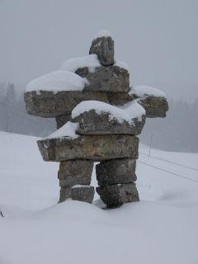
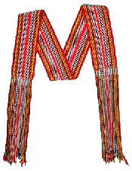
Indigenous
Notes:
The word “Indigenous” is like a big umbrella that refers to all First Nation, Métis and Inuit people in Canada
You may have heard other names, including “Indian”, “Native”, and “Aboriginal”, but these have different meanings to different people and all may have been used in different time periods.
To some, these words do not properly represent the huge variety of cultures found in Canada’s Indigenous First Peoples community
Turn and Talk to a partner: how do you think these 3 images represent First Nations, Métis and Inuit people?
(Cedar Tree represents First Nation in BC, the Métis Sash represent the Métis people and the Inuksuk represents Inuit)
The term Indigenous refers to the original inhabitants of the land that is now Canada. This term is common in Canada but is not commonly used in the United States.
The history of relationships between the Canadian state and Indigenous peoples is complex. Terminology can represent colonial histories and power dynamics. Words can be used as a powerful method to divide peoples, misrepresent them and control their identity. For example, what we can see in Canada today with “status” and “non-status”, the legally defined categories of people under the Indian Act (http://indigenousfoundations.arts.ubc.ca/home/identity/terminology.html)
The Canadian government declares that people must prove their bloodlines percentage to obtain a status card.

Slide 3
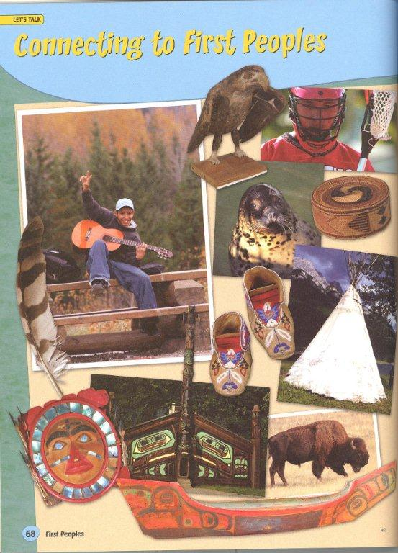
Notes:
Turn and Talk: How do these pictures connect to the lives of First Peoples in the past and now? (ask students to volunteer what they and their partners noticed in the collage picture)
If you’re not sure what some of the objects are you can just say “I’m not sure what that is, wouldn’t it be interesting for us to find out?” .

Slide 4
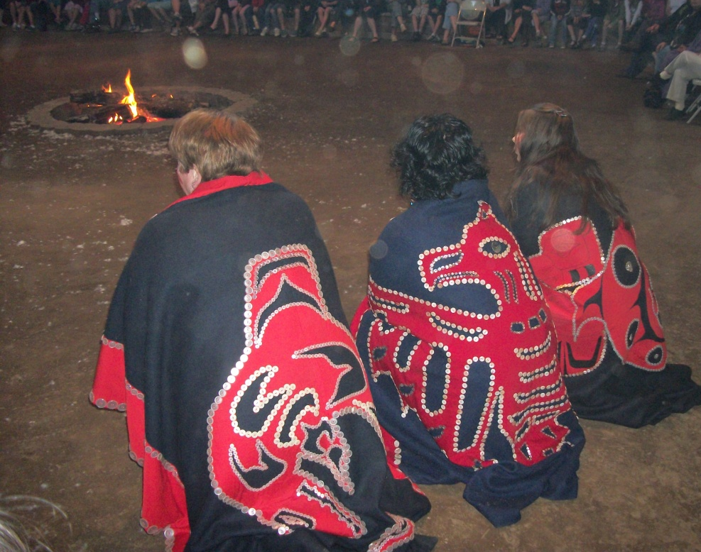
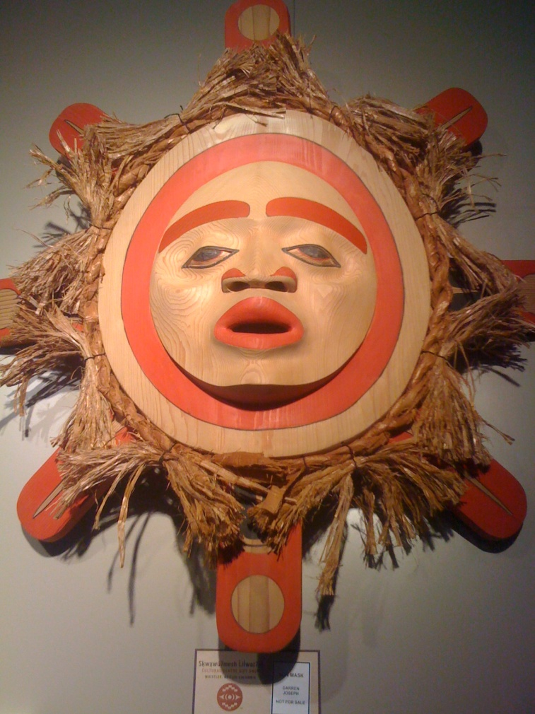
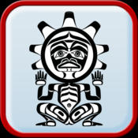
First Voices
Did you know?
There are 61 First Nation language dialects spoken in British Columbia!
Notes:
Over 60 distinct First Nation languages that are spoken in BC
Approximately 60% of the First Nations languages of Canada are spoken in BC.
Click on the First voices link (BC , Vancouver Island, and the Kwak’wala link to the North of the Comox Valley) Kwak’wala is the language you will hear at the Big House. Gilakas'la is a greeting, it means hello and welcome.
You can also put a Kwak’wala app on your Iphone or Ipad (image on lower right corner)

Slide 5
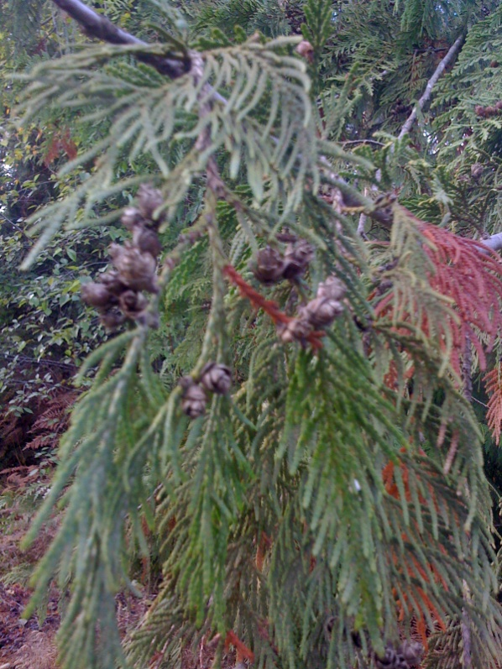
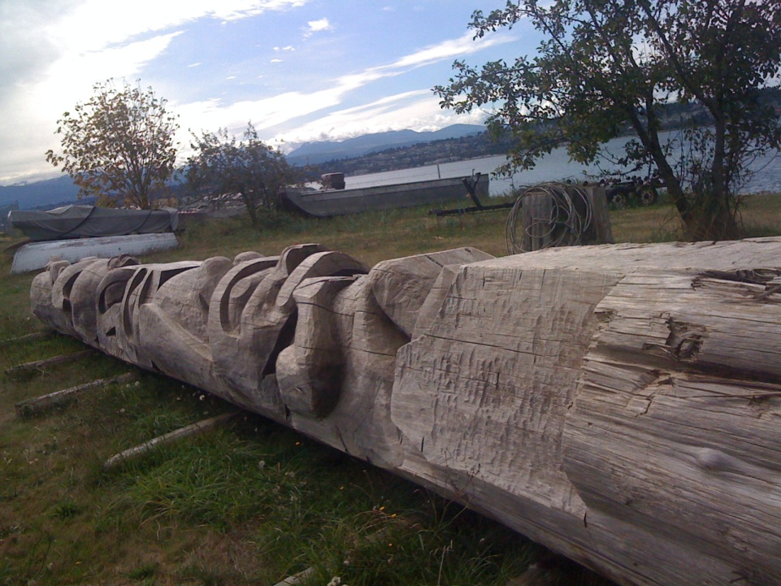
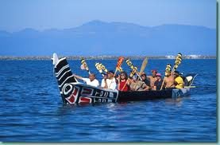
“We are one with the land, sea and air”
Notes:
Indigenous people have believed that humans are an interconnected part of the environment. All living creatures are equal and deserve respect.
Indigenous people share the core values of mutual respect and recognition, the interconnection of all things in creation, and stewardship over our lands and resources.
The strong belief in interconnectedness is reflected in many languages such as the Nuu-chah-nulth term “hishuk-ish t’sawalk” meaning everything is one. Or the Kwak’wala word “aweetna geeola” meaning “we are one with the land sea, and air”
They made sure that they took care of the environment and its resources (animals and plants). Sustainability was the key to survival.
When they hunt, fish and harvest plants they don’t take more than they need and they don’t waste any part of an animal so that there will be enough wildlife for the future generations.

Slide 6
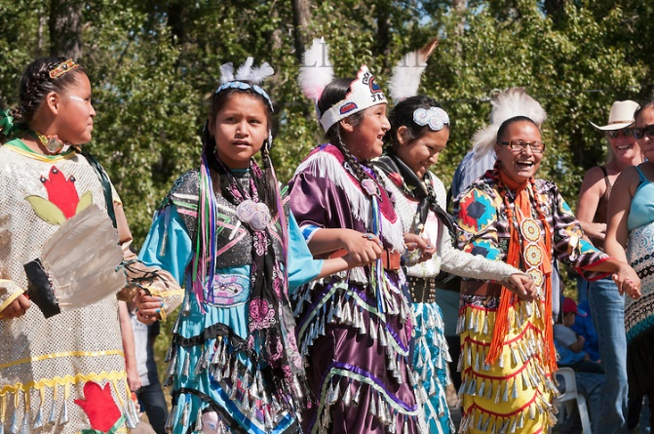
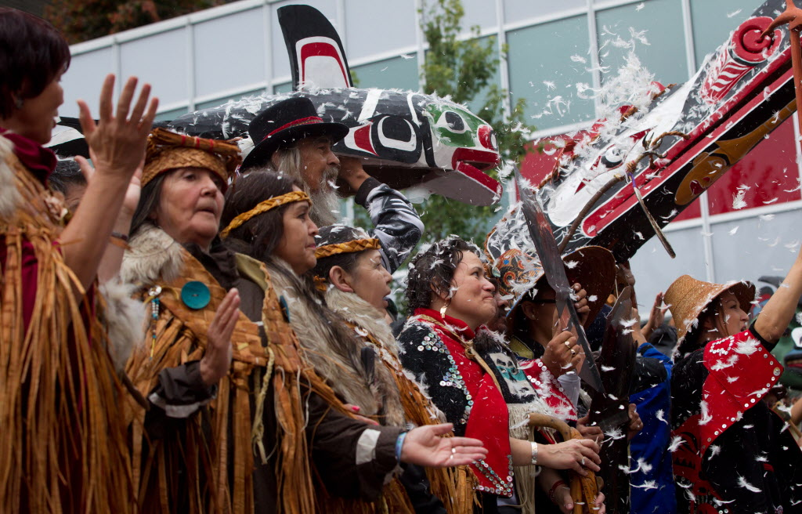
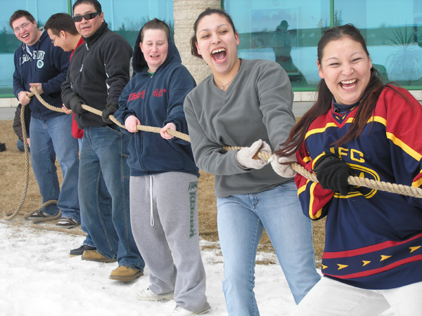
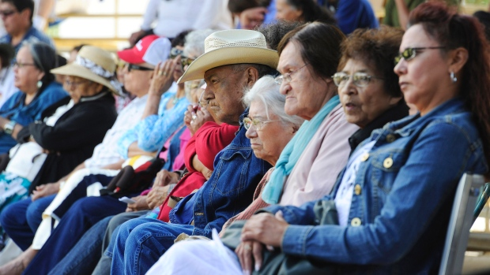
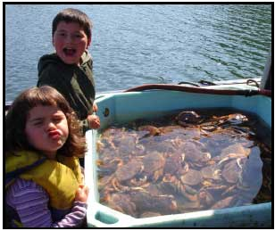
Notes:
Indigenous people are diverse groups of people that live all across what we know today as Canada
First Nations is a term used to describe Indigenous peoples of Canada who are neither Inuit or Métis and many have creation stories of how they became to be on this land
First Nations refers to both Status and Non-Status “Indian” peoples in Canada.
Currently, there are at least 630 First Nation communities, which represent more than 50 nations or cultural groups

Slide 7
First Nations

Slide 8
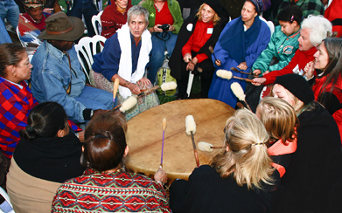
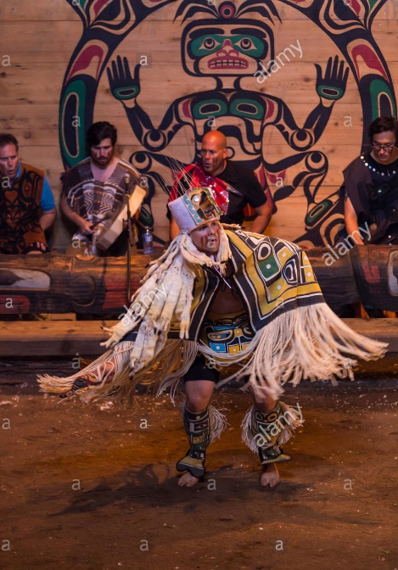
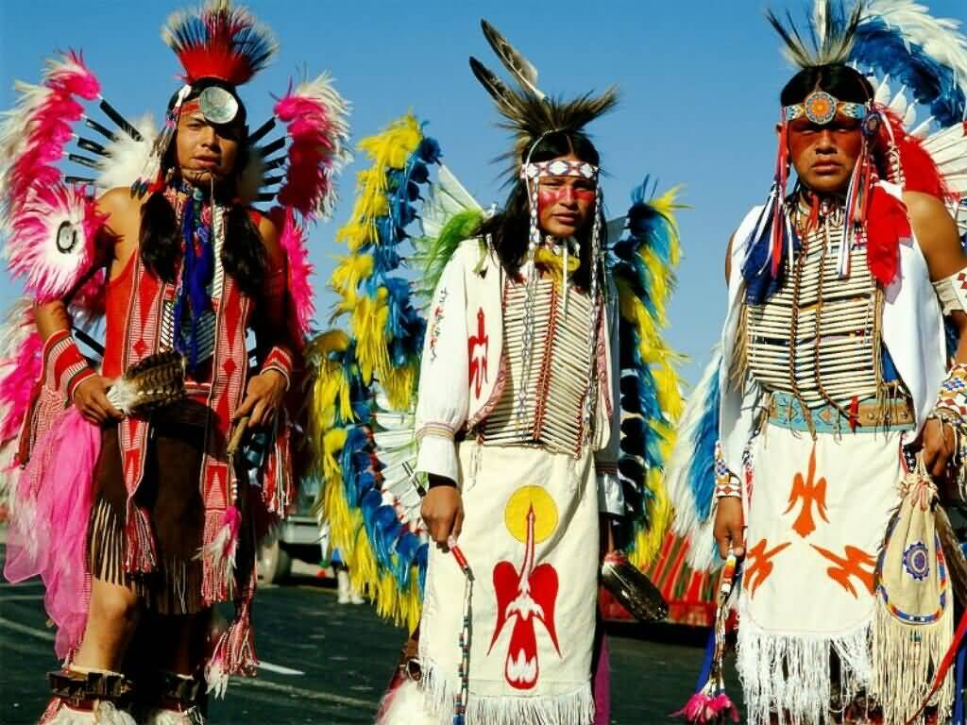
Celebrating culture and traditions.
Notes:
Importance of celebrating traditions and culture is common to all Indigenous groups across Canada
(beating a powwow drum, scene from a canoe journey, Inuit Games in the Arctic, celebrating a powwow on the prairies during summer time)

Slide 9
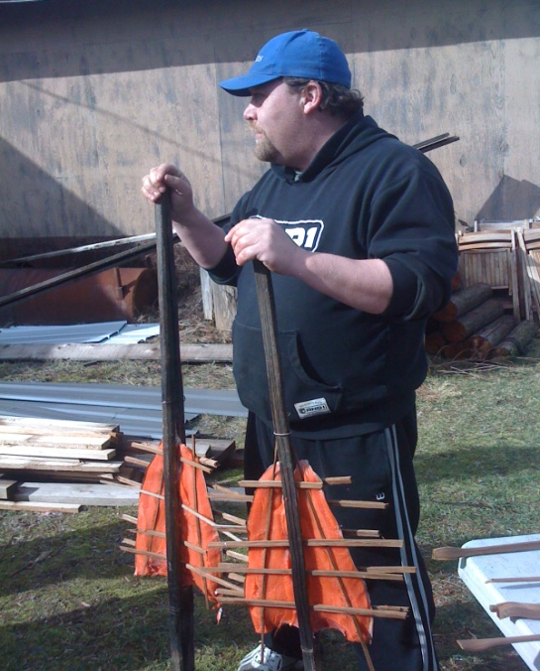
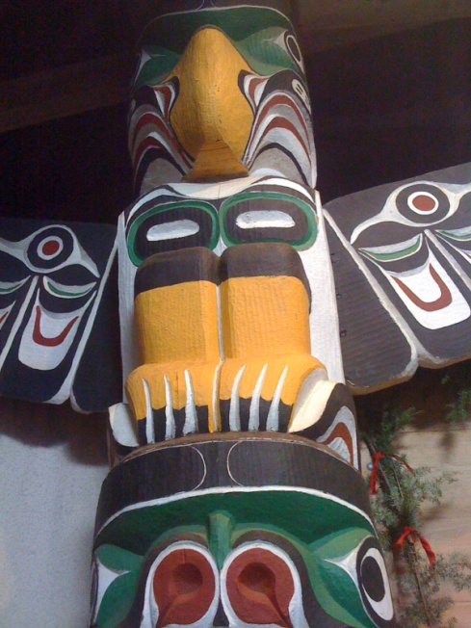
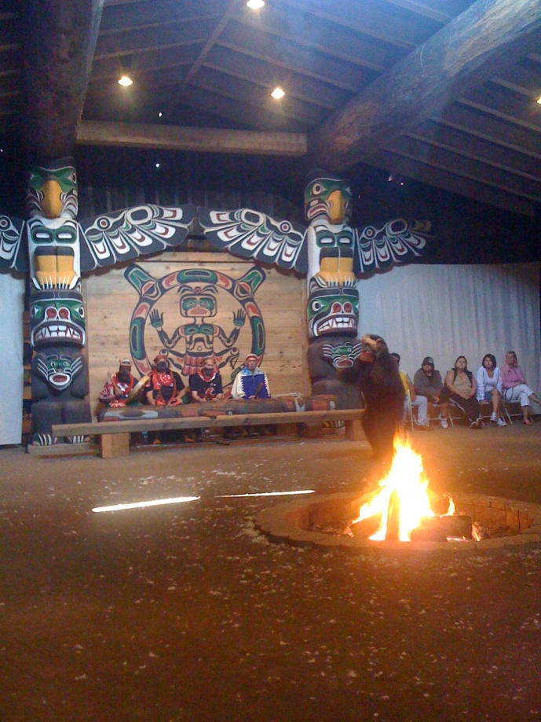
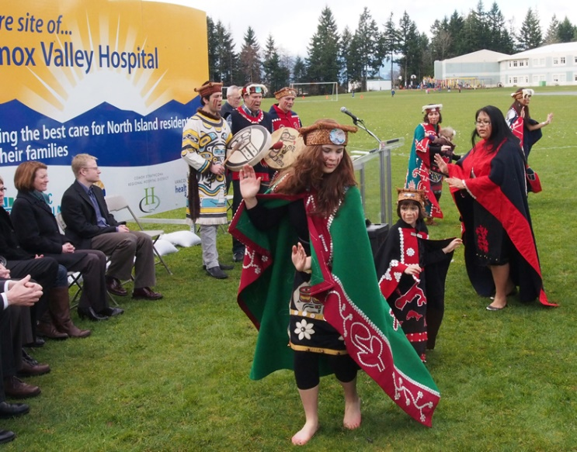
K’ómoks First Nations
Notes:
Our local First Nation is the K’omoks First Nation
Like many other First Nations cultural groups their way of life revolves around their natural surroundings;
The towering cedar trees are used to make dugout canoes, totem poles, houses, fish nets, baskets, bentwood boxes and clothing,
salmon and cedar are the most important resources

Slide 10
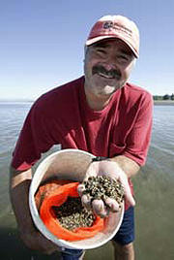
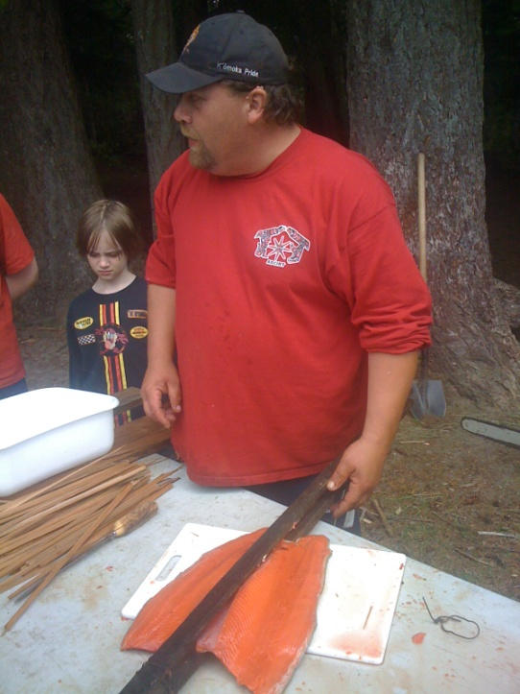
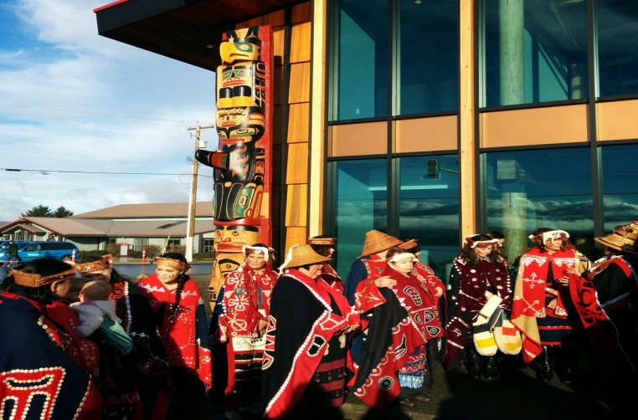
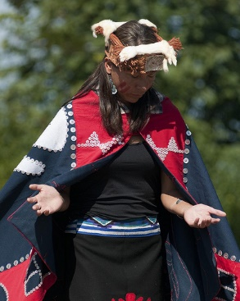
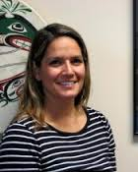
K’ómoks people today.
Notes:
These are some members of the K’omoks band today. They live, work and play in the Comox Valley just like everyone else. They only wear their regalia when they are celebrating important cultural events, like the opening of the new administration building, the opening of a community event or a celebration in the Big House,
(Kumugwe dancers in the Big House, Salish Seafoods, Cory Frank demonstrating the traditional salmon fillet technique, opening of the new K’omoks admin building, Katherine Frank Kumugwe Dancer, Charlene Everson, education coordinator for KFN)

Slide 11
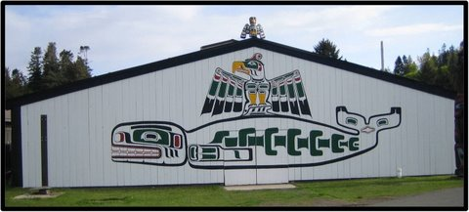
K'ómoks First Nation
Did you know the word K'ómoks roughly translates to land of plenty?
Notes:
The Comox Valley is the traditional unceded territory of the Pentlatch, Ieeksun and the K’omoks people
This is a Big House in K’omoks with Queneesh whale on the front
The location is on the Dyke road between Courtenay and Comox
Many of the K’omoks people celebrate their traditions and culture in the Big House
All Grade 4’s in School District #71 visit the Big House in the spring

Slide 12
Big House and totem poles
Notes:
This picture is the inside of the Big House in K’omoks
Traditionally Big Houses was a permanent winter home that housed as many as 5 families. Villages could range in size from 7-30 houses (housing 200- 1,000 people)
Since different foods were found in specific areas during certain times of the year, people would often move from their winter villages to other sites such as summer camps throughout the seasons, then back again to their home base. This is called seasonal rounds.
Families would remove their large cedar planks and take them to make temporary summer shelters as they followed migrating herds and flocks

Slide 13
I-Hos gallery
Notes:
The I-Hos gallery that sits in front of the Big House on the Dyke road. It is open to the public, you can see beautiful art and First Nation artifacts
I-Hos is the double headed sea serpent on the side of the gallery.

Slide 14
K’ómoks First Nation Whale House - administration building

Slide 15
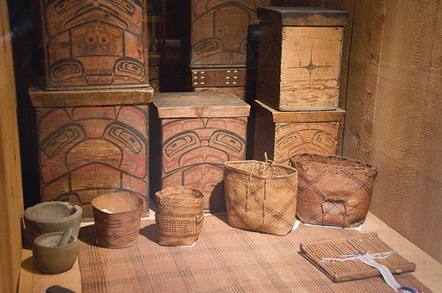
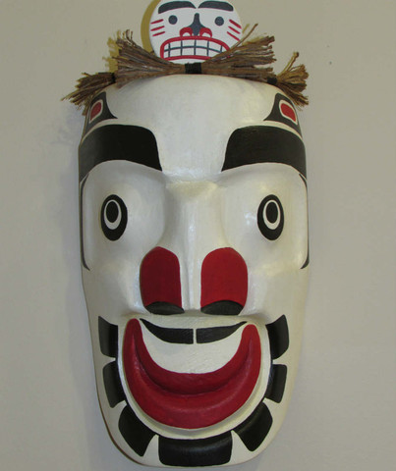
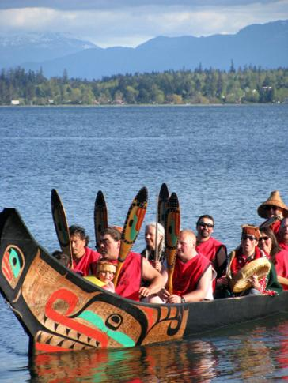
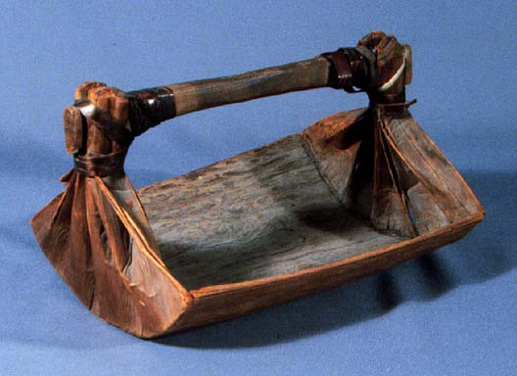
Notes:
Cedar was referred to as the Tree of Life because of all that it provided to the people of the Northwest Coast.
First Nations from the Northwest Coast (including K’omoks people) made many items from cedar: cedar could be woven into sleeping mats, baskets for food gathering and storage, as well as clothing. Cedar planks could be used for housing, or bent into bentwood boxes that were used for food storage, regalia and mask storage, and for cooking. Masks and totems were carved from cedar. Big House posts and canoes were made from cedar as well.
The only time a whole cedar tree was taken was for house posts, totems or canoes. The cedar tree was given thanks for giving itself so that the people could survive

Slide 16
Salmon - important food source
Notes:
Fish weirs were built in the Comox estuary, down at the air park, to catch salmon and other types of fish that would be eaten fresh as well as smoked and dried for winter use
The salmon ceremony was a time when the first salmon of the season was celebrated. This is the only time that children ate before elders
The salmon bones were returned to the water so that the salmon would return year after year to the same spot

Slide 17
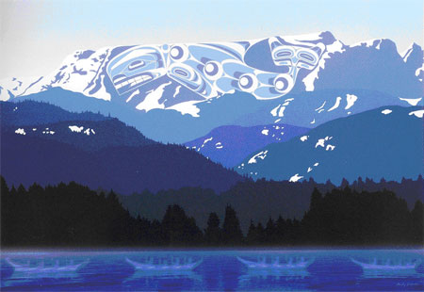
Legend of Queneesh
Artwork by Andy Everson
Notes:
The Legend of Queneesh is a flood story told by the K’omoks people about a great white whale that resides in the Comox Glacier.
The Queneesh whale saved the K’omoks people from the great flood

Slide 18
Métis

Slide 19
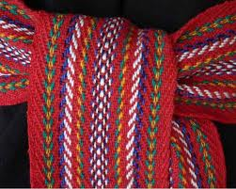
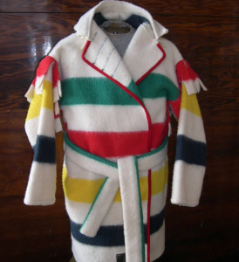
Métis
Notes:
The advent of the fur trade in west central North America during the 18th century was accompanied by a growing number of mixed offspring of Indian women and European fur traders. As this population established distinct communities separate from those of Indians and Europeans and married among themselves, a new Aboriginal people emerged – the Métis people – with their own unique culture, traditions, language (Michif), and way of life, collective consciousness and nationhood. Metisnation.ca
Métis flag – infinity flag
Métis sash is a cultural symbol of the Métis people. It was used for many things: for carrying personal belonging, as a tumpline, as a sewing kit, a blanket etc
Capote – is a coat made from a Hudson Bay blanket

Slide 20
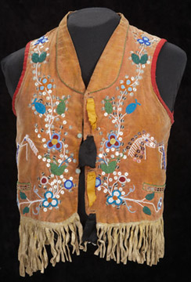
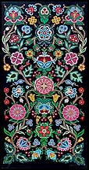
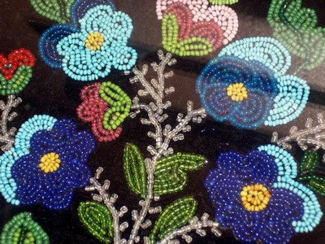
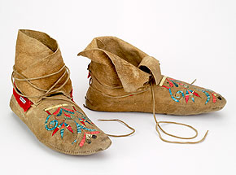
Flower bead work
Notes:
Some people refer to the Métis as the Flowerbeadwork People because of their beautiful beading.
Métis people can tell where someone is from by the designs on their moccasins

Slide 21
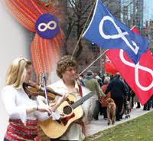
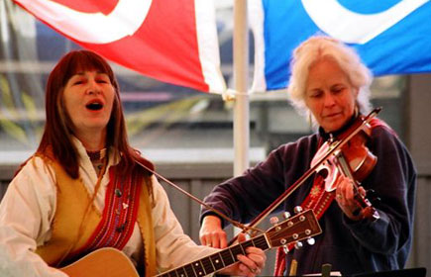
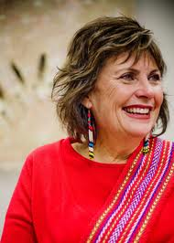
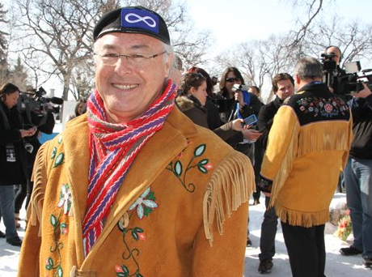
Notes:
The Métis people celebrate their culture with lively music played on a fiddle and a special type of dance called jigging

Slide 22
Inuit

Slide 23
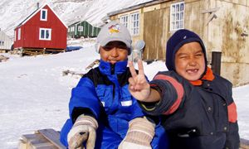
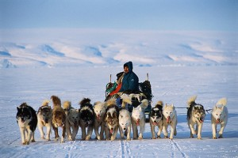
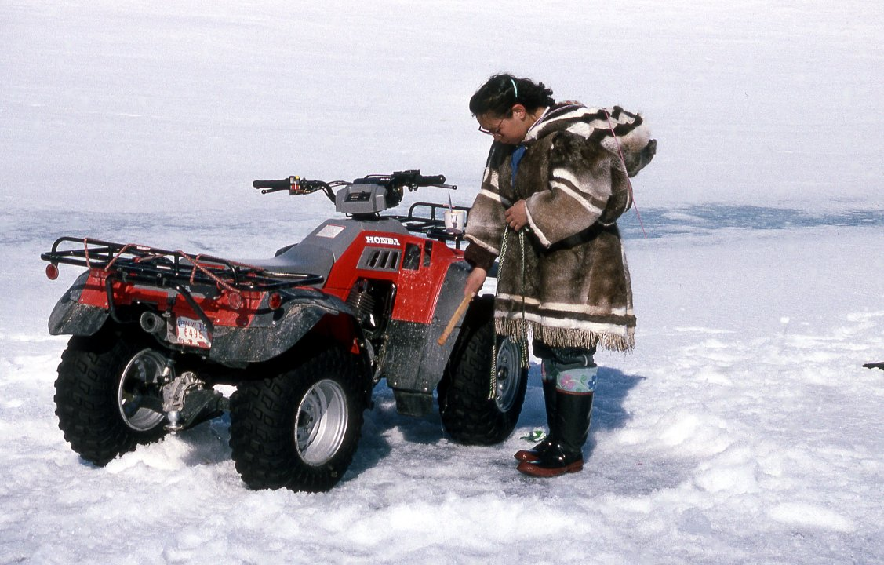
Inuit: people of the Arctic.
Notes:
Inuit people live in the arctic, they speak Inuktitut.
The word "Inuit" means "the people" in Inuktitut and is the term by which Inuit refer to themselves.
Many Inuit people wear big parkas and mukluks in the winter to help them stay warm.
Inuit people used to be referred to as Eskimos in Canada

Slide 24
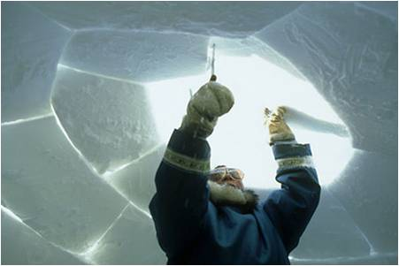
Igloo a temporary snow shelter.
Notes:
Did you know the Inuit word igloo refers to any type of house or home made from any material and the snow house is specifically referred to as an iglooviak?
Igloos are most often used by hunters today as temporary snow shelters

Slide 25
Notes:
Today most Inuit people live in houses or trailers in smaller, remote villages

Slide 26
Transportation past and present
Notes:
Inuit transportation past and present:
The Komatik (dog sled) the kayak (one person boat) , and umiak (5 or 6 person boat, usually paddled by women) were traditional forms of transportation.
Snowmobiles, quads and trucks are used for transportation today.

Slide 27
Notes:
Questions
What changes do you notice? Past and present?
What are some things that you think are the same in your life as an Inuit child’s life and what are some things that might be different?

Slide 28
What does the word Indigenous mean?
What 3 groups of people are referred to as Aboriginal people in Canada?
What are some things that Indigenous people have in common with each other?
Notes:
The word Indigenous refers to the original inhabitants of Canada
Indigenous refers to First Nation, Inuit and Métis people in Canada
Some things all Indginous people share are: strong ties to the land, an understanding of the interconnectedness of the environment, they are caretakers of the land and resources, their languages and culture are valued. Respect for Elders, valuing human relationships and sharing food are very important.

