Slide 1

Bursary and Scholarship Guide
2025

Slide 2
Important Dates
Feb 3rd: Booklets are available online
March 7th: Application deadline @ 3:00 pm
(Late applications will not be accepted.)

Slide 3

Isfeld Bursary Program
Bursaries and Scholarships are based on financial need, volunteerism, leadership, area of study, and references.
Each Bursary and Scholarship description will emphasize their criteria.

Slide 4
Bursary? Scholarship?
What is the Difference?
Bursaries - Criteria based on…
Financial Need
Leadership and/or Volunteerism
Area of study
Scholarships - Criteria based on…
Academic Standing
Leadership and/or Volunteerism
Financial Need

Slide 5
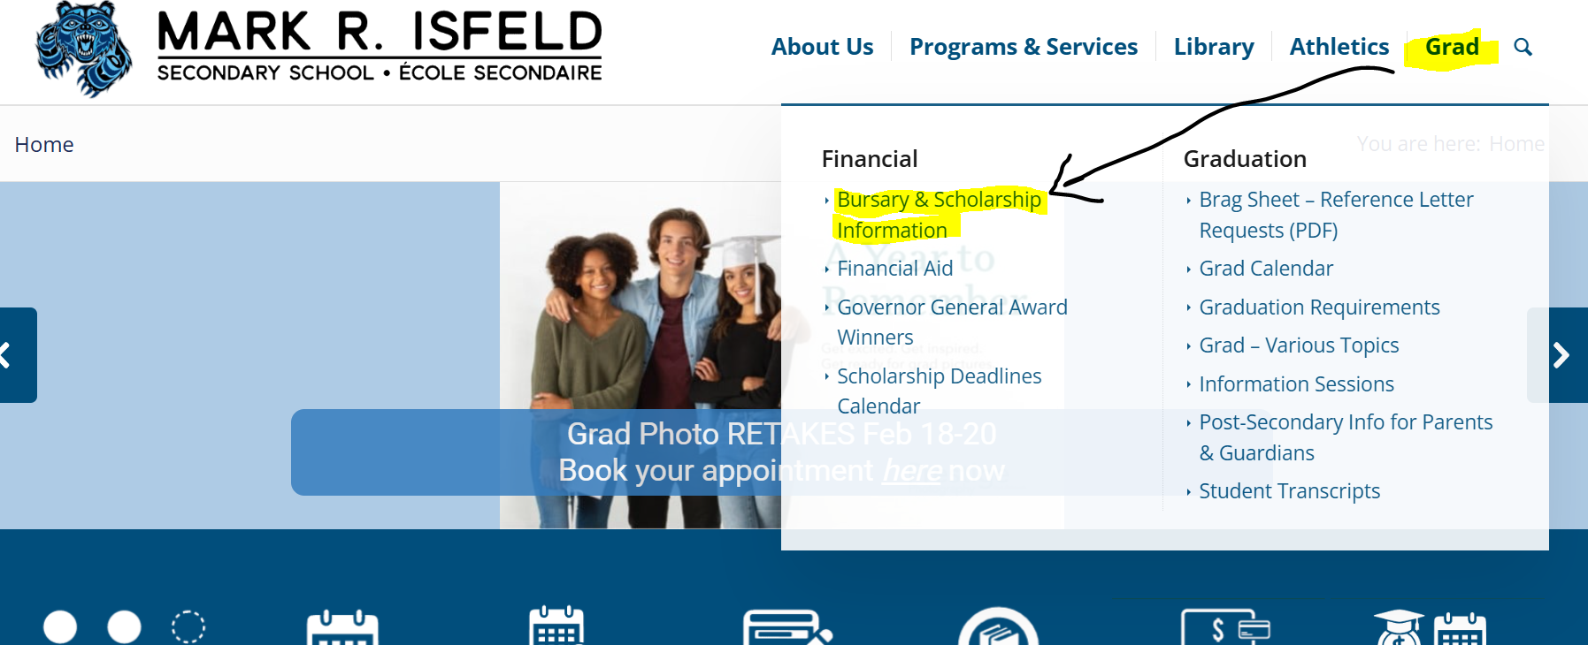
Where Do I Start?
Find the Bursary and Scholarship Booklet online at Mark Isfeld Secondary School Ecole Secondaire
Go to the Grad Tab then Bursary & Scholarship Information

Slide 6
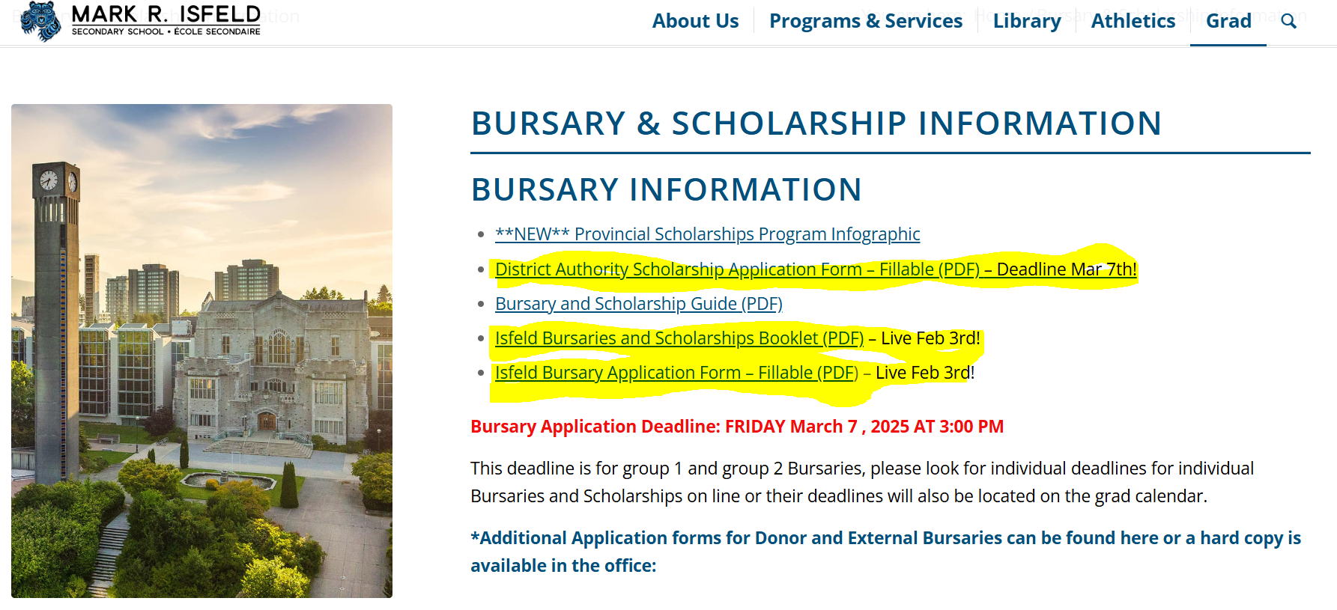
Open the Bursary and Scholarship Booklet and read and review which Bursary and Scholarship are your best fit GROUP ONE BURSARIES
Fill out the Fillable Application Form Isfeld-Bursary-Application-Form-2025_Fillable-.pdf
Reference letter – request/gather a reference letter to attach to your application. Remember that reference letters can not be from family members. Please note, If you are requesting a reference letter from a teacher, we will accept first and last name and contact information in place of a letter. Attach to application.
Letter of Introduction – use proper letter format. Address letter to the corresponding bursary committee and add your signature at the end. Attach to application. There is an example in Student Services.

Slide 7
Organize bursary application packages in this order
Application Form
Reference Letter
Transcript
Examples are in Student Services
Letter of Introduction

Slide 8
Isfeld Bursary Committee Selected Bursaries and Scholarships
These applications stay at Isfeld Secondary School and are selected by the Isfeld Bursary Committee.
You will need only one bursary application package.
Check all the bursaries you are eligible for on the front page of your Bursary and Scholarship Application Form.

Slide 9
Donor Selected Bursaries
These applications are sent to each of the different donor groups to select Bursary recipients.
For Donor Select Bursaries, you will need a bursary package for each Bursary and Scholarship you are applying for.
Please read descriptions carefully. Some bursaries require a special application form. These are available online or in Student Services.

Slide 10
Handing in Applications
Application deadline is March 7th, 2025 @ 3:00 pm.
Late applications will not be accepted.
Staple each application package. Do not place in envelopes.
Hand in to counsellors, Ms. Buckle and Ms. Williams in Student Services.

Slide 11

Remember…
Be organized and plan ahead, do not leave it to the last minute!
Do not send application packages by email. They must be hard copy.
Ms. Buckle and Ms. Williams will be available during Flex to support you with your Bursary and Scholarship applications.
Any questions come see us in Student Services! We are here to support!

