Slide 1

Bursary and Scholarship Guide
2026

Slide 2

Important Dates
Feb 3rd: Booklets are available online
March 6th: Application deadline @ 3:00 pm
*Late applications WILL NOT be accepted

Slide 3

Isfeld Bursary Program
Bursaries and Scholarships are based on:
Financial Need
Volunteerism
Leadership
Area of Study
and References
Each Bursary and Scholarship description will emphasize their criteria.

Slide 4


Slide 5
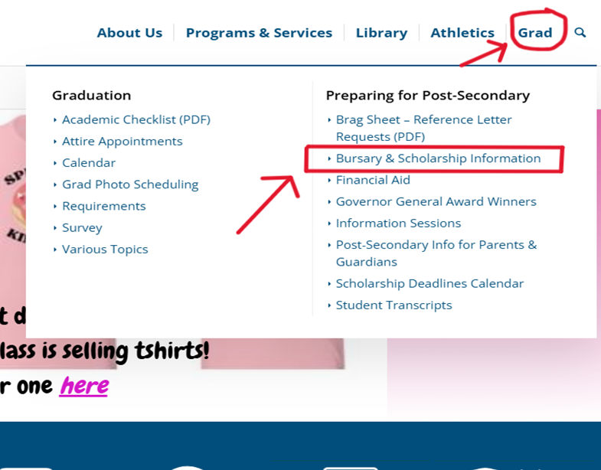





Where Do I Start?
Find the Bursary and Scholarship Booklet on our school website!
Mark Isfeld Secondary School Ecole Secondaire
Go to the Grad Tab then Bursary & Scholarship Information

Slide 6
Applications stay at Isfeld. Recipients are selected by the Isfeld Bursary Committee.
Once the online application is submitted your application is complete. No need to print. *You will receive a confirmation email*
Be sure to check all the bursaries you are eligible for highest chance of selection.
GROUP ONE
ISFELD COMMITTEE SELECTED BURSARIES

Slide 7
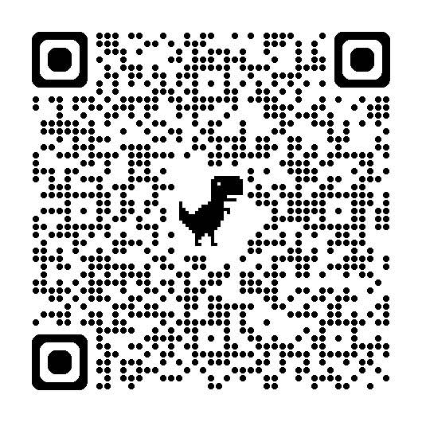
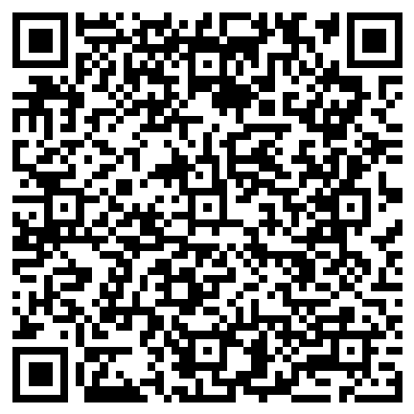
GROUP ONE
ISFELD COMMITTEE
BURSARIES
BOOKLET
Open the Bursary and Scholarship Booklet and
READ and REVIEW
To find which Bursaries and Scholarships are your best fit.
Fill out the Online Application Form
Fill out and upload your documents!
(Letter of Introduction, Reference letter(s) & Transcript
obtain a copy from Jacqueline in the office.)
ONLINE APPLICATION

Slide 8
These applications are sent to each donor group to select Bursary recipients.
You will need a bursary package for EACH Bursary and Scholarship you are applying for.
Read descriptions carefully. Some donors require a SPECIAL APPLICATION FORM. These are available online or in the office.
GROUP TWO
DONOR SELECTED BURSARIES

Slide 9
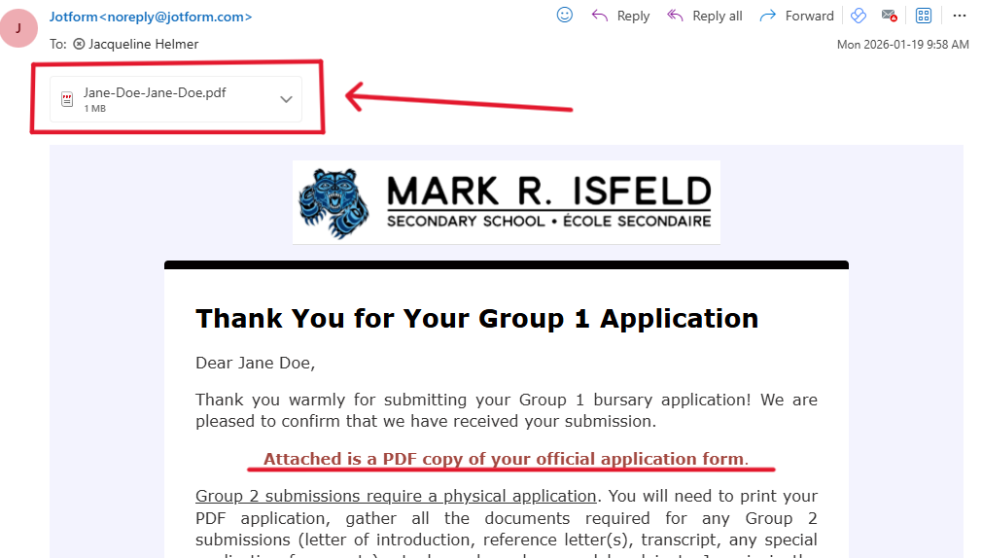
GROUP TWO
DONOR SELECTED
BURSARIES
BOOKLET
Open the Bursary and Scholarship Booklet and
READ and REVIEW
To find which Bursaries and Scholarships are your best fit.
Print your Online Application Form for EACH Group 2 Bursary you are applying for. A copy will be emailed to you once you submit your application.
Compile your documents!
PRINTABLE APPLICATION
Include:
Letter of Introduction
Application
Reference letter(s)
Transcript
*Don’t forget to specify which bursary you are applying for!

Slide 10
Organizing Group Two Bursary application packages
Application Form
Reference Letter
Transcript
Letter of Introduction
Special Application (If required)
*Examples in Student Services*

Slide 11
Submitting & Handing in Group 1, 2 & District Authority Applications
Application deadline is March 6th, 2026 @ 3:00pm
Late applications WILL NOT be accepted.
Staple each Group 2 application package. Do not place in envelopes.
Hand in Group 2 application packages to the office.

Slide 12
DISTRICT
AUTHORITY APPLICATION
BOOKLET
Open the Bursary and Scholarship Booklet and
READ
and
REVIEW
Page 6 explains the District Authority Instructions
Apply via the Online Application Form
ONLINE APPLICATION

Slide 13


Remember…
Be organized and plan ahead, do not leave it to the last minute!
Do not send Group 2 application packages by email. They must be hard copy.
Ms. Buckle and Mrs. Williams will be available during Flex to support you with your Bursary and Scholarship applications.
Any questions come see us in Student Services! We are here to support!

