Slide 1
School District No. 71

Slide 2
How is the School District funded? The Operating Fund: Revenues
2020-21 BUDGETED REVENUES
Provincial Grants
Ministry of Education (MOE) Operating Grant
Other MOE grants
Other Revenue
Tuition
Rentals and leases
Investment income
Prior Year Reserves

Slide 3
Where do we spend our money? The Operating Fund: Expenditures by Category
2020-21 BUDGETED EXPENDITURES
Operating salaries and benefits will cost approximately $79M of the 21-22 total budget.
Operating services and supplies will be approximately $14M.

Slide 4
Where do we spend our money? The Operating Fund: Expenditures by Function
2020-21 BUDGETED EXPENDITURES
Instruction – regular classrooms and instructional support such as Career, English Language Learning, Special Education, and other student support programs.
District Administration – human resources, payroll, finance, governance and education leadership.
Operations and Maintenance – facility and grounds maintenance, custodial and utilities.
Transportation – student busing.

Slide 5
What are Special Purpose Funds?
Funds that are received with restrictions on how they can be spent
The Ministry of Education provides the District with the following restricted (special purpose) funds:
Annual Facilities Grant (maintenance and improvement projects, roofing, painting, mechanical upgrades, etc.)
Learning Improvement Fund (additional support staff for classroom support)
Community Link (student support and school meals program)
Strong Start and Ready Set Learn (early learning)
OLEP - Federal French grant (core French and French Immersion)
Classroom Enhancement Fund (to address BCTF restored language)

Slide 6
What are Capital Funds?
Capital funds are used to acquire land, build schools, or do significant renovations on schools
Capital funds are not provided on a per pupil basis
The district applies to the Ministry of Education for capital funding through our Five-Year Capital Plan submission
The district must make a business case to the Ministry of Education to secure funding for new schools, expansions, seismic or renovations
The district can also generate capital funds by selling assets, including land and buildings, though all or a portion of the proceeds can be restricted by the Ministry

Slide 7
School District No. 71 Strategic Plan
$$ BUDGET $$
Educational Excellence
Community Engagement
Organizational Stability and Environmental Stewardship
Physical Health and Mental Well-Being
Always with a goal of STUDENTS FIRST

Slide 8
PRELIMINARY BUDGET PROCESS
The preliminary budget is based on enrollment projections provided by districts.
February – enrolment projections for the following September are submitted to the Ministry
March – preliminary grant funding announced by the Ministry (based on projected enrolment from February)
March/April/May – preliminary budget development process takes place – must be a balanced budget
May – preliminary budget reviewed by Board – must be submitted to Ministry by June 30th (per School Act)

Slide 9
Factors in Current Budget Planning
Setting priorities for the delivery of student learning
Determining the ongoing effects of COVID19
Projecting student enrolment
Projecting the costs of status quo for next year (salaries, benefits, utilities, inflation, etc.)
Determining which costs will or could change and by what estimated amount
Projecting revenues (international student fees, rental fees, interest revenue, Ministry grants, etc.)

Slide 10
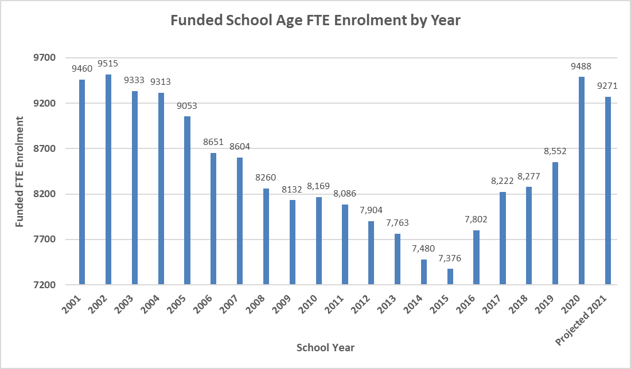
STUDENT ENROLLMENT
Student enrollment is the primary factor in determining MOE revenue
Enrollment in 21-22 is projected to be 9,271
Down from 20-21 with a transfer back to regular school from alternatives and distance education

Slide 11
21-22 Estimated Revenue
Based on the MOE preliminary operating grant announcement: SD71 estimates MOE revenues to be $94,022,777
This is an increase of $3,357,500
Estimated to be offset by reductions in Other Revenues due to COVID of $158,728
Overall 2021-22 Revenues are estimated to be increased by $3,198,772 to approximately $99,520,000
These amounts are calculated from the 2020-21 Amended Annual Budget

Slide 12
21-22 Estimated Expenses
Based on our preliminary staffing and cost pressures: SD71 estimates operating expenses to be approximately $99,500,000
This is an increase of $3,184,747
Cost pressures include negotiated wage increases, additional staff in bricks & mortar schools, post-COVID challenges, enhanced cleaning protocols and HVAC projects

Slide 13
The Good News
The District is in the early stages of the preliminary budget preparation. The draft preliminary budget will not be finalized for presentation until the May public board meeting.
Based on our early estimates of enrollments, revenue, and expenses, we anticipate a balanced budget.
Trustees and Senior staff have worked very hard in past years to right-size and ensure the District is not in a structural deficit.
We are not anticipating a significant deficit or drawing down of reserves to balance operations for the 21/22 School Year

Slide 14
AMENDED BUDGET PROCESS
The UPDATED budget is based on actual enrolment reported to the Ministry at September 30th.
September 30th - Actual enrolment reported to Ministry (1701 report)
December 15th – final recalculated grant provided (based on actual enrolment)
February - amended annual budget approved by Board – must be submitted to Ministry by February 28th (per the School Act)

Slide 15
QUESTIONS / FEEDBACK
Questions or requests for information can be emailed to:
https://www.comoxvalleyschools.ca/budget-feedback/

