Slide 1




District Equity Scanning Team Meeting
Comox Valley –February 13, 2026

Slide 2

Sharing of Data Themes – Gerald
Overview of key themes / Context and meaning-making / Connections to community voice

Slide 3





Slide 4





Slide 5
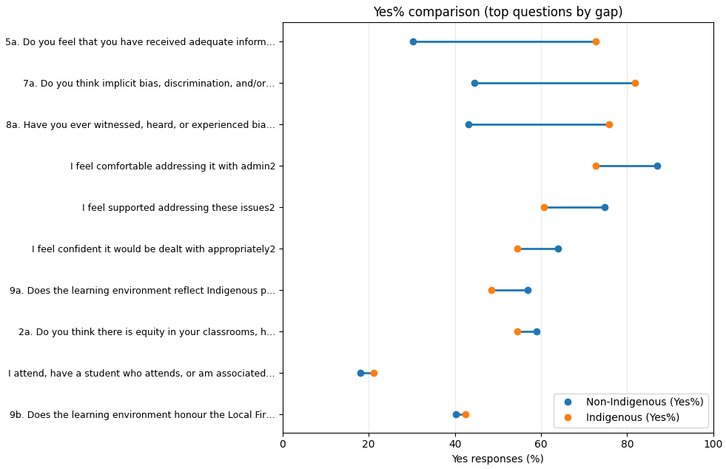
Indigenous VS non-Indigenous Staff

