Slide 1

School-Based Equity Scanning Planning PPT
SD71
The first 5 slides of this PPT are meant as preparatory materials for all School Based Equity Scanning Teams.
*Slide 6 onwards is shared as a possible Staff Meeting Equity Scanning Team PPT to guide your school’s scanning process of staff.
PLEASE READ THE PRESENTER NOTES BELOW FOR SUGGESTIONS & IDEAS
Notes:
Firstly. THANK YOU for being an important member of your school’s Equity Scanning Team.
The data used in this survey will be used to create a more equitable education system in the Comox Valley, and the work you do will contribute to that important work.
The work you are doing here is very important and we hold up our hands to you!

Slide 2
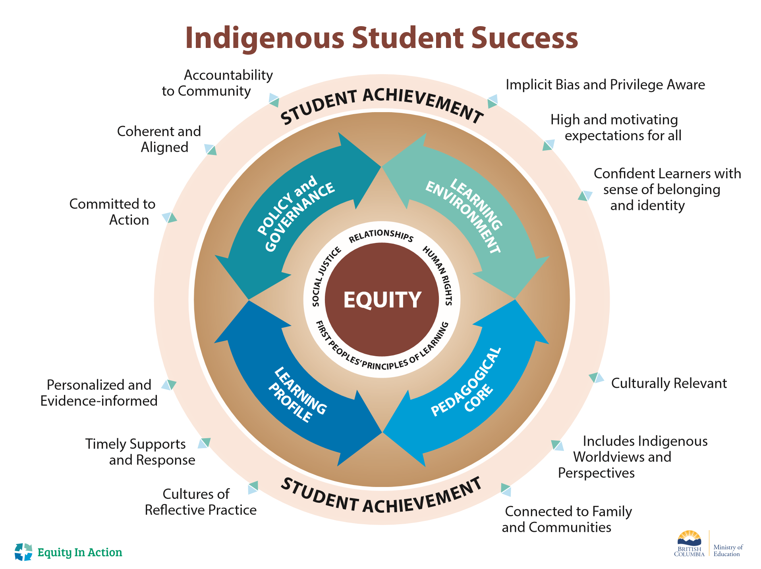
Notes:
information for School Based Equity scanning Teams only. You do not have to use this slide, but may wish to reference.
---Framework with 4 Pillars of Equity:
Equity Scanning Survey Questions reflect inquiry into 4 interlocking arrows (or Pillars)
We will use this framework to “Hold a Mirror up to our Organization” and assess where we land in each of the 4 Pillars

Slide 3

Framework for Equity
1. Create a District Equity Scanning Team
5. Define Goals and Set Equity Action Plans
2. Conduct Equity Scan
4. Develop Theory of Change
3. Create District Equity Profile
Notes:
Information for School Based Equity scanning Teams only. You do not have to use this slide, but may wish to reference.
The Framework for Equity has 5 steps.
* We are here
May, June – (Scan the System)
October November (Scan the System)
December - January (Create District Equity Profile = Develop Theory of Change)
February (Define Goals and Set Equity Action Plans)
This is an ongoing process. Not a One year and and Done initiative.

Slide 4
Conduct The Equity Scan
Equity Scanning is about going deeply into the culture and Ways of Being within the district
Questions are designed to be points of inquiry that Equity Teams work through
Will indicate areas of strength and areas of concern to be addressed
2. Conduct Equity Scan
Notes:
Information for School Based Equity scanning Teams only. You do not have to use this slide, but may wish to reference.
*Former Districts have used various methods to scan their district (Surveys, Meetings with Indigenous Parents, Indigenous Students, Local First Nations IN COMMUNITY, Principals, CUPE staff, Teaching staff, Exempt staff) to get multiple perspectives.

Slide 5
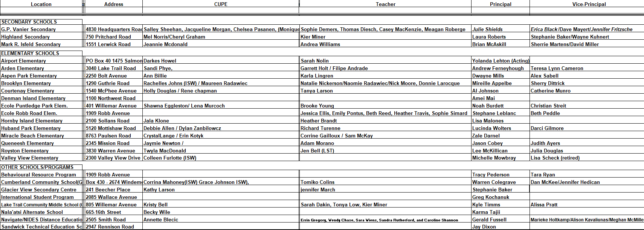
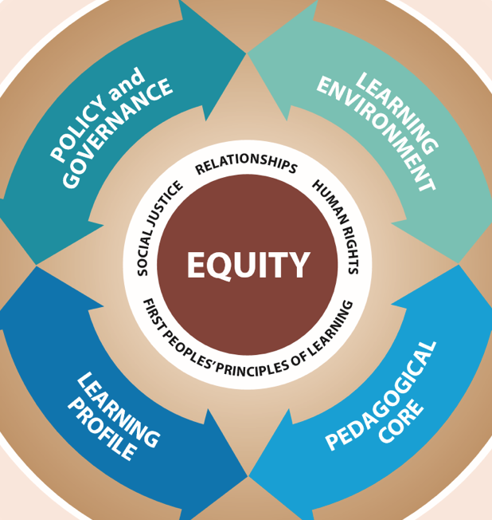
School Equity Teams
CUPE Support Staff
Teacher
Principal
Methods = Staff meetings
CUPE meetings – Add to Pay Funding Code = “Equity Scanning Meeting”
Notes:
The list above indicates the CUPE/CDTA and Principals who are on the School-Based Equity scanning Teams throughout the district. (Please note that not all VP’s are expected to join the teams but are always welcome).
Please ensure that all CUPE members are aware that they will receive Add to Pay funding for their participation in the scan. “use Equity Scanning Meeting ” Code in AMS.

Slide 6

Acknowledgement of Territory
We humbly acknowledge that SD71 operates on the Traditional, Ancestral, Unceded Territory of the K’ómoks First Nation. Further Acknowledging and respecting the unique History, Culture, and relationship with the land of the Pentlatch, E'ikʷsən, Sahtloot, and Sasitla people who have been here since time immemorial and who are still here.
Notes:
This is NOT the agreed upon land acknowledgement for SD71. Feel free to use this acknowledgment of territory, or your own personalized one. This should open your staff meeting.

Slide 7
Suggested Staff Mtg. Agenda
3:30 – Acknowledge Territory / Ways of Being in Courageous Conversations
3:35 – Share Equity Scan Introduction Video
3:36 – Complete Individual Confidential Surveys
4:05 – 3 Equity Prompts will Guide Staff Conversations
        (Larger schools will separate staff in groups of 20-25 to separate classrooms ensuring note takers in each group capture key ANONYMOUS quotes) There is also a 4th additional prompt if you wish to use it
4:55 – Concluding slide (give aways and thank you)
Notes:
Please feel free to use / alter this suggested staff meeting Agenda to suit your school’s unique needs
*Suggestion: You may consider a small give-away to folks (Reciprocity) for participating in the scan.
Consider sharing out your agenda so staff know what will occur during this meeting.

Slide 8
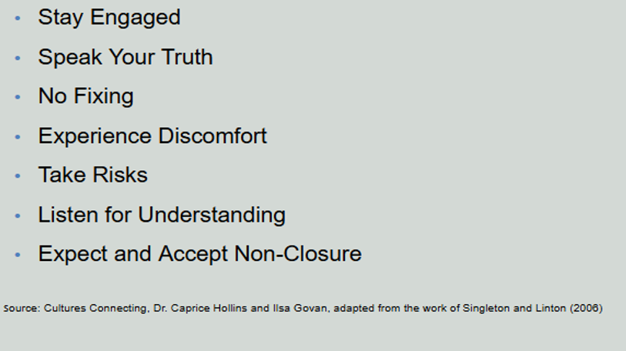
Ways of Being in Courageous Conversations
Notes:
It is suggested that you share /email the “Ways of Being card descriptions” document with ALL staff prior to your staff meeting to ensure that everyone is aware of what this staff meeting is about.
Equity Scanning Teams should be able to summarize (briefly) the 7 Ways of Being (or “Norms/Agreements”) as this slide should anchor the scanning process and ensure that respectful dialogue is honoured and encouraged. Scanning Teams should reference this slide during the Equity Scan Staff Meeting, but not spend too much time (please do not read through the card descriptions, as this will take up much needed time).

Slide 9
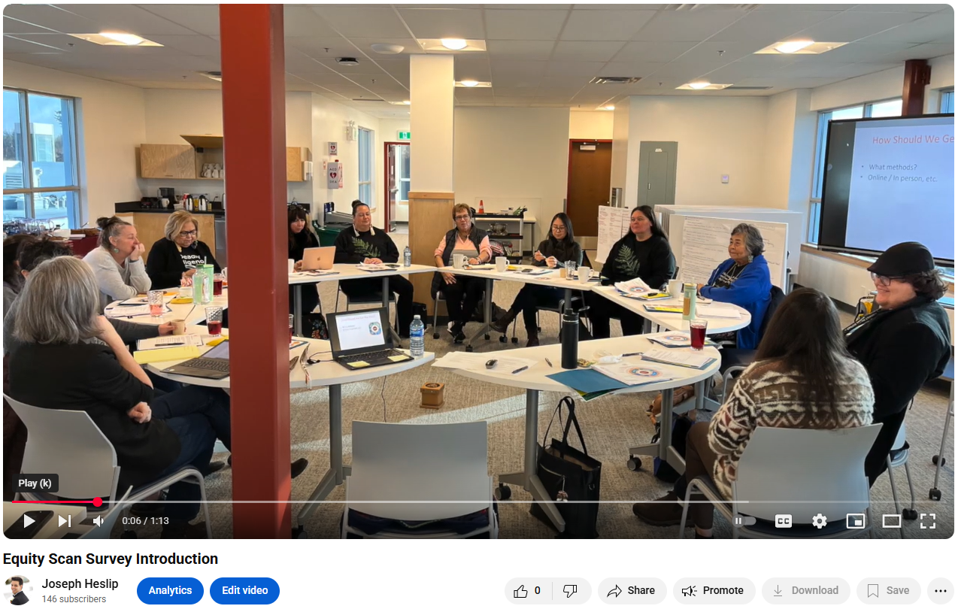
Equity Scan Survey Introduction
Notes:
Click the blue title / link or image above to set the stage for your staff.
This is a 1 minute video that shares: How the equity scanning questions were created, by whom, and for what purpose

Slide 10
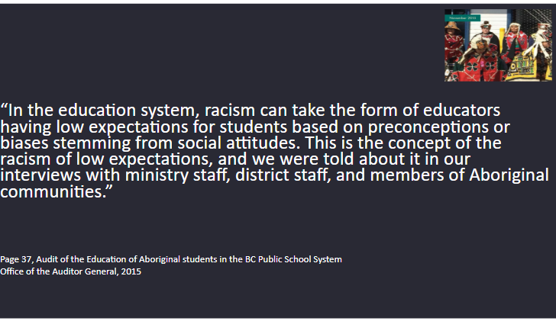
Notes:
This slide explains the “WHY are we doing an equity scan” questions that may arise from some staff. (This slide and the next slide indicate the rationale for why EVERY SCHOOL DISTRICT IN BC has already done a version of this equity scan) – Many districts have conducted multiple scans over the years since 2017 and continue to dig deeper to achieve Equity for Indigenous learners….
You can share this slide out prior to the staff meeting addressing the “WHY” behind the scan via Email.

Slide 11


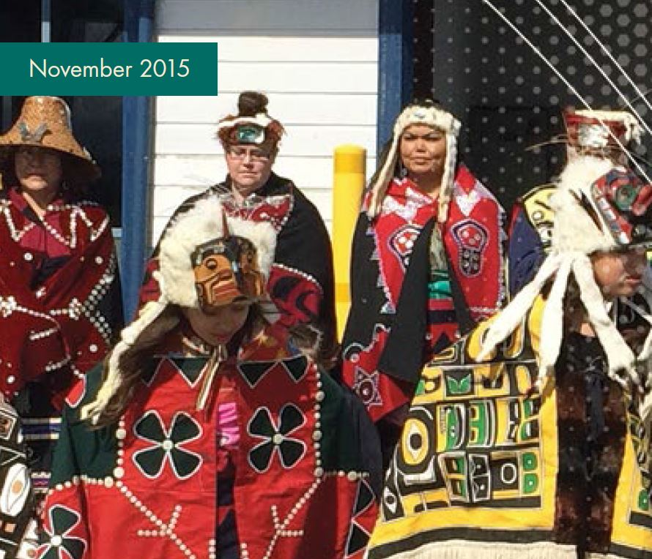



Foundations for Equity
Truth and Reconciliation
Declaration on the Rights of Indigenous Peoples Act (DRIPA)
Office of the Auditor General
Equity in Education
Indigenous Rights
Human Rights
British Columbia Tripartite Education Agreement (BCTEA)
Social Justice
9th Professional Standard for BC Educators
Moral Imperative
Notes:
This slide can be used to articulate some of the external / internal motivating factors for conducting an Equity Scan and addressing Inequities within the education system.
*Alternatively, you can share this slide out prior to the staff meeting (via email) addressing the “WHY” behind the scan.

Slide 12
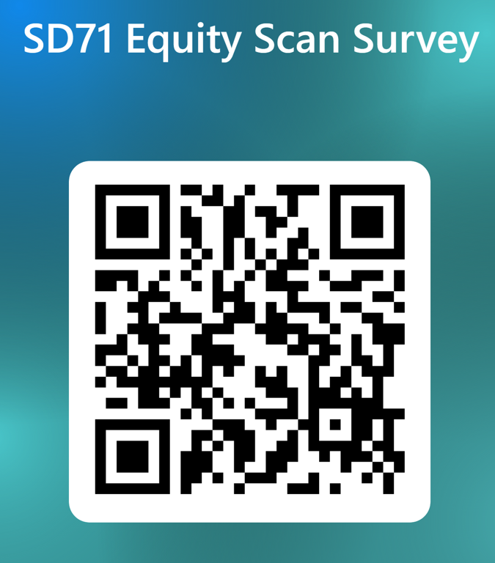
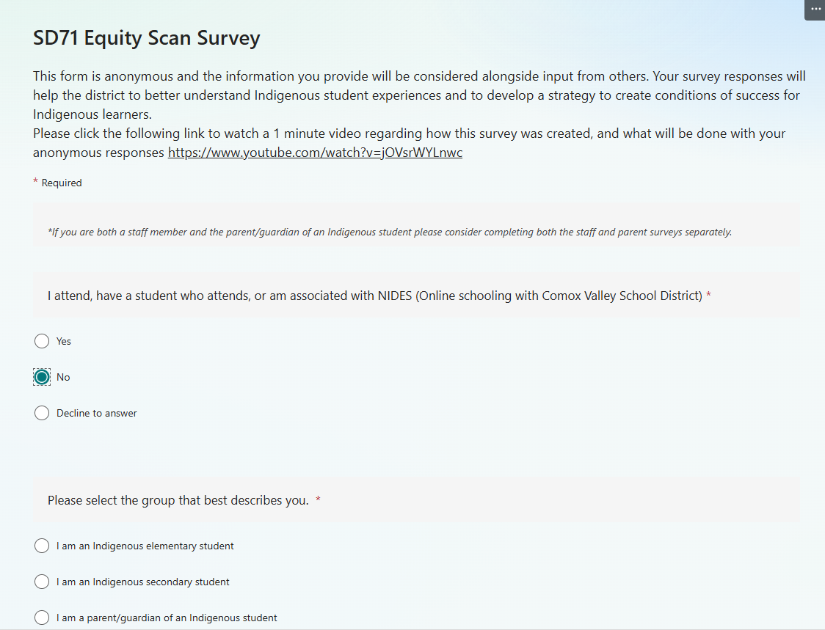
25-30 minutes Individual Silent Data Entry
Please use your Laptop or Handheld device
https://forms.office.com/r/K3dMUbxcZ6
Notes:
Please Send out this link and QR Code (THE MORNING OF THE STAFF MEETING). Please ensure that all staff bring their laptop and / or personal device, (or ensure that all staff have access to a device to input individual data).
The email to staff “the morning of” is intentional as we want to ensure that staff have this link at the top of their inbox as they come into the staff meeting, but not so long prior to the meeting that they unknowingly complete the survey on their own.
The idea is to have every staff member spend 25-30 minutes together / yet separate / reflecting on the questions. This will prepare the space for the staff discussion that will occur once the individual surveys are complete.
Please be sure to let staff know that they MUST answer all questions or they cannot submit their survey. If staff have to leave a comment box blank, they can simply write “no comment” and move to the next question.
It is vital that staff are able to fully answer these questions, so please read the room regarding how long this portion of your staff meeting takes. (The last thing we want is superficial data)

Slide 13
Inquiry Dialogue Question #1
What does success mean to you regarding the students you serve, when considering their future?
Notes:
Let the conversation flow and encourage everyone to share.
Reading the room is important during these questions.
While there are 3 (or 4 questions available), this should not be an exercise where people feel rushed. Don’t worry if you don’t get to all questions. You may only have a dialogue about this first question.

Slide 14
Inquiry Dialogue Question #2
CDTA:
What have you done to seek out the information needed to teach Indigenous content in a culturally sensitive way?
(How have you implemented this in your practice?)
CUPE:
What have you done to seek out the information needed to support Indigenous students in a culturally sensitive way?
(How have you implemented this in your practice?)
Notes:
*Please note that this question is an amalgamation of CDTA / CUPE questions. The brackets (or support),
*While these questions reflect separate partner groups, the dialogue will likely have members of CDTA, CUPE mixed within possible breakout groups

Slide 15
Inquiry Dialogue Question #3
Do you think implicit bias, discrimination, and / or racism exists for Indigenous learners in this school & district?
(If so / if not, please elaborate)

Slide 16
Inquiry Dialogue Question #4
Have you ever witnessed, heard, or experienced bias, discrimination and / or racism in the workplace?
(If yes, what did you do to address this?)

Slide 17

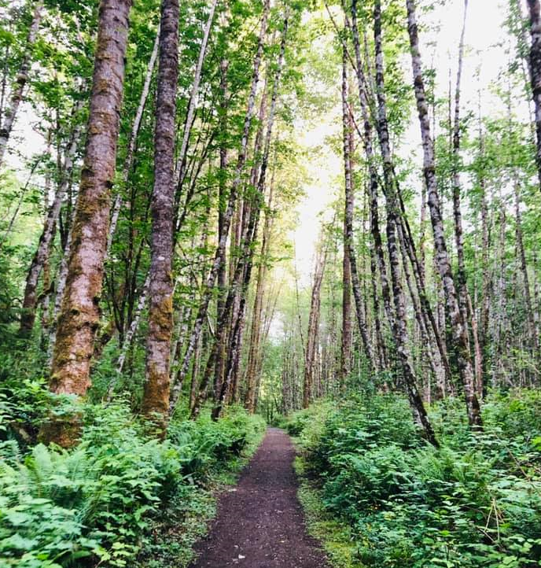

Self-Care
Engaging in this meaningful work can sometimes bring up challenging emotions—and that’s a normal part of the process. Taking care of yourself is important, and we encourage you to make space for self-care to stay grounded, balanced, and resilient. Here are a few self-care practices you might find helpful after this meeting:
Show compassion for yourself
Get outside. Take a nature walk, garden, paddle
Check-in with yourself and name your feelings
Practice relaxation techniques such as washing your face and hands with cold water, yoga, meditation, breathing exercises, etc
Share a meal and hold space for conversation and laughter

Slide 18


Gilakas’la
Joe.Heslip@sd71.bc.ca
250-207-3801
Please take care of yourself
Thank you!

Slide 19


